Slide 1



TRENDS IN CRIMINAL POLICY: (DIS)
ORGANISING THE CHAOS
Lecture 2. INTERNATIONAL CRIMINAL POLICY
Dr.Hab. Prof. Viacheslav Tuliakov
NU ‘Odesa law academy’ (Ukraine), university of Castilla La Mancha (Spain)

Slide 2
Criminal policy
means based on human rights protection
ethical and philosophical concept
process and result
of combatting and preventing crime
by means of
Substantive and International criminal law

Slide 3
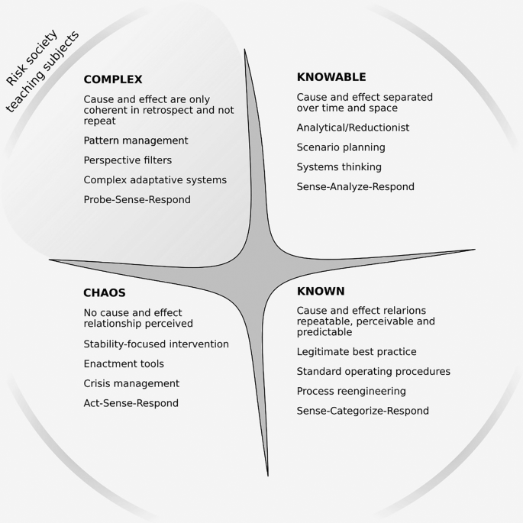

To learn
Globalization, Imbalances, Crime and the Risk Society (North vs South)
Concept and Dynamics of international and transnational crimes. New actors, old privileges
SDG-s and international criminal policy (UN soft is soft)
Rome statute and ad-hoc tribunals. Who prosecute Mr.Putin?
Victims of transnational crimes (Understand and forgive)

Slide 4

To Know
Concept of Emerging Criminal Law
Trends in international (transnational) crime in risk society
UN Soft Law (SDGs, Kyoto Declaration, Declarations on basic principles of justice)
ICC Rome Statute
UN Convention on organized (transnational) crime, 2000

Slide 5
The “criminal offence”
concept (“infraction” in the French version) has an autonomous meaning,
like “criminal charge” in Article 6 of the Convention1. The three criteria set out in the case of Engel and Others v. the Netherlands, § 82 (reaffirmed in Jussila v. Finland [GC], § 30) for assessing whether a charge is “criminal” within the meaning of Article 6 must also be applied to Article 7 (Brown v. the United Kingdom (dec.); Société Oxygène Plus v. France (dec.), § 43; Žaja v. Croatia, § 86):
▪ classification in domestic law;
▪ the very nature of the offence (the most important criterion, see Jussila v. Finland [GC],
§ 38);
▪ the degree of severity of the penalty that the person concerned risks incurring.

Slide 6
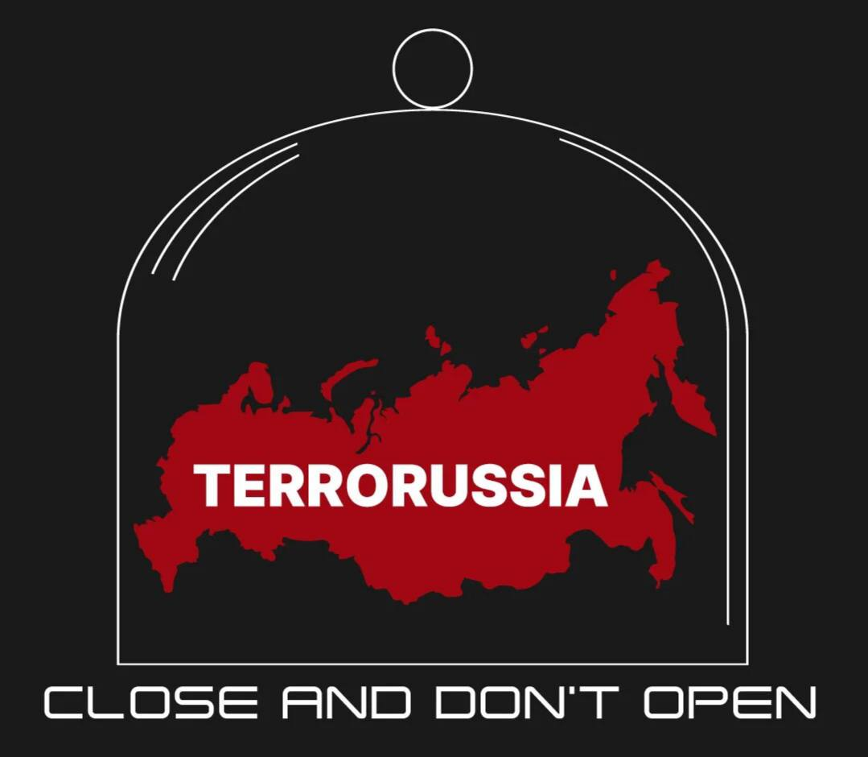
Additive (synergetic)
Non-additive (emergent)

Slide 7
Integral properties of CL are synergetic, emergent, entropic, and multiplicative.
The integration of national CL into the global space is a complex and unpredictable process, as it is difficult to ensure its effective functioning.
Identification and monitoring of latent threats and dangerous phenomena that threaten international security is relevant.
A study of the theoretical foundations of unpredictable strategies, which are characterized by non-additive (emergent) properties of criminal regulation phenomena, is advisable.
Timely identification of the emergent non-additive properties of criminal legal systems and their effective direction will enable the development of evolution to rise to higher and higher levels - to emergent evolution.

Slide 8

SYNERGETIC CL IN FORCE
1. Criminal Code
1. The Criminal Code of Ukraine is the only law which, on the basis of the rule of law, regulates relations arising
1) in connection with the commission of a criminal offence (criminal law relations), taking into account the interests of the victim;
This Code defines:
1) signs of corpus delicti of criminal offences - crimes and criminal
(hereinafter in this Code - misdemeanours) and their exhaustive list
2) types and amounts of criminal legal means;
3) grounds and conditions under which these means are applied or not applied.
ADDITIVENESS MEANS THAT NORMS OF CL ARE ADDITIVE (PROTECTIVE) TO BASIC SOCIAL RELATIONS DEFINED BY ANOTHER SPERE OF LAW

Slide 9
EMERGENT CL
Emergent international criminal law refers to the body of laws and principles that have developed over time to address and punish international crimes, such as genocide, war crimes, crimes against humanity, and other serious violations of international humanitarian law.
On national level ECL means legal instruments aided against crimes of emergency (catastrophes, terrorist crimes, wartime)

Slide 10
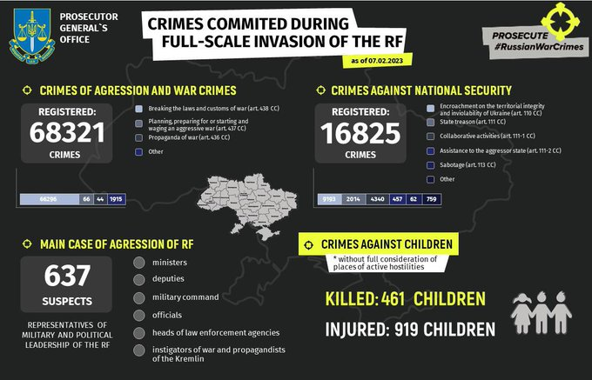

Slide 11
The emergence of international criminal law can be traced back to the Nuremberg Trials, which were held after World War II to prosecute high-ranking Nazi officials for their role in the Holocaust and other atrocities.
The Nuremberg Trials established the principle of individual criminal responsibility for international crimes and paved the way for the creation of international criminal tribunals and courts.
Since then, a number of international criminal tribunals and courts have been established, including the International Criminal Tribunal for the former Yugoslavia, the International Criminal Tribunal for Rwanda, and the International Criminal Court.
These institutions have contributed to the development of international criminal law by defining and clarifying the elements of international crimes, establishing procedures for their prosecution, and promoting accountability for those responsible.

Slide 12
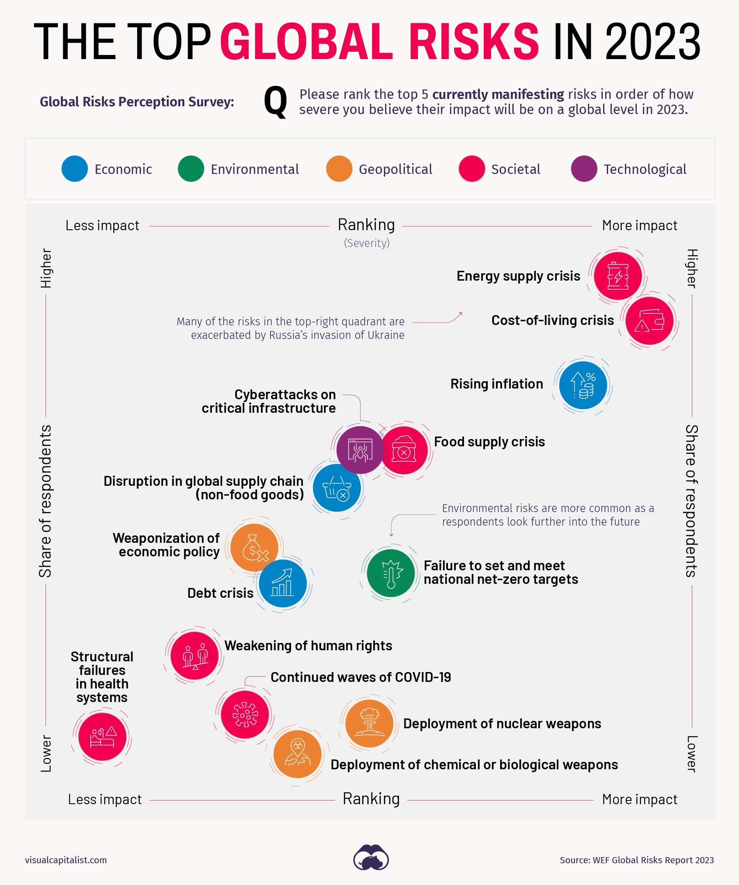
Risk society
Is characterized by the constant presence of new and uncertain risks, international or transnational crime has evolved in various ways. WEF divides top global risks in These risks are grouped into five general categories: economic, environmental, geopolitical, societal, and technological.
Here are some trends in Criminal RISKOLOGY:
Globalization and Technology: Globalization and advances in technology have made it easier for criminals to operate across national borders. Criminal networks have become more sophisticated and organized, using digital tools and encryption methods to communicate and conduct illegal activities.

Slide 13
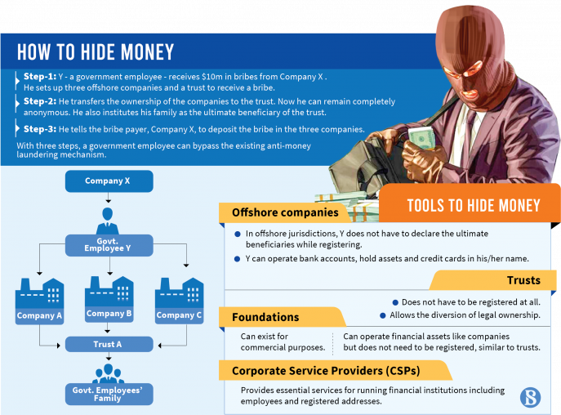
Financial Crimes:
Financial crimes such as money laundering, cybercrime, and tax evasion have become more prevalent in the risk society.
Criminals use technology and global financial networks to move money across borders and hide their assets.

Slide 14
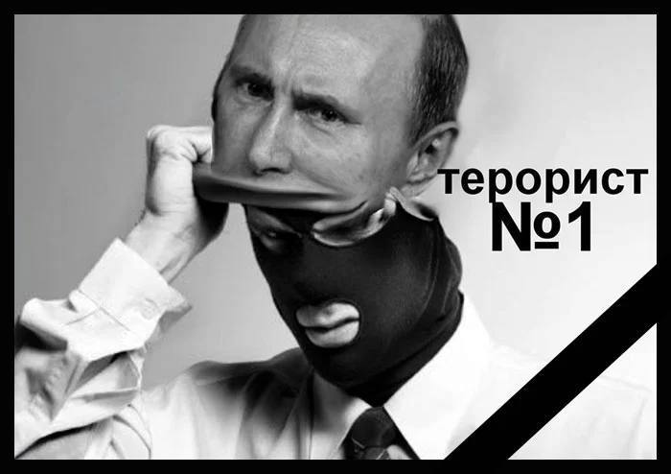
Terrorism:
The threat of terrorism has increased in the risk society, with violent extremist groups using social media and the internet to recruit members, spread propaganda, and plan attacks across borders.

Slide 15
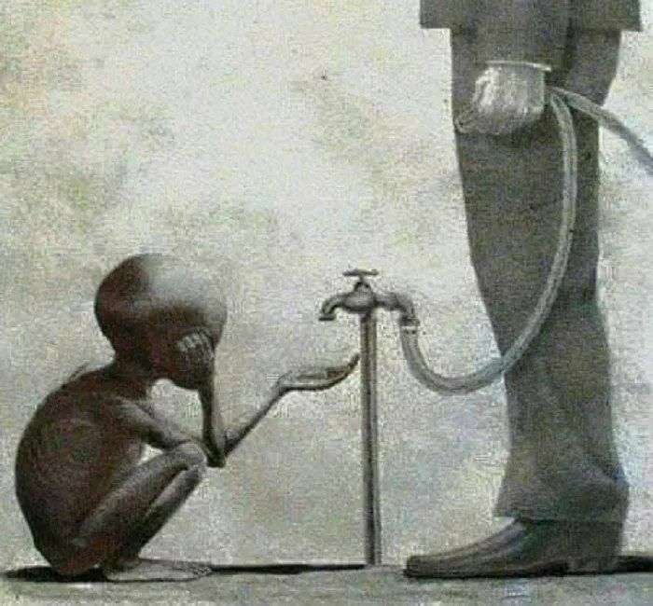
Human Trafficking:
Human trafficking has become a growing problem in the risk society, with criminal networks exploiting vulnerable individuals for forced labor or sexual exploitation. This often involves the movement of people across borders and negative impact of developed countries policies to migration processes
The nexus is outsourcing, slavery in chains supply, exploitation of South

Slide 16

Environmental Crimes:
Environmental crimes, such as illegal logging, wildlife trafficking, and illegal dumping of hazardous waste, have also become more prevalent in the risk society. These crimes often involve transnational networks and have far-reaching impacts on the environment and public health.

Slide 17
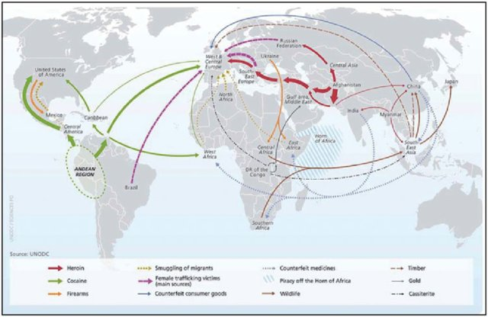

Slide 18
Synergic criminal law
known as additional criminal law, refers to the idea that international crimes can be addressed through a combination of international and domestic criminal law. Under this approach, states would have the authority to prosecute international crimes within their own legal systems, in addition to international criminal tribunals and courts.
The concept of synergic criminal law has been proposed as a way to complement and reinforce the work of international criminal tribunals and courts, by providing a more decentralized and accessible means of holding individuals accountable for international crimes. Advocates of synergic criminal law argue that it would increase the number of prosecutions for international crimes, and help to build a culture of accountability and respect for human rights at the domestic level.

Slide 19
In addition to these institutional developments as reactions to international and transnational criminal activity, international criminal law and policy has also been shaped by a number of important legal and policy developments, including
the recognition of the principle of universal jurisdiction,
the development of international human rights law,
and the increasing use of international criminal law to address terrorism and other forms of transnational crime.
Overall, emergent international criminal law reflects a growing recognition of the need for accountability and justice for serious international crimes and represents an important step towards a more just and peaceful world.

Slide 20
North vs South
The North-South divide is a significant aspect of international criminal policy, with the global imbalances heavily favoring the North at the expense of the South.
The North has enjoyed significant economic growth, while the South has lagged behind. This has led to an increase in economic inequality, with the North having access to more resources and opportunities than the South.
One of the consequences of this imbalance is an increase in crime, particularly in the South. Crime in the South is often driven by poverty, lack of economic opportunities, and political instability. The South is also often used as a source of cheap labor and resources by the North, leading to environmental crimes, human trafficking, and other forms of exploitation.
The risk society exacerbates this situation, as criminals take advantage of the increasing complexity and interconnectivity of the global economy to engage in transnational crime. This includes money laundering, cybercrime, and other forms of financial crime that exploit the imbalances between the North and South.
Addressing these issues requires a global response that addresses the root causes of global imbalances, including poverty, inequality, and political instability.

Slide 21

Advancing crime prevention, criminal justice, and the rule of law is essential for achieving the UN SDGs 2030 Agenda.
It requires investment in capacity building, crime prevention, anti-corruption measures, international cooperation, and gender equality. Only by working together to address these issues can we create a safer, more just, and more prosperous world for all.

Slide 22
Rome statute. ICC and ad-hoc tribunals.
By decision of the UN Security Council, or the UN GA ( to create, to clarify mandate and jurisdiction)
ICC as a permanent International Criminal Trial against crimes aganst humanity, war crimes
Ad hoc tribunals and chambers (Yugoslavia, Rwanda, Sierra Leone, CAR, Lebanon)
Ratification and Legality…

Slide 23
Who prosecute Mr.Putin?
RC crime of aggression and its implementation via ICC
Ad hoc tribunal on synergy basis (OSCE, PACE, NATO, EU Parliament)
AD hoc tribunal by the UN Mandate (SC vs GA)
Local courts with Universal jurisdiction (the concept of impunity, diversification of actors)

Slide 24
Victims
Due to the UN soft law and IHL there existed different forms of reparation: restitution, compensation, rehabilitation, satisfaction, and guarantees of non-repetition, I remain. “Basic Principles and Guidelines on the Right to a Remedy and Reparation for Victims of Gross Violations of International Human Rights Law and Serious Violations of International Humanitarian Law” (E/CN.4/RES/2005/35 were endorsed by the United Nations General Assembly in 2006 (A/RES/60/147, 21 March 2006).
The principles emphasize the specific obligation of each State to offer appropriate remedies to victims of violations, which are often committed by its own agents. There exists the United Nations Voluntary Fund for Victims of Torture, created in 1981; and Voluntary Fund for Victims of Contemporary Forms of Slavery, created in 1991 for special occasions as ad hoc funds.
International Criminal Court in Rome Statute consist provisions for the compensation of victims of war crimes, crimes against humanity, and genocide (Art. 75) and the creation of a Trust Fund for Victims and their families (Art. 79.1) This Fund works within jurisdiction of ICC but separately. Nevertheless there is a special practice, ie, ICC-01/04-01/06, Prosecutor v. Thomas Lubanga Dyilo , Decision Establishing the Principles and Procedures to Be Applied to Reparations, paras. 185–97):
  The right to reparations is a well-established and basic human right (para. 185).

Slide 25
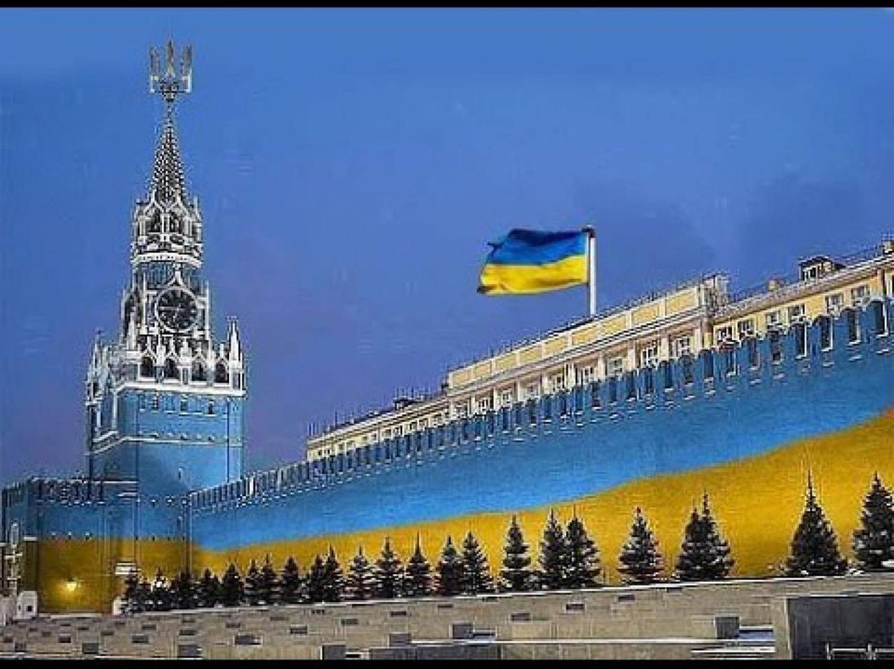
There are many who believe that the war can end with a total Ukrainian victory.
More than 13 million people are displaced, about 8 million of them abroad. The war is taking place on Ukrainian soil, with its cities being bombarded to rubble, its factories razed, its people turned destitute. If the war grinds on like this for years, it will be worth asking – are we letting Ukraine get destroyed in order to save it?
https://edition.cnn.com/2023/02/24/opinions/fareed-zakaria-ukraine-column/index.html

Slide 26
2 compensate for forgiving
  All victims are to be treated fairly and equally as regards reparations, irrespective of whether they participated in the trial proceedings.
  humanity and dignity. Their safety, physical and psychological well-being, and privacy shall be ensured. Reparations may be granted to direct and indirect victims, including the family members of direct victims, but also to legal entities
  Reparations shall be accessible to all victims on a gender-inclusive approach. Victims, their families, and their communities shall have the right to participate in reparation schemes and receive the appropriate support

Slide 27
The States Parties to this Statute,
Mindful that during this century millions of children, women and men have been victims of unimaginable atrocities that deeply shock the conscience of humanity,
Recognizing that such grave crimes threaten the peace, security and well-being of the world,
Affirming that the most serious crimes of concern to the international community as a whole must not go unpunished and that their effective prosecution must be ensured by taking measures at the national level and by enhancing international cooperation,
Determined to put an end to impunity for the perpetrators of these crimes and thus to contribute to the prevention of such crimes…
To be continued

Slide 28
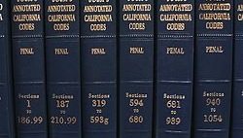

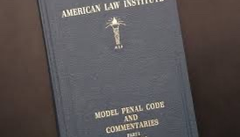

THANK YOU
Viacheslav Tuliakov
( C )2023

