Slide 1

International Human Rights Treaties and the ECHR: Legal Perspectives
This presentation explores the framework of international human rights treaties and the European Court of Human Rights (ECHR).
We'll examine key instruments, interpretation principles, and landmark cases that shape human rights law.
Prof. Viacheslav (SLAVA) TULIAKOV
Viacheslav.Tuliakov@esic.university
VV

Slide 2

Introduction to International Human Rights Treaties
1
Definition
2
Purpose
Legal instruments that formalize human rights obligations of states.
To protect fundamental rights and freedoms universally.
3
Importance
Strengthening the rule of law and accountability.
"Human rights are not a privilege conferred by government. They are every human being's entitlement by virtue of his humanity." — Mother Teresa

Slide 3

Key International Human Rights Instruments
Universal Declaration of Human Rights (1948)
1
Core civil, political, economic, social, and cultural rights.
2
ICCPR (1966)
Civil and political rights, including fair trial and freedom of speech.
ICESCR (1966)
3
Rights to work, education, and adequate living standards.
4
Convention on the Rights of the Child (1989)
Special protection for children's rights.

Slide 4

Additional Instruments: CEDAW & CRC
CEDAW (1979): "Eliminate discrimination against women."
  General Recommendation 35: Gender-based violence.
CRC (1989): "Best interests of the child."
  Article 12: Right to be heard.

Slide 5
The Status of Human Rights Treaties
Ratification and Implementation
Legal Hierarchy
States' obligations after ratifying a treaty. National legislation must adapt.
Legal Principle: Pacta sunt servanda (States must uphold treaties).
Data: 173 states ratified ICCPR; 171 for ICESCR.
Link: UN Treaty Collection
Primacy over domestic law in some countries. Incorporation into national legal systems.
Quote: "Human rights are the foundation of freedom, justice, and peace." – UDHR Preamble.

Slide 6

Treaty Analysis: How to Approach Legal Texts
Step 1
Identify key articles and provisions.
Step 2
Analyze the language for legal obligations.
Step 3
Examine interpretations in case law and doctrine
.
Example: Analyzing Article 6 (Fair Trial) in the ICCPR.

Slide 7
Vienna Convention (1969): "Textual interpretation + object/purpose."
Case Law: Golder v. UK (ECHR 1975): ICCPR Article 25 interpreted via ECHR Article 6.
The ECtHR in Golder interpreted the European Convention on Human Rights using the principle of "plain interpretation" in light of the Vienna Convention on the Law of Treaties (1969). According to Article 31 of the Vienna Convention, a treaty must be interpreted "in good faith in accordance with the ordinary meaning to be given to the terms of the treaty in their context and in the light of its object and purpose."
In the Golder case, the Court emphasized that the right to a fair trial under Article 6(1) implicitly guarantees the right of access to a court despite the absence of explicit wording in the Convention. The Court took a teleological approach, interpreting the provision in a way that aligns with the broader aim of protecting fundamental rights. Look https://hudoc.echr.coe.int/eng?i=001-57496 para 34
The ECtHR also referred to the International Covenant on Civil and Political Rights (ICCPR) to support its reasoning. Article 14(1) of the ICCPR guarantees the right to a fair and public hearing, and the Court used this as contextual evidence to bolster its interpretation. The use of the ICCPR reflected the Court's view that human rights treaties should be read harmoniously and purposively, affirming the unity of international human rights law.
In essence, the plain interpretation of international covenants in the Golder case meant reading the ECHR provisions in their ordinary sense, while also taking into account the purpose of the Convention and similar international standards (like the ICCPR) to ensure comprehensive protection of fundamental rights.

Slide 8
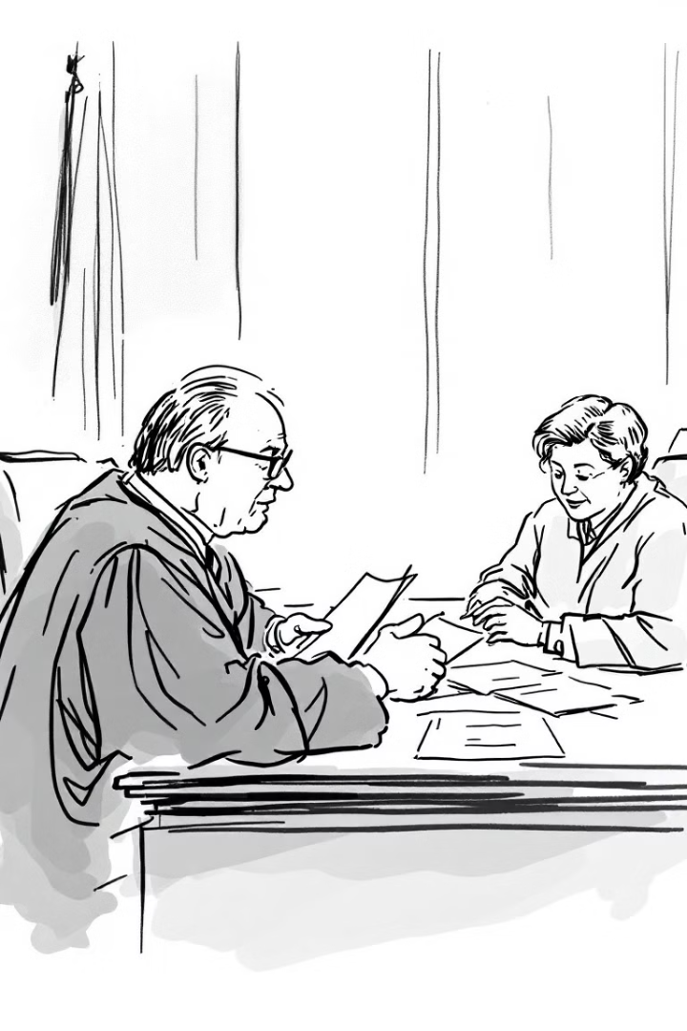
Treaty Interpretation Principles
General Rule (Article 31, Vienna Convention)
Supplementary Means (Article 32)
Ordinary meaning in context and object/purpose.
Use of preparatory work when ambiguous.
Good Faith Principle
"A treaty shall be interpreted in good faith."

Slide 9



Challenges in Treaty Implementation
Case Examples
1
Non-implementation of ECHR judgments
Political Challenges
2
Resistance due to national interests
Sovereignty Conflicts
3
Domestic law vs. treaty commitments

Slide 10



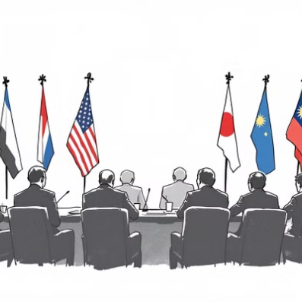
Regional Human Rights Treaties
Regional frameworks include the ECHR (1950), American Convention (1969), African Charter (1981), and ASEAN Declaration (2012).

Slide 11




Case Study: ICCPR in Practice
Toonen v. Australia (1994)
Legal Issue
Outcome
Whether such laws violated privacy rights under ICCPR.
Violated privacy rights under Article 17 of ICCPR.
Challenge to laws criminalizing same-sex relationships.

Slide 12
TOONEN v AUSTRALIA
United Nations Human Rights Committee (Views on Communication, No 488/1992, adopted 31 March 1994)
International Covenant on Civil and Political Rights, art 17 - optional protocol, art 5 - privacy and sexual orientation - Tasmanian Criminal Code
Toonen (T), an Australian citizen and resident of Tasmania, is an activist for the rights of homosexuals. He claimed s122(a) and (c) and s123 of the Tasmanian Criminal Code, which criminalise all sexual contact between consenting male adults in private, breached various Articles of the International Covenant on Civil and Political Rights (ICCPR). He submitted a communication as author and victim against Australia (the State party) to the UN Human Rights Committee, under art 5 of the optional protocol to the ICCPR.
T claimed that the Tasmanian provisions breached the ICCPR because (a) their enforcement violates the right to privacy, as it brings private sexual activity into the public domain; (b) ''they distinguish between individuals in the exercise of their right to privacy' on the basis of sexual activity, orientation or identity; and (c) they discriminate between homosexual men and women.
The Committee unanimously held:
1. T was a ''victim' within the meaning of art 1 of the optional protocol, despite the fact that the Tasmanian provisions had not been enforced for a number of years, because the threat of enforcement and impact of the continuing existence of the provisions on administrative practices and public opinion affected him personally.
2. T had no effective domestic remedy, because Australian courts will not provide a remedy for breaches of the ICCPR as part of domestic law. No ''administrative' remedy was available, as support from the necessary parliamentary majority to have the Tasmanian Parliament repeal the legislation was lacking.
The Committee first considered art 17(1) which provides in part ''No one shall be subjected to arbitrary or unlawful interference with his privacy, family, home or correspondence'.
3. ''Adult consensual sexual activity in private is covered by the concept of "privacy", and ... [T] is actually and currently affected by the continuing existence of the Tasmanian law.' The Tasmanian provisions therefore ''interfere' with T's privacy.
4. The interference was ''arbitrary'. The Committee has previously noted that the ''introduction of the concept of arbitrariness is intended to guarantee that even interferences provided for by the law should be in accordance with the provisions, aims and objectives of the Covenant and should be, in any event, reasonable in the circumstances' (General Comment 15(32) on art 17, Doc CCPR/c/21/Rev1, 19 May 1989). The Committee here ''interprets the requirement of reasonableness to imply that any interference with privacy must be proportional to the end sought and be necessary in the circumstances of any given case'.
The Tasmanian government's argument that the laws were ''reasonable' as justified on public health and moral grounds were rejected, both as to the claim that they were a means of preventing the spread of HIV/AIDS, and as to the claim that moral issues must be deemed a matter for domestic concern. Australia, as State party, accepted that the laws were arbitrary.
5. T was therefore a victim of an ''arbitrary interference with his privacy', contrary to art 17(1).
6. An effective remedy would be the repeal of the Tasmanian provisions.
http://hrlibrary.umn.edu/undocs/html/vws488.htm

Slide 13

The European Convention on Human Rights (ECHR)
Adoption: 1953 (entered into force).
Unique Features:
  Individual petition (Article 34).
  Binding judgments (Article 46).
Link: https://www.echr.coe.int/documents/d/echr/Convention_ENG

Slide 14




The European Court of Human Rights
Structure
Jurisdiction
1
Court based in Strasbourg, France
2
All Council of Europe member states
Impact
4
Admissibility
Landmark cases shape human rights standards
3
Exhaustion of domestic remedies
The ECHR ensures enforcement and interpretation of rights across Europe, balancing national sovereignty with universal human rights principles.

Slide 15

Admissibility Criteria (Article 35 ECHR)
Requirements:
  Exhaustion of domestic remedies.
  6-month time limit.
Case Law: Akdivar v. Turkey (1996): Remedies must be effective.
https://hudoc.echr.coe.int/eng?i=001-58062

Slide 16
Significance:
Clarification of Exhaustion of Domestic Remedies:
  The Court emphasized that applicants are required to exhaust only those remedies that are both effective and accessible. In situations where domestic remedies are non-existent or ineffective, applicants are not obliged to pursue them before seeking redress from the ECHR.
  In the context of this case, the Court acknowledged the applicants' fear of reprisals and the ineffectiveness of the available legal avenues in Turkey at the time.
Responsibility of States for Violations:
  The case held Turkey accountable for violations of Article 8 (right to respect for private and family life), Article 3 (prohibition of torture), and Article 13 (right to an effective remedy) of the European Convention on Human Rights, relating to the destruction of homes and displacement of Kurdish villagers.
  It established the state’s obligation to conduct thorough and effective investigations into human rights violations.
Impact on Subsequent Jurisprudence:
  The decision set a precedent for assessing the effectiveness of domestic remedies, influencing numerous subsequent cases involving states with internal conflicts or systematic human rights violations.
  It reinforced the principle that the burden of proof could shift to the respondent state when it is in a better position to provide evidence.

Slide 17

Derogations & Limitations
Article 15 ECHR: Allows derogations in "war or public emergency."
Limitations Clauses:
  "Prescribed by law" (Article 8-11).
  "Necessary in a democratic society.”
  "Soft law meets hard obligations." – Harris, Cases and Materials on International Law .

Slide 18
ECHR Case Law & the Catalan Parliament Case
  Catalan Parliament suspended debates on independence (Article 155, Spanish Constitution).
  Applicants claimed violation of ECHR Article 10 (free speech) and Article 3 (effective remedy).
Court’s Ruling: Complaints inadmissible (2022).
  Reason 1: Domestic remedies not exhausted (Spanish Constitutional Court had not ruled).
  Reason 2: No "arguable claim" under Article 10 (margin of appreciation).
Quote: "The Court is not a fourth-instance tribunal." – ECHR Press Release.
Court’s Position: Avoids adjudicating "highly political" disputes.
Comparative Case: Georgia v. Russia (II) (2021): Admitted due to armed conflict.
The Court prioritized state sovereignty over free speech.
Conclusion & Questions
Key Takeaway: "ECHR jurisprudence balances subsidiarity with supranational oversight."
Discussion Prompt: How should the Court address politically charged cases?
https://hudoc.echr.coe.int/fre-press?i=003-8167279-11453994

Slide 19

Thank U!
Viacheslav TULIAKOV © 2025
Viacheslav.Tuliakov@esic.university

