Slide 1

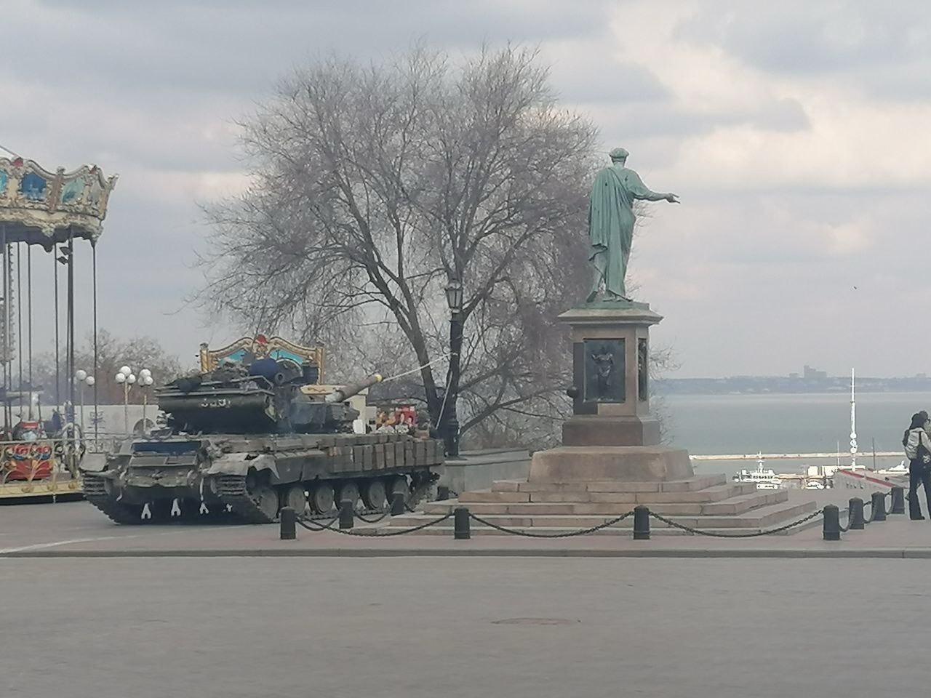

Unit 5 (1).
Human Rights Instruments
The Universal Declaration of Human Rights.
.
Prof. Viacheslav (SLAVA) TULIAKOV
Viacheslav.Tuliakov@esic.university

Slide 2

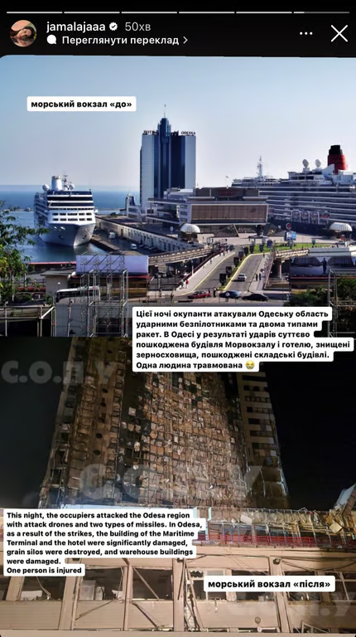
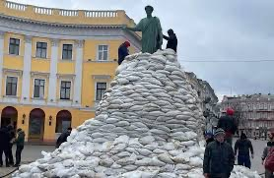
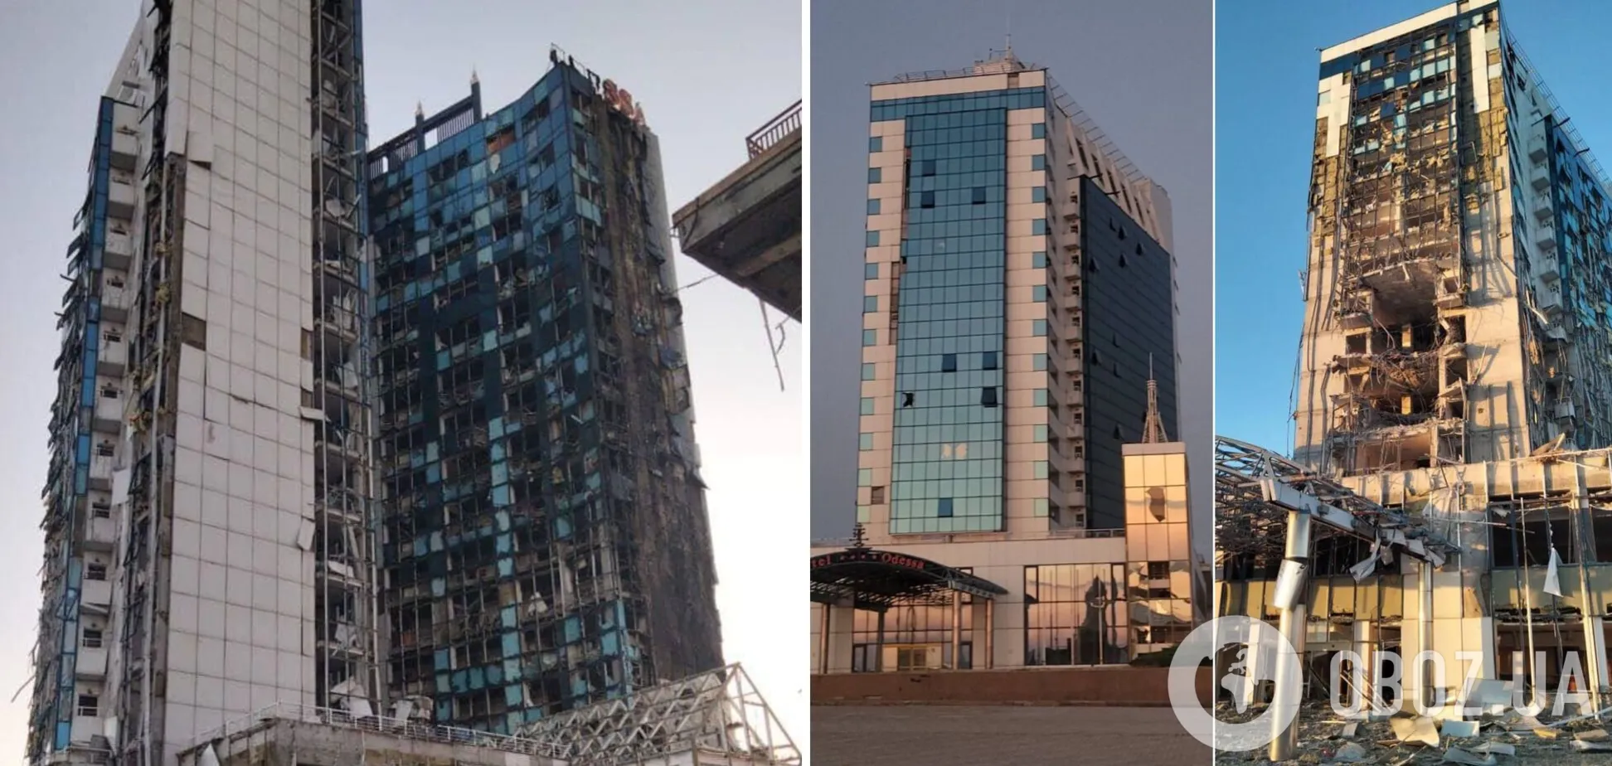

Slide 3
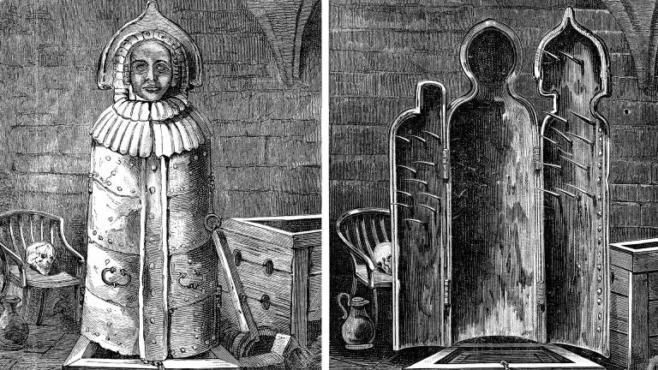
A shift to equality
To promote and protect human rights for all individuals, regardless of nationality, race, or religion.
Key components include treaties, declarations, and specialized bodies.

Slide 4
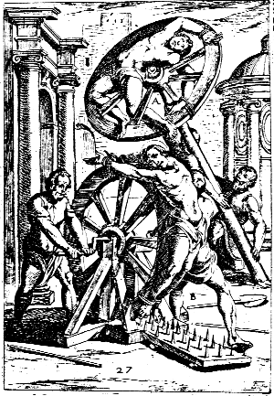
DISCIPLINE AND PUNISH
More than 250 years ago, Robert-François Damien, who had attempted to kill King Louis XV, was quartered in the Place de Greve in Paris.
The description of his heinous execution begins ‘ DISCISPLINE (Supervise) and Punish’, one of the most revolutionary books on modern social theory.
The bloody spectacle of the execution allows Foucault to demonstrate the differences between individual violence and state violence and to show how, over time, the main object of state control becomes not the body but the soul of the criminal.
The evolution of modes of surveillance and punishment gradually transforms crude state violence into a complex mechanism of total biopower that envelops modern man in his daily life and forms a society of total control.

Slide 5
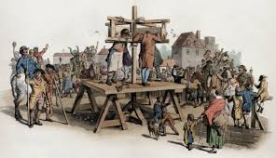
Punishment options included imprisonment, payment of fines or forfeiture of estate, and various corporal sanctions including whipping, stocks, pillory, branding or the removal of a body part such as a hand or foot, or capital punishment, normally by hanging, though certain crimes were punished by burning.
Time changes in respect of human rights
https://youtu.be/gA5sUoE0M4g?si=QID2RlTFbE-mzNlX

Slide 6
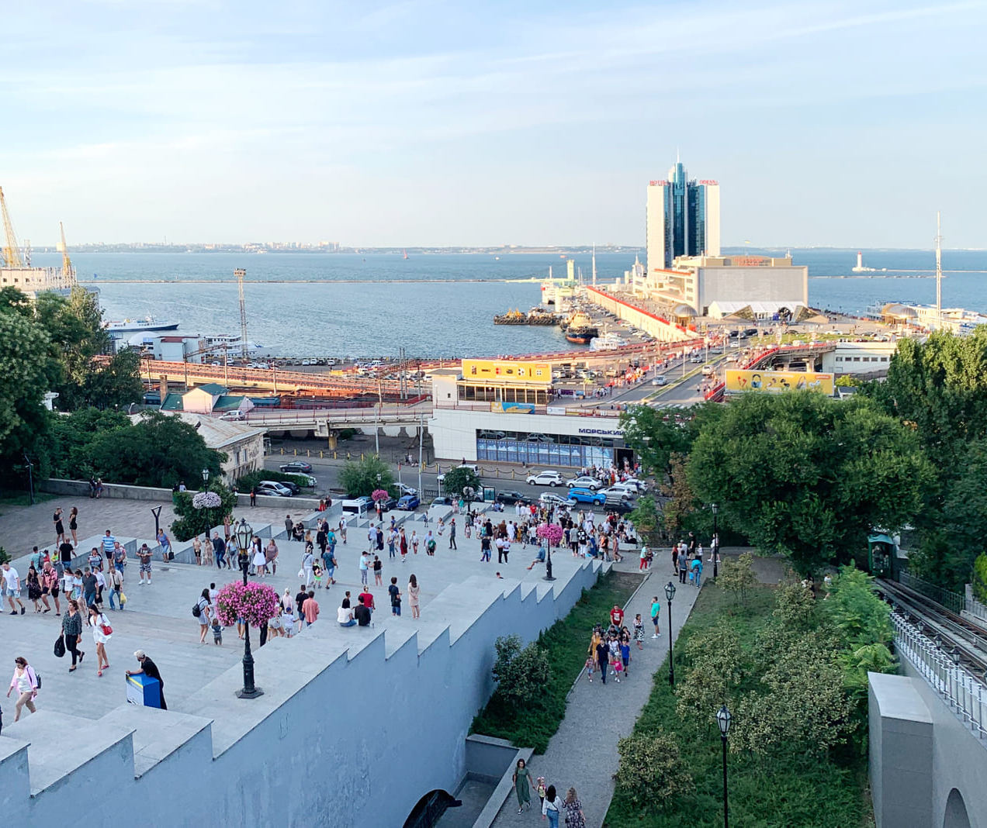
CHALLENGE OF UDCHR
Significance of the UDHR:
  A foundational document for human rights globally.
  Adopted in 1948 to prevent future atrocities like those of WWII.
Objectives
Understand how the UDHR is incorporated into Spanish and European legal frameworks.
  Explore key case studies demonstrating its application.
  Discuss challenges in enforcing universal human rights principles.
  https://youtu.be/5RR4VXNX3jA?si=GPbOiD-Hl5kioptO

Slide 7
Fundamental Principles of the UDHR
Civil and Political Rights:
Right to life, liberty, and security of person.
Freedom of speech, thought, and religion.
Prohibition of torture and arbitrary detention.
Economic, Social, and Cultural Rights:
Right to education, work, and an adequate standard of living.
Right to participate in cultural life.
Non-Discrimination Principle:
Protection against discrimination based on race, gender, nationality, etc.

Slide 8

DECLARATION step by step
https://www.un.org/en/udhrbook/
SEEKING EQUAL JUSTICE

Slide 9
Problems and Challenges in Direct Application
Non-Binding Nature: The UDHR lacks enforceability compared to treaties.
Conflicts with National Traditions: Resistance to integrating international norms.
Political and Social Challenges: Balancing national sovereignty with universal obligations.
Example: Tensions in Spain regarding Catalonia’s independence claims vs. constitutional order.

Slide 10
The Debate on the Legal Force of the UDHR
Comparison with Binding Treaties:
  International Covenant on Civil and Political Rights (ICCPR).
    ICCPR Text
  International Covenant on Economic, Social, and Cultural Rights (ICESCR).
    ICESCR Text
Scholarly Perspectives:
  Role of the UDHR in shaping modern international law.
Future Developments: Strengthening its legal impact.

Slide 11
Application in European Union Law
Charter of Fundamental Rights of the EU (2000):
  Legally binding since the Treaty of Lisbon (2009).
    https://eur-lex.europa.eu/legal-content/EN/TXT/?uri=CELEX%3A12012P%2FTXT
    European Convention on Human Rights (ECHR):
  Enforceable through the European Court of Human Rights (ECtHR).
  https://youtu.be/Bsm_vhEgKew?si=w3yCnJFMDN7QWKZB
  EU Treaties and Directives:
  Directive 2000/43/EC on racial equality.
    https://eur-lex.europa.eu/legal-content/EN/TXT/?uri=CELEX%3A32000L0043Video Resource:

Slide 12
Implementation in Spanish Legislation
Constitutional Basis:
The Spanish Constitution of 1978 incorporates many UDHR principles in Title I.
Judicial Interpretation:
The Constitutional Court ensures laws align with international human rights norms.
Specific Laws:
Organic Law 1/2004 on Integrated Protection Measures against Gender Violence.
https://www.youtube.com/watch?v=5Dwsq_0-By0

Slide 13
The Debate on the Legal Force of the UDHR
Comparison with binding human rights treaties (ICCPR, ICESCR).
Legal scholars’ perspectives on the UDHR’s role in international law.
Possible future developments in strengthening its legal impact.

Slide 14
Case Study: Spain and Human Rights Mechanisms
Tensions Between the UDHR and National Laws
Conflicts in areas such as asylum policy, freedom of speech, and anti-terrorism laws.
Responses from Spanish and European courts.
Example: Spain’s deportation policies and their compliance with human rights principles.
Case link: https://www.ohchr.org/sites/default/files/lib-docs/HRBodies/UPR/Documents/Session35/ES/Spain_Infographic_35.pdf

Slide 15

Rap as a CRIME?
https://eucrim.eu/news/cjeu-ruling-spanish-rapper-case/
https://globalfreedomofexpression.columbia.edu/cases/the-extradition-case-of-jose-miguel-arenas-valtonyc/#:~:text=Case%20Summary%20and%20Outcome,not%20be%20extradited%20by%20Belgium.

Slide 16
Chat GPT and…
https://www.perplexity.ai/
https://scite.ai
https://www.zotero.org
https://www.mendeley.com
https://evernote.com
https://uacademic.info
https://x.ai
https://claude.ai/
https://gemini.google.com/
https://chat.qwenlm.ai

Slide 17
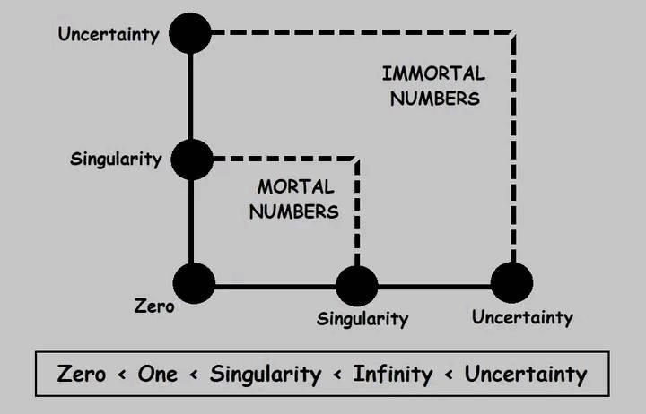
Thank U!
Viacheslav TULIAKOV © 2025
mail: Viacheslav.Tuliakov@esic.university

