Slide 1



TRENDS IN CRIMINAL POLICY: (DIS)
ORGANISING THE CHAOS
Lecture 4.
CRIMINALISATION VS DECRIMINALISATION
(INSTITUTIONAL APPROACH)
Dr.Hab. Prof. Viacheslav Tuliakov
NU ‘Odesa law academy’ (Ukraine), university of Castilla La Mancha (Spain)

Slide 2
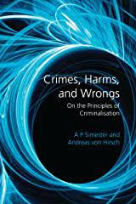
principles of criminal law and socio-legal foundations of criminal policy
equality,
legal certainty,
proportionality,
predictability,
subsidiarity,
legality
vector of the primacy of human rights safety of victims of criminal offenses,
complementarity of coercion and decent treatment,

Slide 3
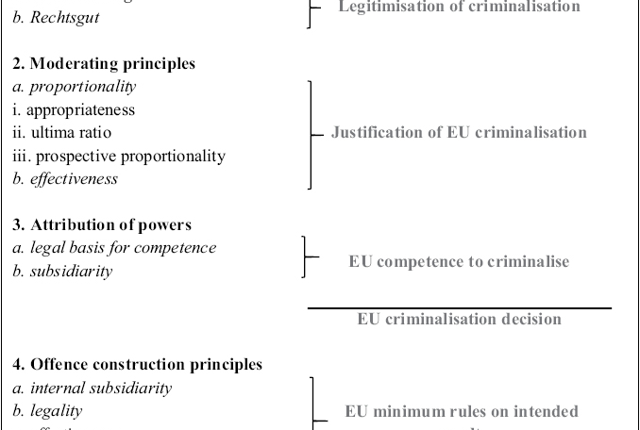
PRINCIPLES OF CRIMINALISASTION EU

Slide 4
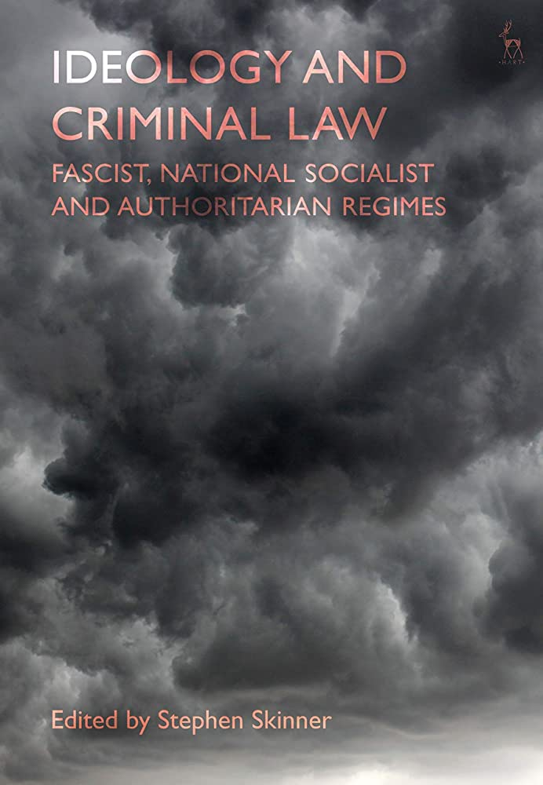
Оppression
Terror
Transition
Democracy
Post-truth
Virtual
Singularity

Slide 5
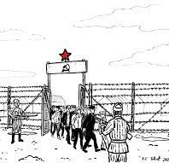
“Anyone who thinks that the Communist regimes of Central Europe are exclusively the work of criminals is overlooking a basic truth: The criminal regimes were made not by criminals but by enthusiasts convinced they had discovered the only road to paradise. They defended that road so valiantly that they were forced to execute many people. Later it became clear that there was no paradise, that the enthusiasts were therefore murderers.”
Milan Kundera

Slide 6


REGIMES OF REGULATION – LEVELS OF TRANSITION
International
Supranational
Interregional
National
Local
Individual

Slide 7
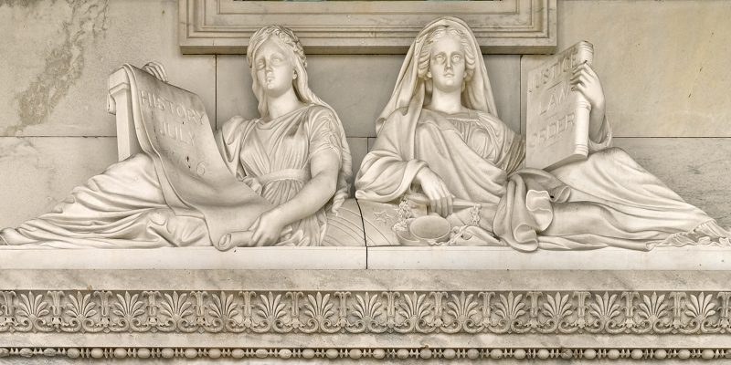
ELEMENTS
The state as a criminal
Territories under official control (effective governance needs occupation)
Substantial criminal law in search of balance between security of people and state`s security
Civil society and criminal law
War against all

Slide 8
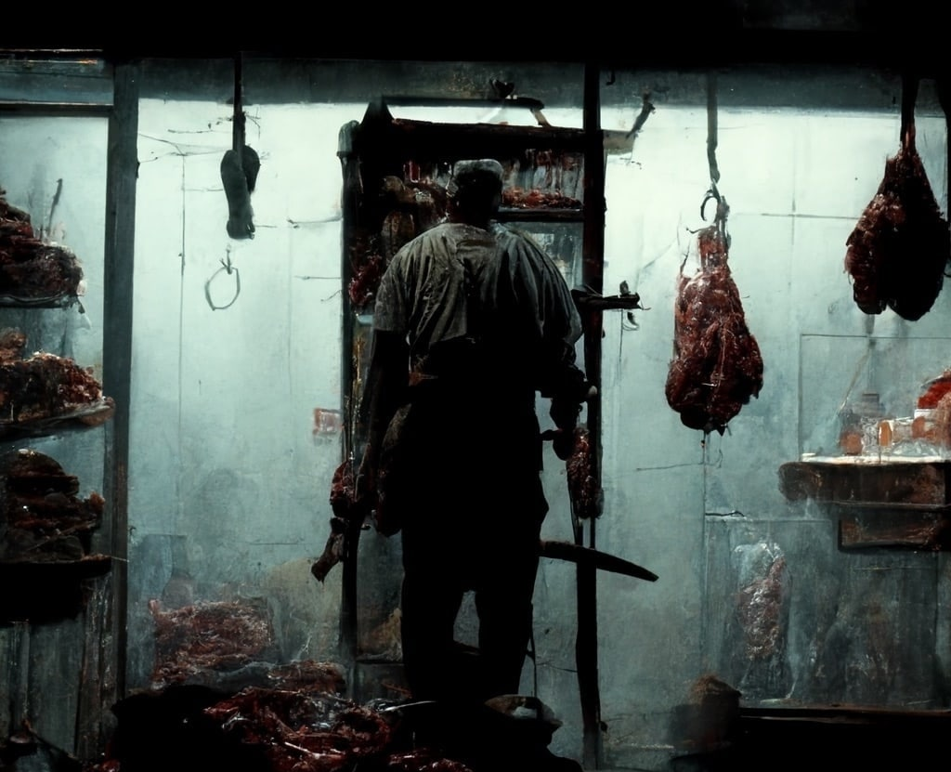
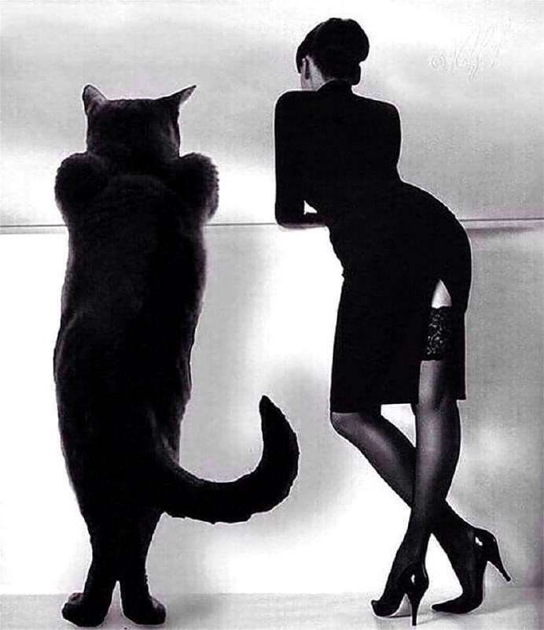
Oppressive techniques
“China has adopted no specific law penalising public outcry against the millions of victims of the Cultural Revolution, the Tiananmen Square massacre, and countless other abuses.”
There was no single regime in history that first kills, then decrees that it is guilty of it.

Slide 9
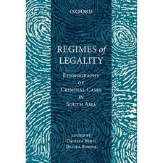

Criminal regimes
Common (General, Complicity, Attempt)
Special (Legal persons, Corruption)
Emergent (Privileged, Proscriptive – Martial Law, Catastrophes)
Non-law (Legal fiction, Singularity)

Slide 10
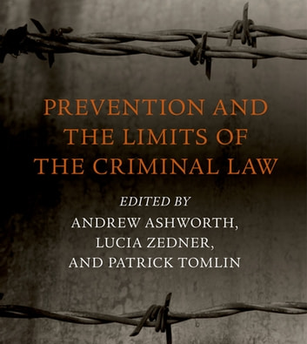
Oppression & Terror/ Role of CL
Byzantian ROL – Absolute powers of Sovereign
Empire governing – Distribution of penalties
Socialist/Fascist terror – Material definition – Social threat
Virtual state (DAESH, Cartel ruling in LA) – changing cards – hidden codes
Religious states (Saudis, Iran) -ancient prescriptions and morals over

Slide 11
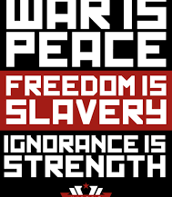
Non-Law
Law disobedience as legal order
Non law as Legal Orwellian governing
Genocide as policy
A request for a superpower.
The request for personal rights and freedoms to be secondary.
A request for an external culprit for our problems.
A request for paternalism.
Demand for size and power as arguments in an argument.

Slide 12
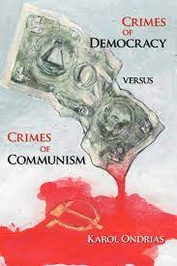
DEMOCRACY AND CRIME
Democracies enjoy higher levels of legitimacy in the eyes of their citizens, thus the rule of law is more highly respected.
Democracies punish serious crimes more severely and petty crimes less severely, meaning that they deter murder more effectively than non-democracies.
The cultural values espoused by the citizens of democracies are more peaceful and egalitarian than those of non-democracies, resulting in lower murder rates.

Slide 13
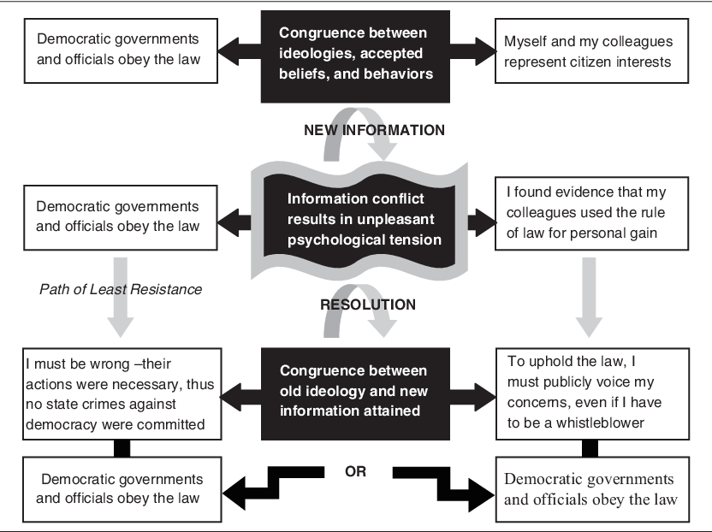

Slide 14
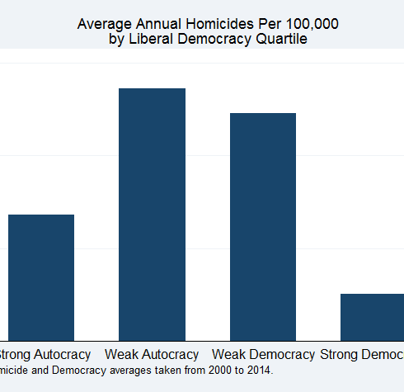
Legitimising Criminalisation
DIGNITY (e.g. the right to life, the right to personal integrity),
FREEDOMS (e.g. right to liberty and security, right to property),
EQUALITY (e.g. non-discrimination, rights of the child),
SOLIDARITY (e.g. right of collective bargaining and action, fair and just working conditions),
CITIZENS’ RIGHTS (e.g. right to vote, right to good administration),
JUSTICE
HARM AND WRONG
LEGAL INTERESTS
https://www.brookings.edu/wp-content/uploads/2017/09/fp_20170905_democracy_crime_working_paper.pdf

Slide 15
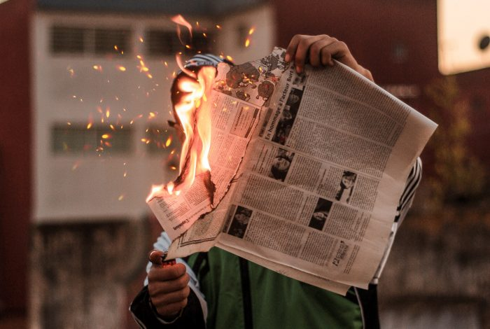
FAKE STATES & CRIMINALISATION
FAKE STATES VS FAKE NEWS
NON-LAW IN ACTION
OCCUPATIONAL (EFFECTIVE GOVERNANCE) CRIMINAL LAW
UKRAINE AND NETHERLANDS VS RUSSIA Ihttps://www.echr.coe.int/Pages/home.aspx?p=hearings&w=801916_26012022&language=lang

Slide 16

SINGULARITY…
NEGATIVE (ANOMIE, VIRTUAL LAW)
ADOPTED SYNERGY
WEAKNESS OF GOVERNING

Slide 17

punishment probably won't exist.
installing certain mental augments and modifications may be mandatory for citizenship
Individuals who are not using the required mods may be flagged for everyone to see or even physically banned from specific locations.
There will likely be drones and surveillance everywhere and the majority of attempts at crime will probably be foiled before anyone is harmed.
If an individual is not comfortable with this, they will likely have NOT the opportunity of moving elsewhere

Slide 18
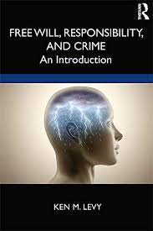
FREE WILL, IDEOLOGY AND CRIME
A criminal case was opened against Vasily Bolshakov because of a joke he posted on VKontakte on November 9, 2022 (https://www.unian.ua/russianworld/u-rosiji-zaveli-spravu-na-cholovika-za-anekdot-pro-vidstup-rf-z-hersona-12178341.html).
"I haven't read a really funny joke in a long time: "Sergei, why are we retreating from Kherson? Volodya, you ordered us to liberate Ukraine from the Nazis and fascists..." the man wrote.
Taking into account the previous fine for his statements on social networks, a criminal case was opened against him under the article on repeated discrediting of the Russian army (Article 280.3 of the Criminal Code of the Russian Federation)...

Slide 19
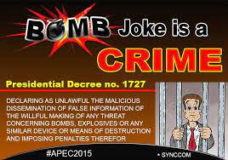
CRIME AS A JOKE?
JOKE AS A CRIME
CULTURAL AND NARRATIVE CRIMINOLOGY IN METAMODERN POLICY…
2 BE CONTINUED…

Slide 20
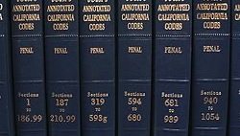

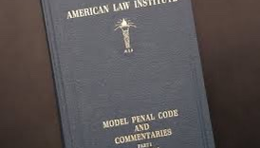

THANK YOU
Viacheslav Tuliakov
( C )2023

