Slide 1
CRIMINAL LEGISLATION
Dr.Hab. prof Viacheslav Tuliakov
NU ‘Odesa law academy’, university of Castilla La Mancha, IE University

Slide 2

CRIMINAL VS PENAL
The concept of Сriminal Law varies significantly across different segments of society, encompassing citizens, media, social groups, and law enforcement authorities.
The autonomous concepts of criminal law, punishment and crime exist also in ECHR and ECJ judgments
Tuliakov V. О. Trends in criminal policy: (dis) organising the chaos. Concept [Electronic resource] : lecture 1 : [presentation PowerPoint] / V. О. Tuliakov. – Electronic data (14 slides). – Ciudad Real, 2023. http://dspace.onua.edu.ua/handle/11300/25979

Slide 3

PRINCIPLES OF CRIMINALIZTION
"Principles of determining the threshold for criminalization (harm, protected legal interests);
Principles of justification of criminalization (proportionality, effectiveness);
Principles of distribution of State, EU and International powers in the field of criminalization (legal basis of competence, subsidiarity);
Principles of construction of the offense (internal subsidiarity, normativity, effectiveness of proof and prosecution, retrospective proportionality)".
Tuliakov V. О. Trends in criminal policy: (dis) organising the chaos. Criminalisation vs decriminalisation (institutional approach) [Electronic resource] : lecture 4 : [presentation PowerPoint] / V. О. Tuliakov. – Electronic data (20 slides). – Ciudad Real, 2023 URL:http://dspace.onua.edu.ua/handle/11300/25983

Slide 4

IN FORCE
Article 1. Objectives of the Criminal Code of Ukraine
1. The objective of the Criminal Code of Ukraine is to provide legal protection of the rights and liberties of every human being and citizen, property, public order and public safety, the environment, and the constitutional order of Ukraine against criminal encroachments, to secure peace and safety of mankind, and also to prevent crime.
2. To this aim, the Criminal Code shall define which socially dangerous acts or omissions count as offences, and which punishments shall be imposed upon persons who commit them.
1. The Criminal Code of Ukraine based on the Ukraine and generally recognised principles and rules of international law shall be the Ukrainian legislation on criminal liability.
2. The Ukrainian laws on criminal liability, adopted after the effective date of this Code, shall be incorporated in this Code following its entry into force.
3. The criminality of any act as well as its punishability and other criminal consequences shall be determined exclusively by this Code.
4. Application of the law on criminal liability by analogy shall be prohibited.
5. The laws of Ukraine on criminal liability shall be consistent with provisions of existing international treaties, ratified by the Verkhovna Rada of Ukraine.
6. Amendments to the legislation of Ukraine on criminal liability shall be made only under laws amending this Code and/ or the criminal procedure legislation of Ukraine, and/or the legislation of Ukraine on administrative offences.

Slide 5
Drafting
Decree of the President of Ukraine No. 584/2019 of August 7, 2019 "Issues of the Legal Reform Commission" established a working group on the development of criminal law within the said commission
Article 1.1.1. Criminal Code
1. The Criminal Code of Ukraine is the only law which, on the basis of the rule of law, regulates relations arising
1) in connection with the commission of a criminal offence (criminal law relations), taking into account the interests of the victim;
2) the commission of unlawful acts provided for by this Code by insane persons and persons under the age of the subject of the relevant criminal offense;
3) infliction by a person of damage to social values defined in Articles 2.5.2 - 2.5.7 of this Code, under circumstances that exclude the unlawfulness of the act.
2. This Code is based on the Constitution of Ukraine. If in other normative legal acts of Ukraine
of Ukraine, the issues defined in part 1 of this Article are resolved differently than by this Code, then, taking into account the provisions of Article 1.2.8 of this Code, the provisions of this Code shall apply.
3. In case of contradiction between the provisions of the General and Special Parts of this Code, the provisions of the General Part shall apply.
Article 1.1.2. Purpose of the Criminal Code
1. This Code defines:
1) signs of corpus delicti of criminal offences - crimes and criminal
(hereinafter in this Code - misdemeanours) and their exhaustive list
) types and amounts of criminal legal means;
3) grounds and conditions under which these means are applied or not applied.
https://newcriminalcode.org.ua/criminal-code

Slide 6

Principles
Article 1.2.1. Legality
1. An act not provided for by this Code as a crime or misdemeanor shall not be a criminal offence.
2. Criminal legal means not provided for by this Code may not be applied.
3. The application of this Code to criminal law relations not regulated by it (analogy of law) shall not be allowed with regard to:
1) types and signs of criminal offences,
2) types and amounts of criminal legal means and
3) grounds and conditions under which these means are applied or not applied.
Article 1.2.2. Legal certainty
1. The provisions of this Code shall meet the requirements of accessibility, stability, sufficient clarity, unambiguity and predictability to enable a person to know in advance what acts constitute criminal offences, what criminal legal remedies are established for their commission and under what grounds and conditions these remedies are or are not applied.

Slide 7
Article 1.2.3. Equality before the Criminal Code
1. All persons are equal before this Code.
Article 1.2.4. Proportionality
3. Means of criminal liability are established in proportion to the degree of gravity of the criminal offense and are applied in accordance with the degree of its gravity and the person of the perpetrator.
Article 1.2.5. Individuality
1. Criminal legal means have individual character. Collective responsibility and responsibility of a person for the acts of other persons shall not be allowed.
Article 1.2.6 Humanism
1. This Code provides for humane restriction of rights and freedoms of a person who has committed an unlawful act.
2. Criminal legal means are not intended to cause physical suffering or humiliate human dignity.
3. This Code ensures the recognition and observance of the rights, freedoms and legitimate interests of the victim, including the right to restitution and compensation.
Article 1.2.7. Uniqueness of application of criminal legal means
1. A person may not be subjected to criminal legal means under this Code more than once for the same criminal offence.
Article 1.2.8. Good faith performance of international obligations
1. This Code shall comply with the current international treaties ratified by the Verkhovna Rada of Ukraine.
3. This Code shall be applied taking into account the case law of the European Court of Human Rights.

Slide 8
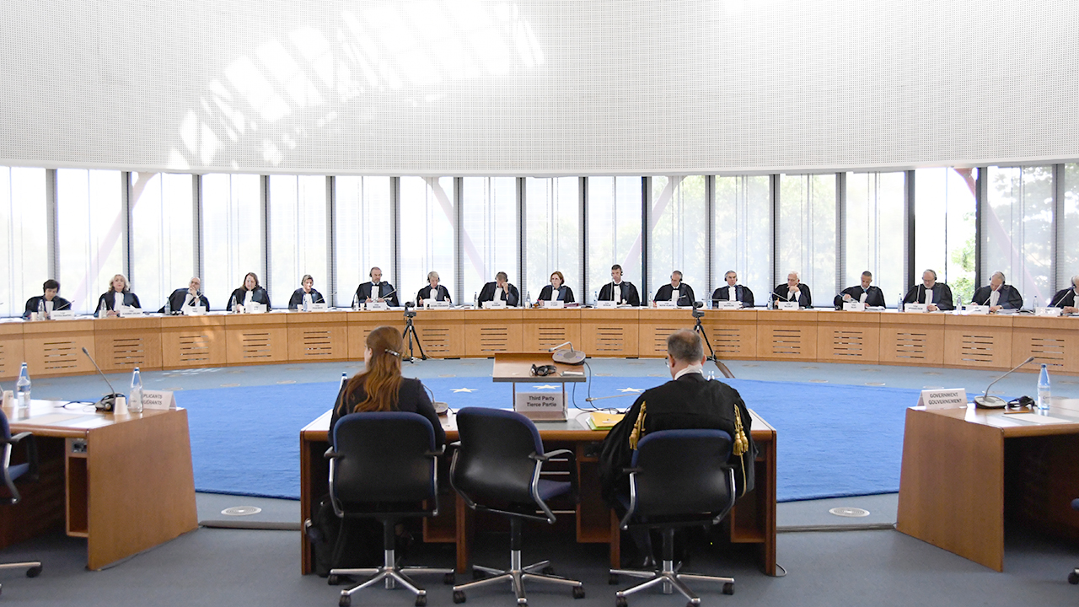
«Article 7 of the Convention – No punishment without law
“1. No one shall be held guilty of any criminal offence on account of any act or omission which did not constitute a criminal offence under national or international law at the time when it was committed. Nor shall a heavier penalty be imposed than the one that was applicable at the time the criminal offence was committed.
2. This article shall not prejudice the trial and punishment of any person for any act or omission which, at the time when it was committed, was criminal according to the general principles respected by civilised nations.».
— https://www.echr.coe.int/Documents/Guide_Art_7_ENG.pdf

Slide 9
The “criminal offence” concept
(“infraction” in the French version) has an autonomous meaning,
like “criminal charge” in Article 6 of the Convention1.
The three criteria set out in the case of Engel and Others v. the Netherlands, § 82 (reaffirmed in Jussila v. Finland [GC], § 30) for assessing whether a charge is “criminal” within the meaning of Article 6 must also be applied to Article 7 (Brown v. the United Kingdom (dec.); Société Oxygène Plus v. France (dec.), § 43; Žaja v. Croatia, § 86):
▪ classification in domestic law;
▪ the very nature of the offence (the most important criterion, see Jussila v. Finland [GC],
§ 38);
▪ the degree of severity of the penalty that the person concerned risks incurring.

Slide 10
Recommendation CM/Rec (2023)2 of the Committee of Ministers of the European Council,
Transitioning from a binary framework (statics vs. dynamics, positive law vs. law as a value), criminal law operates on various dimensions, manifesting at individual, societal, and institutional levels. Its primary function is to maintain equilibrium among the individual, society, and the state by safeguarding the objects of criminal-law protection.
We are currently witnessing a paradigm shift from the "age of information" to the "age of reputation," emphasizing the importance of information that has undergone external evaluation and commentary.
In the context of Approximation of EU aquis and COE norms to Ukrainian criminal legislation, it becomes evident that contemporary criminal law serves as a fundamental tool for safeguarding human rights. This theoretical framework aligns with Recommendation CM/Rec (2023)2 of the Committee of Ministers of the European Council, which underscores the paramount importance of protecting individual human rights.
“Crime is a wrong against society and a violation of the individual rights of victims. (para 2)
Member States should, therefore, ensure the effective recognition of, and respect for, the rights of victims with regard to their human rights; they should, in particular, respect the liberty, security, property, dignity, private and family life of victims and recognise the negative effects of crime on victims” URL: https://search.coe.int/cm/Pages/result_details.aspx?ObjectID=0900001680aa8263

Slide 11
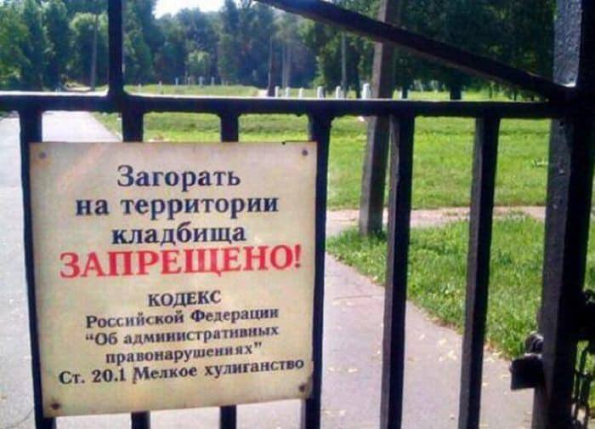
Sources strict - CRIMINAL CODE
Sources narrow (regulation)
ECHR practice
International treaties
Constitutional court
Supreme court
aquis (EU legislation, ECJ, infridgement procedures)

Slide 12
ARTICLE 4. Operation of the law on criminal liability in time
1. The law on criminal liability shall enter into force ten days after its official promulgation, unless otherwise is provided by the law itself, but not prior to the day of its publication.
2. The criminality and punishability, as well other criminal and legal consequences of an act shall be determined by such law on criminal liability as was in effect at the time of commission of the act.
3. The time of commission of a criminal offence shall be the time in which a person committed an act or omission stipulated by the law on criminal liability.
ARTICLE 5. Retroactive effect of the law on criminal liability in time
1. The law on criminal liability, which repeals the criminality of an act or commutes criminal liability, shall be retroactive in time, that is it shall apply to persons who had committed respective acts before that law entered into force, including persons serving their sentence or those who have completed their sentence but have a conviction.
2. The law on criminal liability that criminalises an act or increases criminal liability or otherwise deteriorates the situation of a person shall not be retroactive in time.
3. The law on criminal liability, which partially commutes criminal liability or otherwise improves the situation of a person, and partially increases criminal liability or otherwise deteriorates the situation of a person, shall have retroactive effect only in the part that commutes criminal liability or otherwise improves the situation of a person.
4. Where the law on criminal liability has been amended several times since a person committed an act stipulated by this Code, the law that repeals criminality of an act or commutes criminal liability or otherwise improves the situation of a person shall be deemed retroactive.

Slide 13
« The impugned decision concerns exclusively the way in which the lawfully prescribed sentence is to be executed; it does not raise issues under the principle nulla poena sine lege, the basic principle at the core of Article 7.
The applicable criminal legislation remains the same, as does the prison sentence imposed, even though, as a result of the Spanish courts correcting what they deemed to be a mistaken interpretation and, thus, a mistaken implementation of that criminal legislation over previous years, a different method for calculating the reduction of the applicant’s prison sentence was applied. It is in this crucial respect that the circumstances of the present case are clearly distinguishable from those of other cases that have been held by the Court to come within the ambit of Article 7.».
DEL RIO PRADA VS SPAIN

Slide 14
Article 6. The operation of the law on criminal liability with regard to offences committed in the territory of Ukraine
1. Any person who has committed an offence in the territory of Ukraine shall be criminally liable under this Code.
2. An offence shall be deemed committed in the territory of Ukraine if it has been initiated, continued, completed or discontinued in the territory of Ukraine.
3. An offence shall be deemed committed in the territory of Ukraine if the principal to such offence, or at least one of the accomplices, has acted in the territory of Ukraine.
4. Where a diplomatic agent of a foreign state or another citizen who, under the laws of Ukraine or international treaties, ratified by the Verkhovna Rada of Ukraine, is not criminally cognisable by a Ukrainian court commits an offence in the territory of Ukraine, the issue of his/her criminal liability shall be settled diplomatically.

Slide 15
Unless otherwise provided by an international treaty of Ukraine, this Code shall apply to a person who has committed an act provided for by it on
1) territory or object of diplomatic or consular representation of Ukraine abroad
2) the territory of a military unit of Ukraine deployed abroad,
3) state aircraft, warship or vessel, or vessel of the Border Guard Service, Civil Protection Service, National Police or Revenue and Duties Authority,
4) another sea, river or air vessel registered in Ukraine and located on the high seas or open airspace or territorial waters or airspace of another state that has not established its jurisdiction over the committed act, or
5) an object belonging to Ukraine and located on the territory that does not belong to the territory of any state.
3. In cases envisaged by an international treaty of Ukraine, this Code shall apply to a person who has committed an act envisaged by it in the exclusive maritime economic zone of Ukraine or on the continental shelf of Ukraine.

Slide 16

Article 7. The operation of the law on criminal liability in regard to offences committed by citizens of Ukraine or stateless persons outside Ukraine
1. Citizens of Ukraine and stateless persons permanently residing in Ukraine, who have committed offences outside Ukraine, shall be criminally liable under this Code, unless otherwise provided for by the international treaties of Ukraine, ratified by the Verkhovna Rada of Ukraine.
2. Where the persons referred to in part 1 of this Article undergo criminal punishment for the committed criminal offences outside Ukraine, they shall not be criminally liable for these criminal offences in Ukraine.

Slide 17
Article 8. The operation of the law on criminal liability with regard to offences committed by foreign nationals or stateless persons outside Ukraine
1. Foreign nationals or stateless persons not residing permanently in Ukraine, who have committed criminal offences outside Ukraine, shall be criminally liable in Ukraine under this Code in such cases as provided for by the international treaties, or if they have committed any of the grave or special grave offences against rights and freedoms of Ukrainian citizens or Ukraine as prescribed by this Code.
2. Foreign nationals or stateless persons who do not reside permanently in Ukraine shall also be liable in Ukraine under this Code if they have committed any criminal offence outside Ukraine provided for by Articles 368, 368⁻³, 368⁻⁴, 369 and 369⁻² hereof in complicity with officials who are citizens of Ukraine or if they offered, promised, provided improper advantages to such officials, or accepted a proposal, a promise of improper advantages or received such advantage from them.

Slide 18
Article 9. Legal consequences of conviction outside Ukraine
1. A judgment passed by a foreign court may be taken into account where a citizen of Ukraine, a foreign national, or a stateless person have been convicted of a criminal offence committed outside Ukraine and have committed another criminal offence in the territory of Ukraine.
2. Pursuant to part 1 of this Article, the repetition of criminal offences, or a sentence not served, or any other legal consequences of a judgment passed by a foreign court shall be taken into account in the classification of any new criminal offence, determination of punishment, in the discharge from criminal liability or punishment.

Slide 19
Article 10. Resolving the issue of criminal liability of persons who are subject to criminal liability under the legislation of a foreign state and who reside in the territory of Ukraine, and the execution of sentences delivered by foreign courts or international judicial institutions
1. Citizens of Ukraine who have committed criminal offences outside Ukraine, shall not be extradited to a foreign state for criminal prosecution and committal for trial.
3. Foreign nationals or stateless persons residing in the territory of Ukraine who have committed crimes outside Ukraine may be extradited to a foreign state for criminal prosecution and committal for trial.
3. Ukraine may take over criminal proceedings in which the judiciary of a foreign state has not passed a sentence against citizens of Ukraine and foreign nationals residing in the territory of Ukraine who have committed crimes outside Ukraine, but who cannot be extradited to a foreign state or their extradition was denied, provided the act in connection with which the transfer of criminal proceedings has been requested is deemed a crime under this Code.
4. Execution in Ukraine of a sentence of a foreign court or international judicial institution shall be only possible provided the act as a result of which the sentence was passed is deemed a criminal offence under this Code or would be a criminal offence if committed in the territory of Ukraine.

Slide 20

Convention on International Cooperation in the Investigation and Prosecution of Genocide, Crimes against Humanity, War Crimes and Other International Crimes — referred to as the Mutual Legal Assistance Treaty (MLA), and now formally titled the Ljubljana-The Hague MLA Convention (26 may 2023)
Міжнародне співробітництво у кримінальному провадженні=International cooperation in criminal proceeedings : навч. посіб. [Електронний ресурс] / В. В.Зуєв, І. В.Гловюк, А. В.Підгородинська, А. С.Степаненко, В.О. Туляков, О.В.Малахова ; за ред. В.О.Тулякова. – Одеса : Національний університет «Одеська юридична академія», 2022. - 221 с. – Режим доступу : https://doi.org/10.32837/11300.26117

Slide 21
Thank you for your attention!
https://www.youtube.com/watch?v=jZfrmHB_2S4
© Viacheslav Tuliakov (2023)

