Slide 1
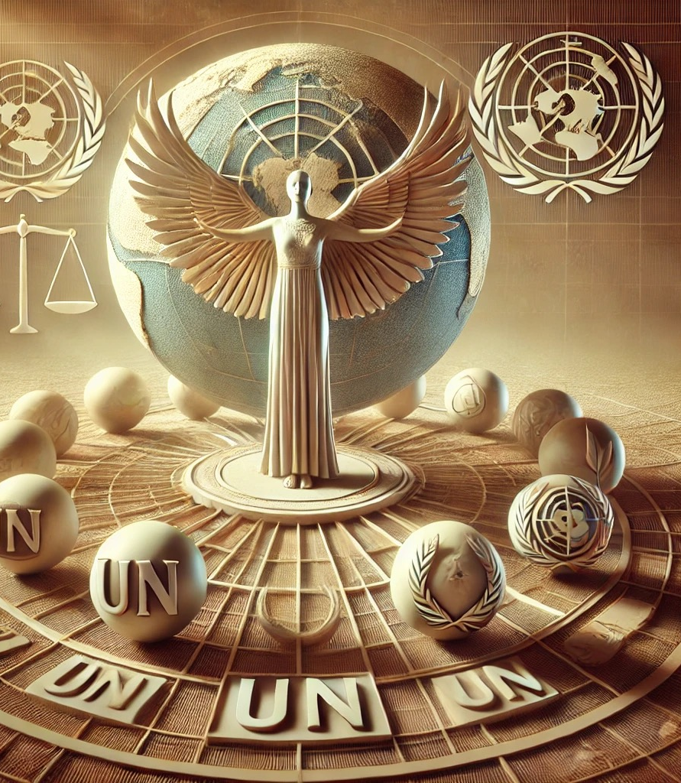
UNIT 6-1.
"Exploring the UN System of Human Rights Protection:
Guardians of Dignity, Freedom, and Justice"
"A Journey Through Global Mechanisms with a Dash of Wit and Wisdom"
Prof. Viacheslav (SLAVA) TULIAKOV
Viacheslav.Tuliakov@esic.university

Slide 2
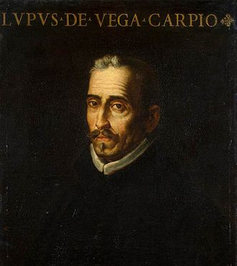
"El que no espera vencer ya está vencido" – Lope de Vega (He who does not hope to win is already defeated).
Это изображение, автор: Неизвестный автор, лицензия: CC BY-SA

Slide 3

United Nations (UN) - Global Organization for Human Rights
Definition :
The United Nations is a global intergovernmental organization founded in 1945 to maintain international peace and security, promote sustainable development, and protect human rights.
Key Features :
  Comprises 193 member states.
  Operates through specialized agencies, such as the Office of the High Commissioner for Human Rights (OHCHR).
Functions in Human Rights :
  Promote Human Rights Standards : Develops conventions, treaties, and declarations (e.g., Universal Declaration of Human Rights).
  Monitor Compliance : Through treaty bodies like the Human Rights Committee and the Committee Against Torture.
  Investigate Violations : Conducts inquiries and special rapporteur missions.
  Provide Capacity Building : Assists states in implementing human rights norms.
  https://www.un.org
  https://www.ohchr.org/en/hrbodies/hrc/home
  https://main.un.org/securitycouncil/en
  https://www.icj-cij.org/home

Slide 4
Introduction to the UN System of Human Rights Protection
The United Nations (UN) system protects human rights through various mechanisms designed to hold states accountable for upholding dignity, equality, and freedom.
01
It’s like having a global referee ensuring everyone plays fair—but sometimes referees get ignored!
02
Fun Fact:
Did you know that over 80 treaties fall under the umbrella of international human rights law? That's more than the number of episodes in your favorite Netflix series!
03

Slide 5
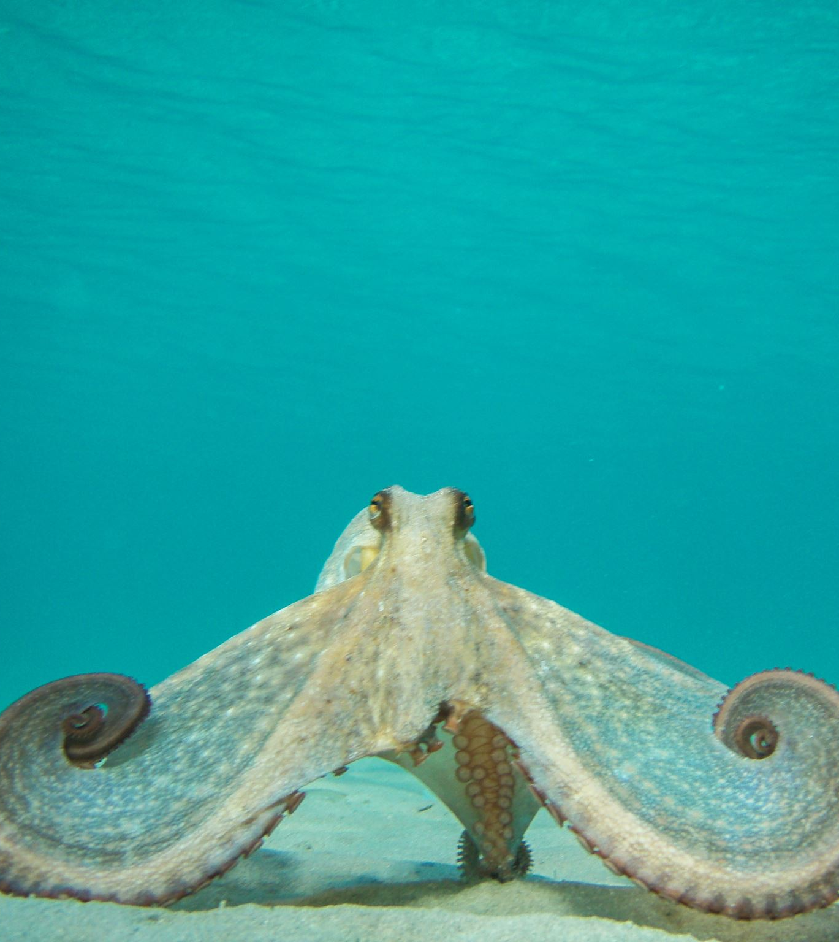
2 THINK
Where there is no justice, it is dangerous to be right." — Francisco de Quevedo
The United Nations (UN) system of human rights protection is like a giant legal octopus, spreading its tentacles into every corner of the globe. Its ambition is grand: to uphold human dignity, protect fundamental freedoms, and ensure that no government can get away with human rights violations without at least being called out.
It’s like an international karaoke night where everyone’s singing, but no one knows the lyrics. Yet somehow, we’re all convinced we’re harmonizing.

Slide 6
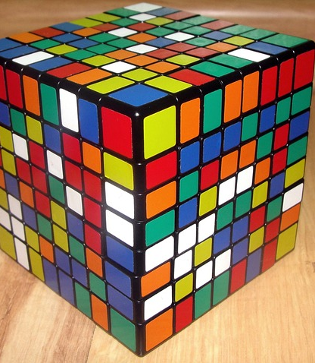
The UN System of Human Rights Protection
The UN, born from the ashes of World War II, aims to prevent history’s worst chapters from repeating themselves. Yet, while the ambition is noble, the reality sometimes resembles a bureaucratic treasure hunt. You might find a powerful resolution... buried under 300 pages of committee reports.
Functions: Setting international standards, monitoring compliance, addressing violations, and promoting human rights education.
Please, note. Trying to navigate the UN’s human rights system feels like solving a Rubik’s Cube while blindfolded—every turn seems promising, but you’re never quite sure how it’s all supposed to fit together.

Slide 7
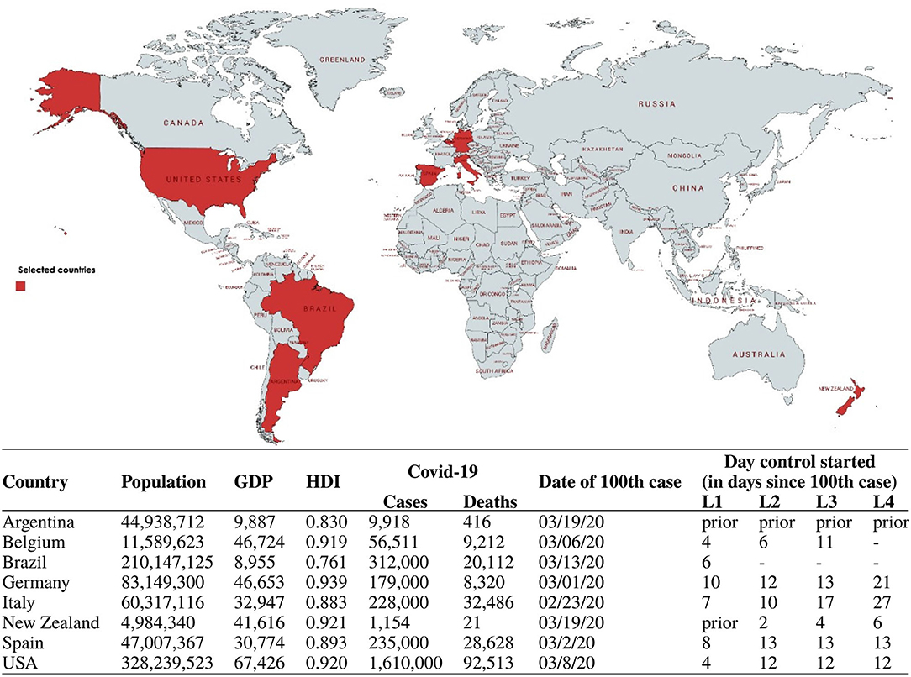

Functions of the UN System
The world breaks everyone, but some are stronger at the broken places.
Key Functions
Think of it as a teacher grading homework—if countries don’t do their assignments, they might get called out during parent-teacher night!
Promotion : Educating governments and citizens about their rights.
Protection : Investigating violations and advocating for justice.
Monitoring : Ensuring compliance with international standards.
Это изображение, автор: Неизвестный автор, лицензия: CC BY
Это изображение, автор: Неизвестный автор, лицензия: CC BY-SA-NC

Slide 8
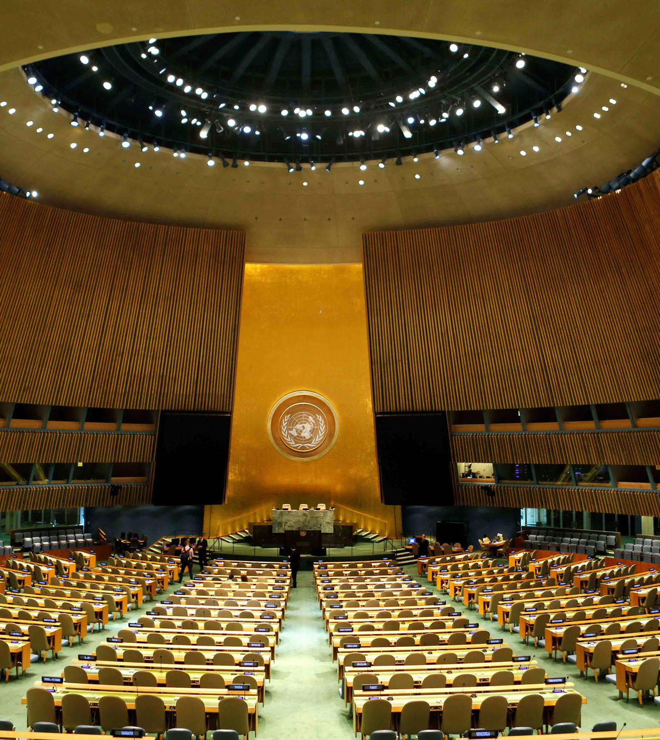
UN Charter Bodies
General Assembly: The global parliament where everyone gets to speak but nobody actually listens. It’s democracy in its purest form—chaotic, loud, and occasionally productive.
Security Council: Where five countries decide who gets peace and who doesn’t. Permanent members act like bouncers at an exclusive club, and if they don’t like you, you’re not getting in.
Economic and Social Council (ECOSOC): Tackles global socioeconomic issues with the speed and efficiency of a sleepy tortoise—important work, but painfully slow.
International Court of Justice: A fancy courtroom where states air their grievances, but rarely leave feeling satisfied.
Это изображение, автор: Неизвестный автор, лицензия: CC BY-NC

Slide 9
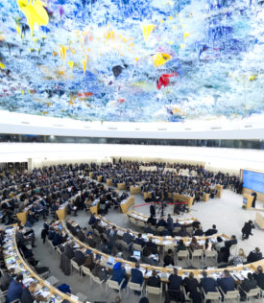
UN Treaty Bodies
These are like specialized doctors diagnosing human rights ailments in member states. Unfortunately, their prescriptions often get lost in transit or ignored entirely.
Examples:
  Human Rights Committee: Ensures civil and political rights—because governments sometimes forget these matter.
  Committee on Economic, Social and Cultural Rights: Advocates for basic human decency, like not starving your citizens.
  Committee on the Elimination of Discrimination against Women: Asking why women are still fighting for basic respect in 2025.
Treaty bodies are like personal trainers—you know you need them, but it’s easier to just keep eating junk and pretending you’ll start next Monday.
Это изображение, автор: Неизвестный автор, лицензия: CC BY-SA-NC

Slide 10
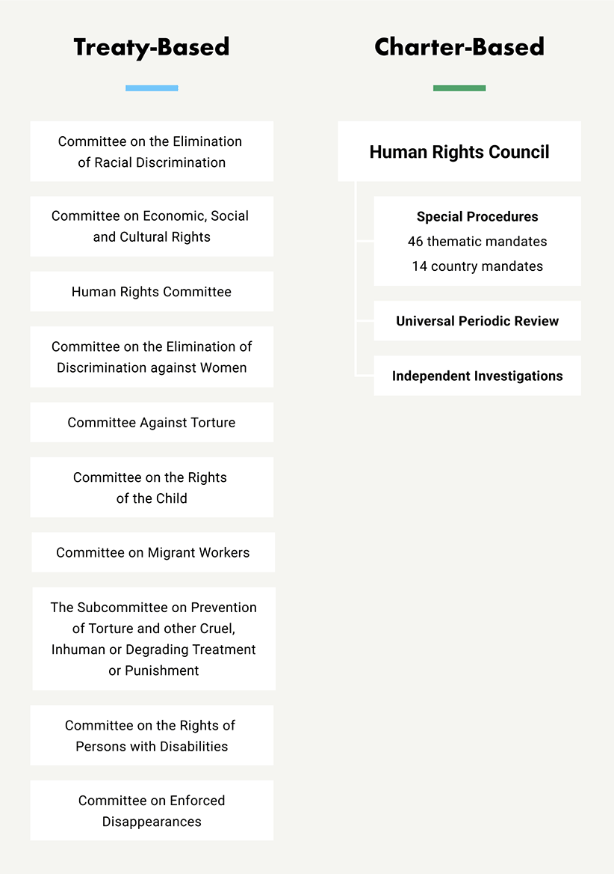
"When life gives you lemons, create two overlapping systems."

Slide 11
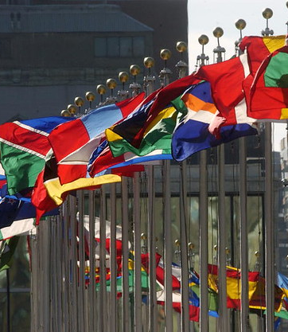
UN Charter Bodies vs. Treaty Bodies
Charter Bodies:
Established directly under the UN Charter (e.g., Security Council, Human Rights Council).
Focus on broader peacekeeping and conflict resolution.
Treaty Bodies:
Created to monitor compliance with specific treaties (e.g., ICCPR, CEDAW).
More specialized; think of them as subject-matter experts.
Question:
Why do we need both? Isn’t one set of watchdogs enough? Or are humans just too complicated?
Это изображение, автор: Неизвестный автор, лицензия: CC BY-NC-ND

Slide 12
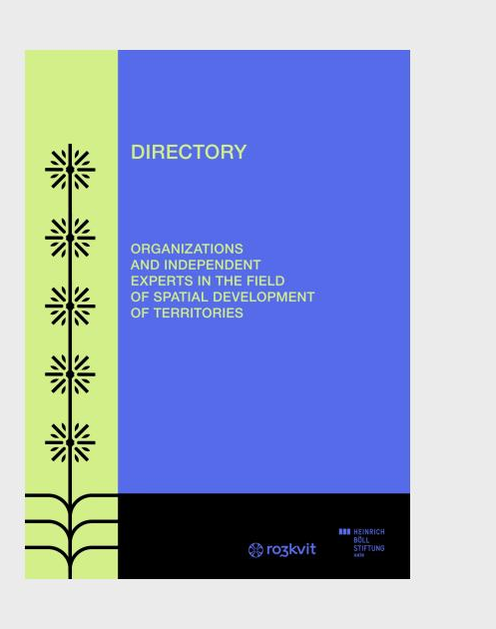
UN Special Procedures and Investigative Bodies
Independent experts with very specific mandates, like human rights detectives. They investigate and advise, often while dodging government hostility and budget cuts.
Sometimes they feel like Don Quixote tilting at windmills, bravely proclaiming injustices that most of the world prefers to ignore.
If UN Special Procedures were superheroes, their superpower would be writing urgent letters that no one reads.
Это изображение, автор: Неизвестный автор, лицензия: CC BY-NC-ND

Slide 13
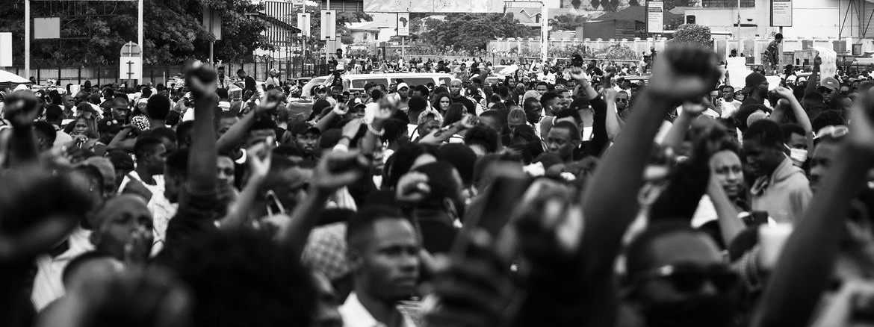
Case Study:
In 2020, a UN Special Rapporteur investigated police brutality in Nigeria following #EndSARS protests. Their findings highlighted systemic failures and sparked global outrage. While the report didn’t fix everything, it shone a spotlight on abuses that might otherwise have gone unnoticed.
https://news.un.org/en/story/2020/11/1076752

Slide 14

The UN Human Rights Council
Overview:
A Geneva-based body responsible for strengthening the promotion and protection of human rights worldwide.
The HRC is the global watchdog—only sometimes it’s more of a lapdog, depending on who’s feeding it.
Composed of 47 member states, including some with questionable human rights records—because who better to teach justice than those with personal experience in bending it?

Slide 15

Deeper Dive
For law students, the HRC presents a fascinating paradox. On one hand, it fosters dialogue and accountability; on the other, its composition raises ethical questions. Critics liken it to hiring a babysitter who doesn’t follow rules themselves. Yet defenders argue exclusion risks alienating key players, undermining legitimacy.
Case Study:
In 2021, the HRC condemned China for its treatment of Uyghur Muslims, sparking diplomatic tensions. Despite pushback, the resolution marked a rare instance of collective action against a major power.
https://www.hrw.org/news/2021/10/21/global-condemnation-chinese-government-abuses-xinjiang

Slide 16
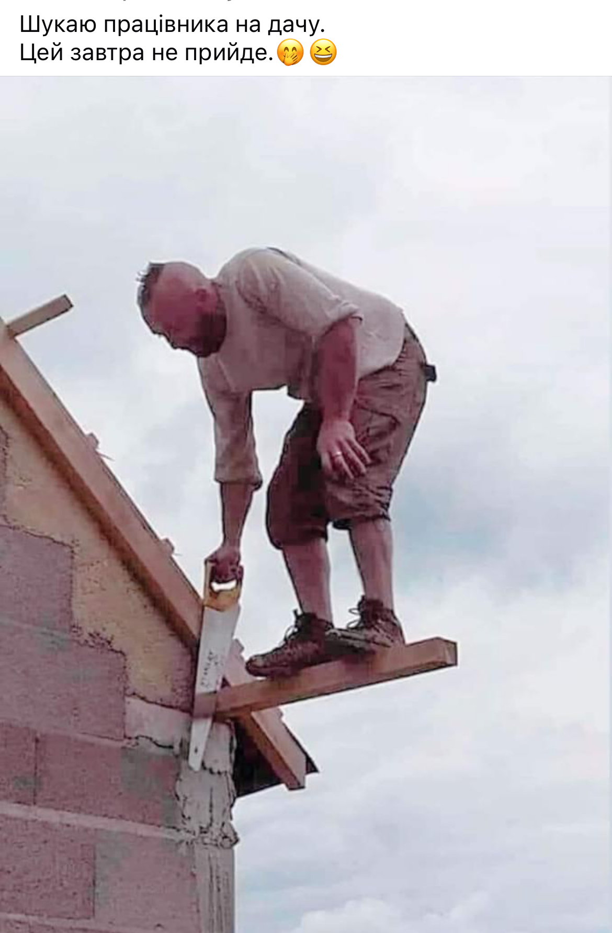
Universal Periodic Review (UPR)
What Is It?
Universal Periodic Review (UPR): A giant group therapy session where every state gets to hear what’s wrong with them—whether they want to or not.
A unique process where all UN member states review each other’s human rights records every 4.5 years.
Peer pressure at its finest!
Imagine if your friends reviewed your behavior every few years—it would either inspire change or lead to awkward silences.
Case Study:
During its UPR in 2018, Saudi Arabia faced criticism for women’s rights violations. Following this, reforms allowed women to drive—a small step toward progress.

Slide 17

Comparing UN Systems with ECHR
European Court of Human Rights (ECHR):
The UN system is like a diplomatic ballroom dance, while the ECHR is more of a gritty street fight where rights are defended case by case.
Regional counterpart to the UN system, focusing specifically on Europe.
Allows individuals to file complaints after exhausting national remedies.
Think on
Is regionalism better suited for addressing localized problems? Or should we stick to one big happy family?

Slide 18
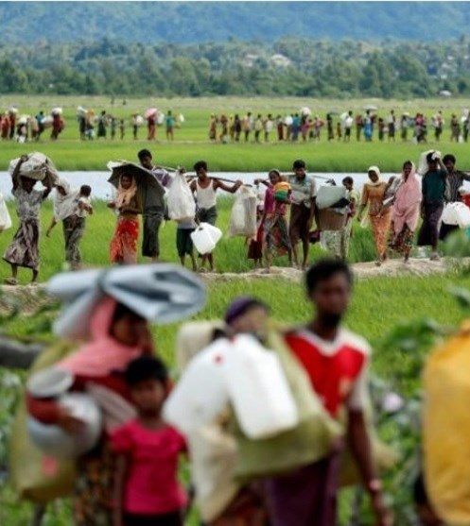
Case Study – Rohingya Crisis
The best way to find yourself is to lose yourself in the service of others." – Mahatma Gandhi
Background:
Myanmar’s military crackdown led to mass displacement of Rohingya Muslims.
UN bodies condemned atrocities but struggled to enforce action due to geopolitical complexities.
If solving human rights crises were easy, there’d be no need for lawyers—or diplomats, for that matter!
https://www.icj-cij.org/case/178
Это изображение, автор: Неизвестный автор, лицензия: CC BY

Slide 19

Challenges Facing the UN HR System
Common Criticisms:
Lack of enforcement power.
Political bias among member states.
Overlap between different mechanisms.
To think:
Can an organization without teeth truly protect human rights? Or is diplomacy just another form of lip service?

Slide 20

Success Stories
"The world is a fine place and worth fighting for."
Hemingway
Examples of Impact:
Abolition of apartheid in South Africa.
Decriminalization of homosexuality in India thanks to advocacy from UN treaty bodies.
Positive Spin:
Despite flaws, the UN system has achieved remarkable victories. Progress may be slow, but it’s steady!
Это изображение, автор: Неизвестный автор, лицензия: CC BY-NC

Slide 21
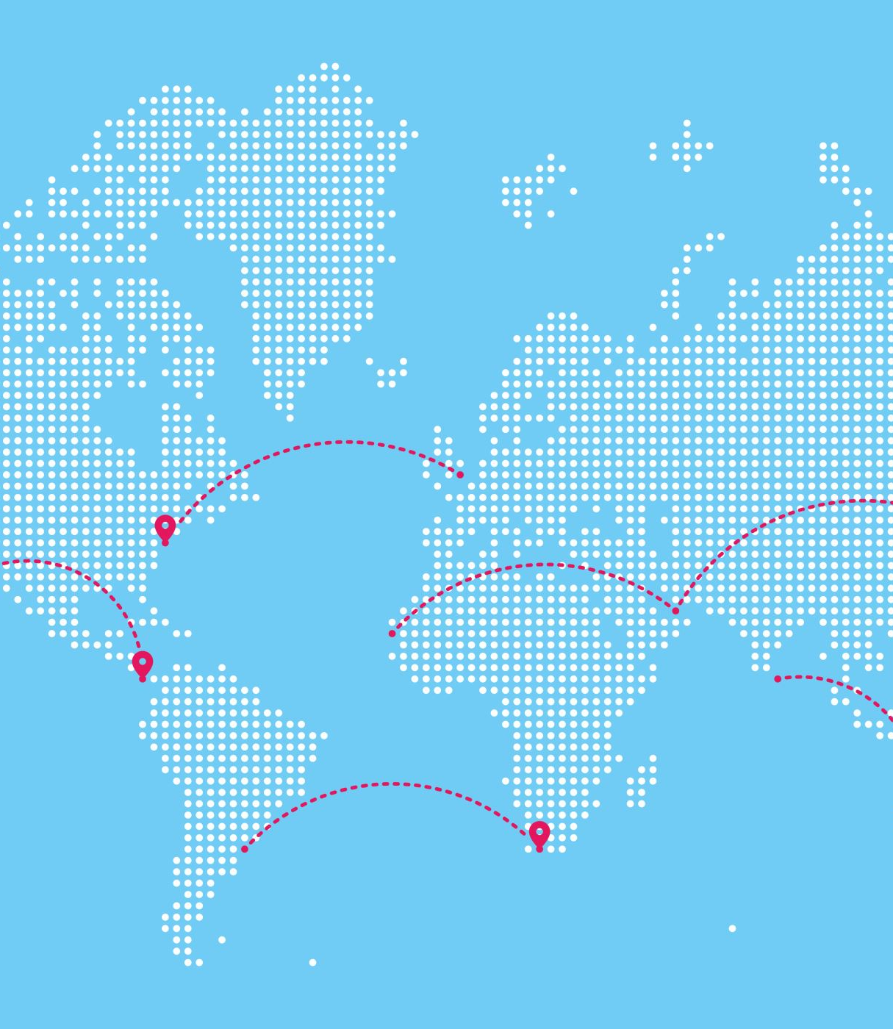
Perceptions of the UN HR Protection Mechanism
Over 87% of respondents believe global cooperation is vital to deal with today’s challenges, and that the pandemic has made international cooperation more urgent.
Seventy-five years after its founding, six in 10 respondents believe the UN has made the world a better place. Looking to the future, 74% see the UN as “essential” in tackling the challenges.
However, respondents want the UN to change and innovate: to be more inclusive of the diversity of actors in the 21st century, and to become more transparent, accountable and effective.

Slide 22
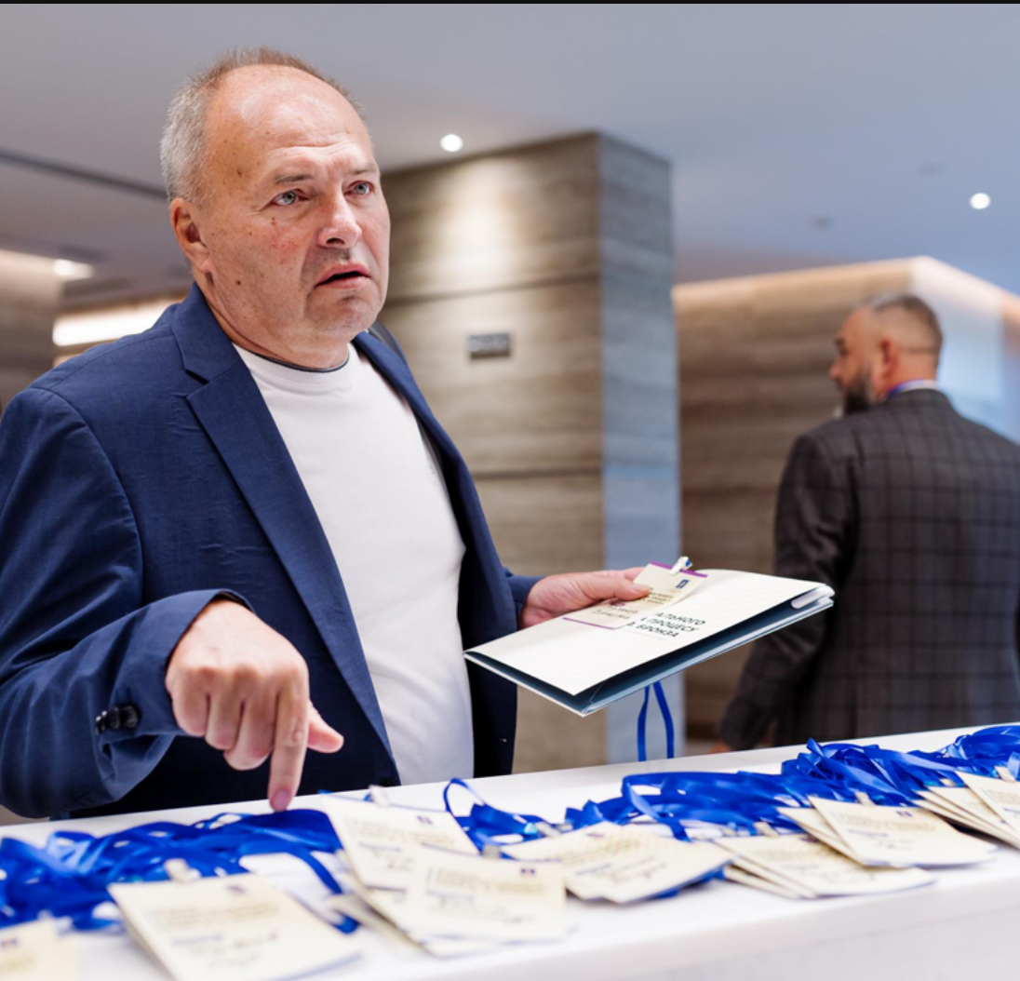
Thank U!
Viacheslav TULIAKOV © 2025
mail: Viacheslav.Tuliakov@esic.university

