Slide 1


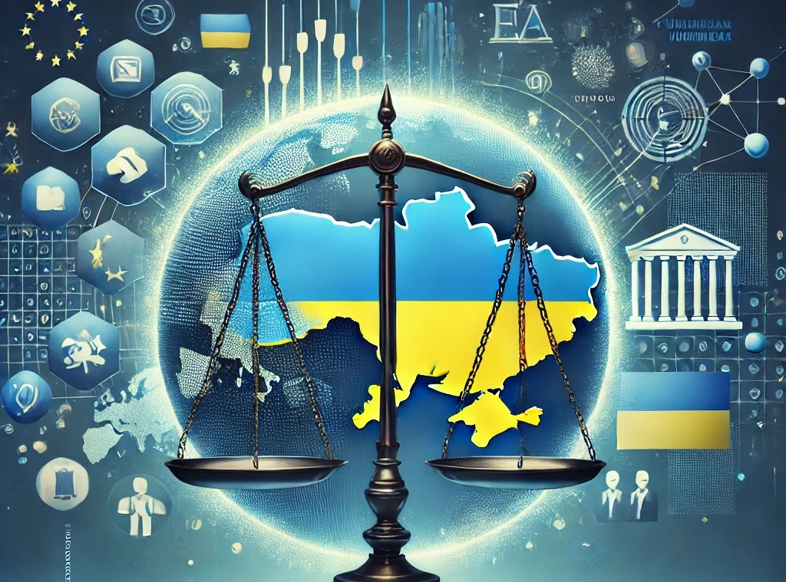
Unit 1-2. HR regulation and legal justification
Prof. Viacheslav (SLAVA) TULIAKOV
Viacheslav.Tuliakov@esic.university

Slide 2
Regulation and legal justification
The relevance of Human Rights: legal justification.
Notions on Law and protection of Human Rights
Human Rights’ generations.
Relationship between international and national dimensions.
Spanish relationship between Human Rights and Fundamental Rights.
CASE STUDY (ECHR Judgements ANALYSIS)

Slide 3


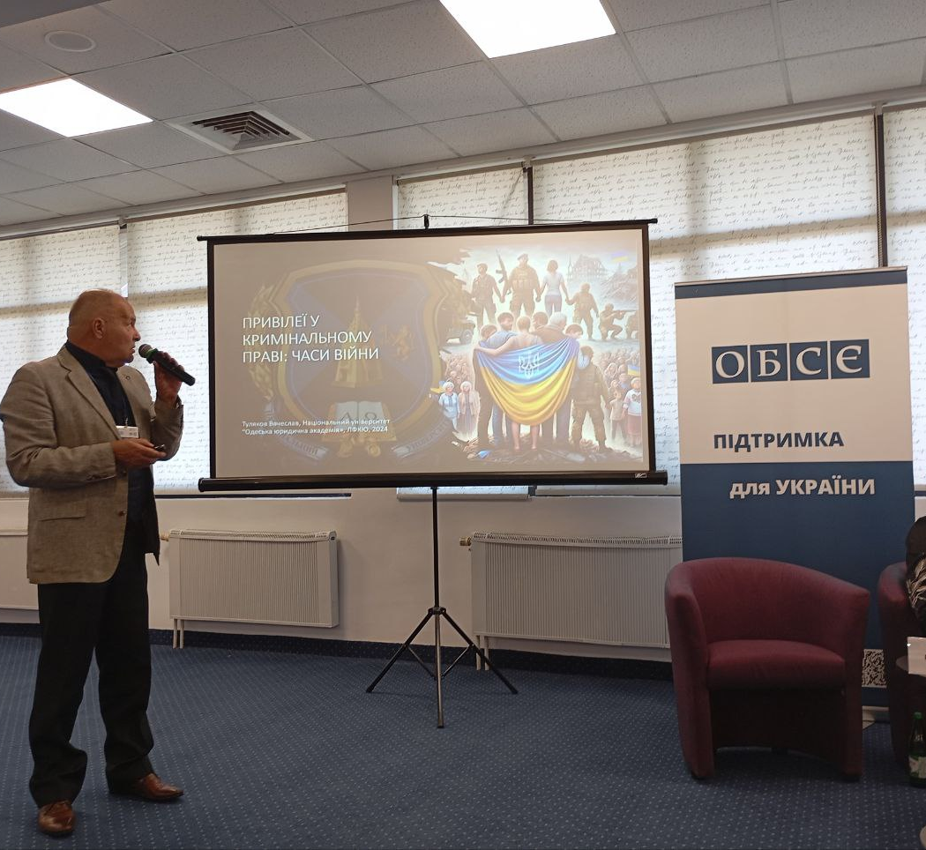
EQUAL VS DOMINATE
"Human rights are rights inherent to all human beings, regardless of race, sex, nationality, ethnicity, language, religion, or any other status." (United Nations, https://www.un.org/en/global-issues/human-rights)

Slide 4

NEWS FROM THE WEST
US to again withdraw from the UN Human Rights Council, stop UNRWA funding
https://www.politico.com/news/2025/02/03/us-withdraw-un-human-rights-council-trump-00202100
a young woman from Donetsk, having endured violence since childhood, expressed her desire for justice: "i was born with a sense of injustice but also with hope for the future. my faith gives me strength to carry on." addressing the pope, she added, "we want peace - a just and lasting peace that will allow us to return to our homes and dreams. we believe that good is stronger than evil."
Pope to Ukrainian youth: 'Be patriots, reject war, forgive’ https://www.vaticannews.va/en/pope/news/2025-02/pope-francis-ukraine-young-people-dialogue-war-forgiveness.html

Slide 5

PREAMBLE
Whereas recognition of the inherent dignity and of the equal and inalienable rights of all members of the human family is the foundation of freedom, justice and peace in the world,
Whereas disregard and contempt for human rights have resulted in barbarous acts which have outraged the conscience of mankind, and the advent of a world in which human beings shall enjoy freedom of speech and belief and freedom from fear and want has been proclaimed as the highest aspiration of the common people,
Whereas it is essential, if man is not to be compelled to have recourse, as a last resort, to rebellion against tyranny and oppression, that human rights should be protected by the rule of law,
Whereas it is essential to promote the development of friendly relations between nations,
Whereas the peoples of the United Nations have in the Charter reaffirmed their faith in fundamental human rights, in the dignity and worth of the human person and in the equal rights of men and women and have determined to promote social progress and better standards of life in larger freedom,
Whereas Member States have pledged themselves to achieve, in co-operation with the United Nations, the promotion of universal respect for and observance of human rights and fundamental freedoms,
Whereas a common understanding of these rights and freedoms is of the greatest importance for the full realization of this pledge,
Now, therefore, The General Assembly,
Proclaims this Universal Declaration of Human Rights as a common standard of achievement for all peoples and all nations
https://www.un.org/en/about-us/universal-declaration-of-human-rights
https://www.youtube.com/watch?v=h-bYMQRT9ik&t=3s

Slide 6

a common standard of achievement
The Universal Declaration of Human Rights (UDHR) serves as a foundational document for human rights protection worldwide. Though not legally binding, it has influenced numerous national constitutions and international treaties.
"The UDHR is a common standard of achievement for all peoples and all nations." (United Nations, https://www.un.org/en/about-us/universal-declaration-of-human-rights)

Slide 7

The Relevance of Human Rights: Legal Justification
Human rights are legally justified through:
International treaties such as the International Covenant on Civil and Political Rights (ICCPR) and the International Covenant on Economic, Social and Cultural Rights (ICESCR).
National constitutions that incorporate human rights protections.
Judicial decisions that interpret and apply human rights standards.
Customary international law, which recognizes certain human rights as universally binding.
Q&A Discussion:
Can you think of a recent case where Human Rights were violated? How was it addressed legally?
How do Human Rights contribute to global peace and security?

Slide 8
Notions on Law and Protection of Human Rights
Human Rights Law: A body of international and national laws that protect fundamental freedoms.
Enforcement mechanisms: Courts (e.g., European Court of Human Rights), human rights committees, and monitoring bodies.
State obligations: To respect, protect, and fulfill human rights.
Q&A Discussion:
What challenges exist in enforcing Human Rights at the national level?
How can indivisibility be applied to address poverty and inequality?

Slide 9

Human Rights’ Generations https://youtu.be/tPEhUPxPy1Y?si=8nsyD_kIefn4bb0p
Human rights are commonly categorized into three generations:
First Generation (Civil and Political Rights): Right to life, freedom of speech, fair trial.
Second Generation (Economic, Social, and Cultural Rights): Right to education, healthcare, and work.
Third Generation (Collective Rights): Right to development, peace, and a clean environment.
Q&A Discussion:
Which generation of Human Rights do you think is most important today? Why?
How do third-generation rights address global challenges like climate change?

Slide 10
ECHR & THE WORLD
29 March 2023, the first case (Association of Senior Women for Climate Protection and Others v. Switzerland, no. 53600/20 https://hudoc.echr.coe.int/eng?i=002-13212 ) concerning the health impact of extreme heat caused by climate change. The lawsuit was filed with the ECHR by the Zurich-based KlimaSeniorinnen, a non-governmental association that uniting pensioners with an average age of 73 years. In their lawsuit, they claim ‘the detrimental impact of climate change on human life and health’ and claim that the negative consequences of climate change directly lead to violations of a number of fundamentalrights and freedoms enshrined in the Convention for the Protection of Human Rights and Fundamental Freedoms
Duarte Agostinho and Others v. Portugal and 32 Other States, no. 39371/20 - https://hudoc.echr.coe.int/eng?i=001-233261) In their view, the governments of these countries have failed to agree on emission reductions fast enough to limit global warming to 1.5°C. They argue that their right to life is threatened by the negative impacts of climate change, such as forest fires, and that the failure to combat climate change discriminates against young people who will be most affected.
https://climatecasechart.com

Slide 11
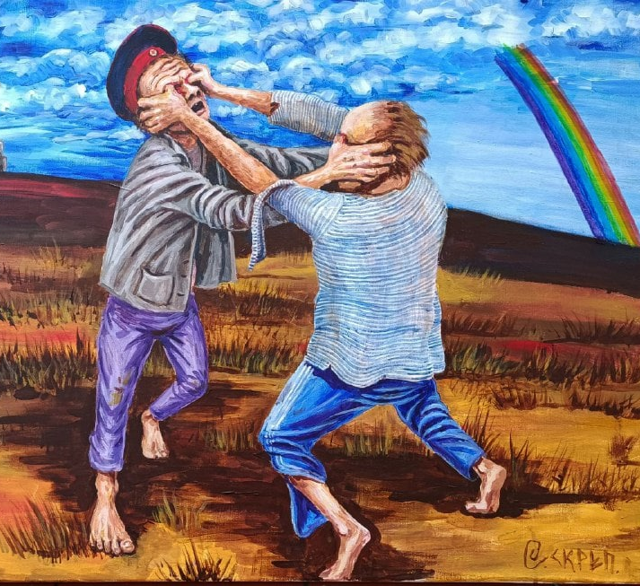
Relationship Between International and National Dimensions
Fragmentation vs INTERNATIONALIZATION
International treaties influence domestic laws.
Countries incorporate international human rights standards into national constitutions.
Judicial decisions enforce human rights principles across different legal systems

Slide 12
EC STEPS 2 JUSTICE
Council of Europe Secretary General Alain Berset has welcomed a major step forward in Brussels today towards creating a Special Tribunal for the Crime of Aggression against Ukraine, within the framework of the Council of Europe. The 13th meeting of the international Core Group* of senior legal experts laid down the legal foundations of the Special Tribunal, including key elements of its statute.

Slide 13

Spanish Relationship Between Human Rights and Fundamental Rights
Spain recognizes human rights through its Constitution of 1978, which distinguishes between:
Fundamental Rights (Derechos Fundamentales): Enforceable by courts (e.g., right to life, freedom of expression).
Other Constitutional Rights: Economic, social, and cultural rights.
"Fundamental rights and freedoms are directly applicable and binding on all public authorities."(Spanish Constitution, Article 53, https://www.boe.es/legislacion/constitucion.php)

Slide 14

Let’s Discuss!
Regulation and Legal Justification: Why is it important to have a legal basis for human rights?
  Answer: A legal basis ensures that human rights are enforceable and respected by governments and institutions.
Protection Mechanisms: What role do courts play in protecting human rights?
  Answer: Courts interpret and apply human rights laws, providing remedies for violations.
Generations of Rights: Can you give an example of a third-generation right and explain its importance?
  Answer: The right to a healthy environment ensures sustainable development and protects future generations.
National vs. International Law: How do national courts use international human rights treaties in their decisions?
  Answer: National courts often cite international treaties to strengthen their rulings and promote consistency with global standards.

Slide 15
“Human rights education is much more than a lesson in schools or a theme for a day; it is a process to equip people with the tools they need to live lives of security and dignity” -Kofi Annan
How does the Universal Declaration of Human Rights influence modern legal systems?
Why is it important to differentiate between fundamental rights and other human rights in national law?
How do international human rights treaties shape national legislation?
Should national laws take precedence over international human rights obligations?
How does Spain's legal system integrate international human rights standards?

Slide 16
CASE STUDY
Case: López Ostra v. Spain (1994) – ECHR.
01
Facts: A waste treatment plant caused severe pollution, affecting the applicant’s health and home.
Violation: Article 8 (Right to Private and Family Life).
Link: López Ostra v. Spain Judgment https://hudoc.echr.coe.int/eng?i=001-57905
How did the ECHR balance the right to private life with economic development?
02
What lessons can Spain learn from this case to improve environmental protection?
05
Having regard to the foregoing, and despite the margin of appreciation left to the respondent State, the Court considers that the State did not succeed in striking a fair balance between the interest of the town’s economic well-being - that of having a waste-treatment plant - and the applicant’s effective enjoyment of her right to respect for her home and her private and family life.
03
There has accordingly been a violation of Article 8
04
.

Slide 17

References
Universal Declaration of Human Rights
https://hudoc.echr.coe.int/eng?i=001-57905
https://hudoc.echr.coe.int

Slide 18
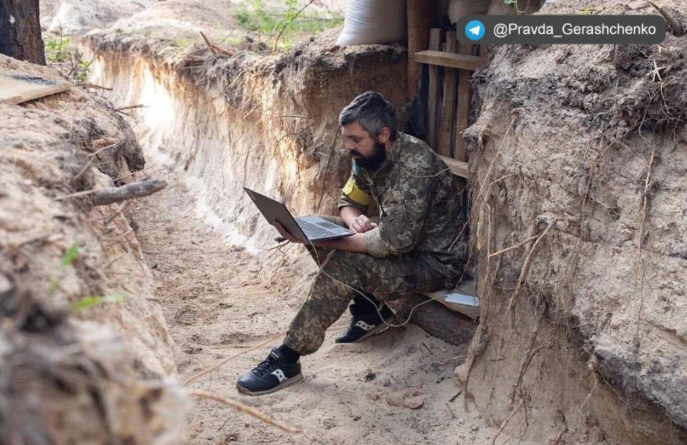
What Have We Learned?
Human rights are legally justified through international treaties and national laws.
Protection mechanisms involve collaboration between international bodies and domestic institutions.
Understanding the generations of rights helps us appreciate the evolution of human rights law.
Spain’s Constitution reflects a strong commitment to fundamental rights, aligned with international standards.
Viacheslav TULIAKOV © 2025
mail: Viacheslav.Tuliakov@esic.university

