Slide 1



TRENDS IN CRIMINAL POLICY: (DIS)
ORGANISING THE CHAOS
Lecture 6\8.
CRIME VS STATE, STATE VS CRIME
Dr.Hab. Prof. Viacheslav Tuliakov
NU ‘Odesa law academy’ (Ukraine), University of Castilla La-Mancha (Spain)

Slide 2
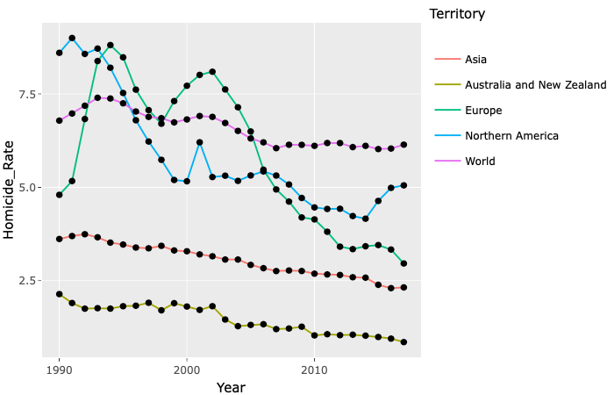
"A Better Path Forward for Criminal Justice»
United Nations Office on Drugs and Crime (UNODC) - https://dataunodc.un.org/GSH_app UNODC, Global Study on Homicide 2019
There are now more offenders serving life sentences than the total number of individuals who were held in all U.S prisons in the early 1970s.
In the Conclusion to “A better path forward for criminal justice,” our experts recommend a strategic pause to gather data that will help us understand why criminal activity has gone up in recent months and inform both immediate responses as well as longer-term initiatives.
https://www.brookings.edu/multi-chapter-report/a-better-path-forward-for-criminal-justice/

Slide 3
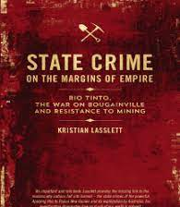
CRIME VS STATE, STATE VS CRIME
International approach (East or West)
European approach
Local developments
Concept of Public law code
Victim-oriented CC???

Slide 4
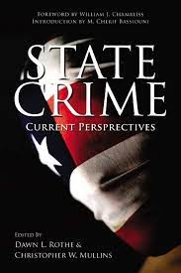
United against… Towards new system of security
Sanctions vs cash flows
Compensate and restitute not prosecute
And sun always rises (how to prosecute criminals effectively)
Diversification vs flexibility

Slide 5
1990 – 2000 \\ 1+1 =
10 % - Judgement
5% - legal service and attorney assistance
5 % – execution order
time and inflation (up to 400 %)
VS
10 %– Сriminal authorities

Slide 6
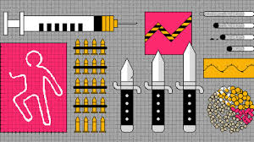
New Code – New Tendencies – New Policies
From Organized crime notion to Criminalizing leaders of criminal impact
According to the National Police of Ukraine, in 2020, there were over 31,000 registered crimes related to organized crime, including extortion, drug trafficking, and human trafficking. This represents a decrease from the previous year when there were over 35,000 such crimes registered.
Statistics show that in the first half of 2022, compared to the same period in 2021, the number of registered particularly serious criminal offenses in Ukraine increased by 77%; crimes committed with firearms increased by 80%, and intentional homicides by almost 7%
last year there were more than 6,000 attempts to cross the border illegally from Ukraine, which was a record for several decades. The number of attempts to smuggle weapons out of Ukraine also increased.

Slide 7
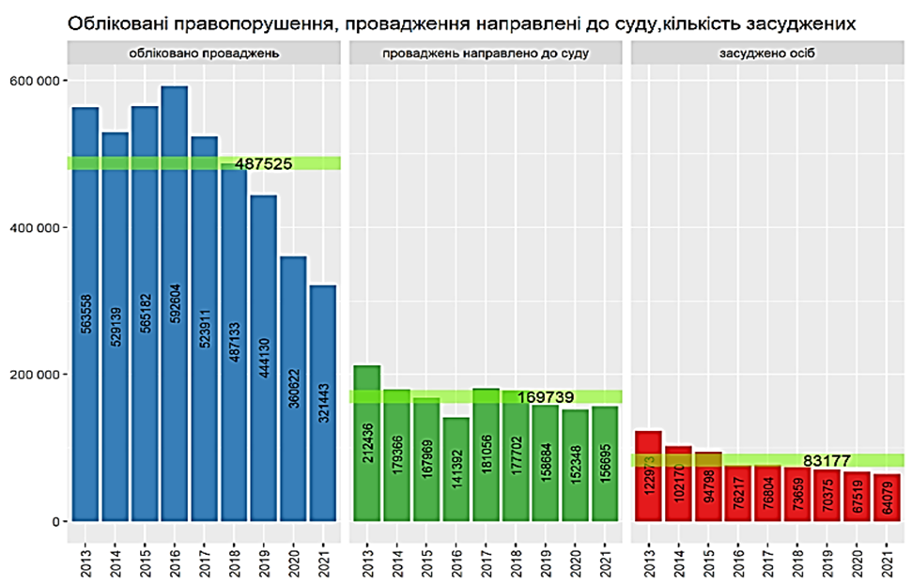
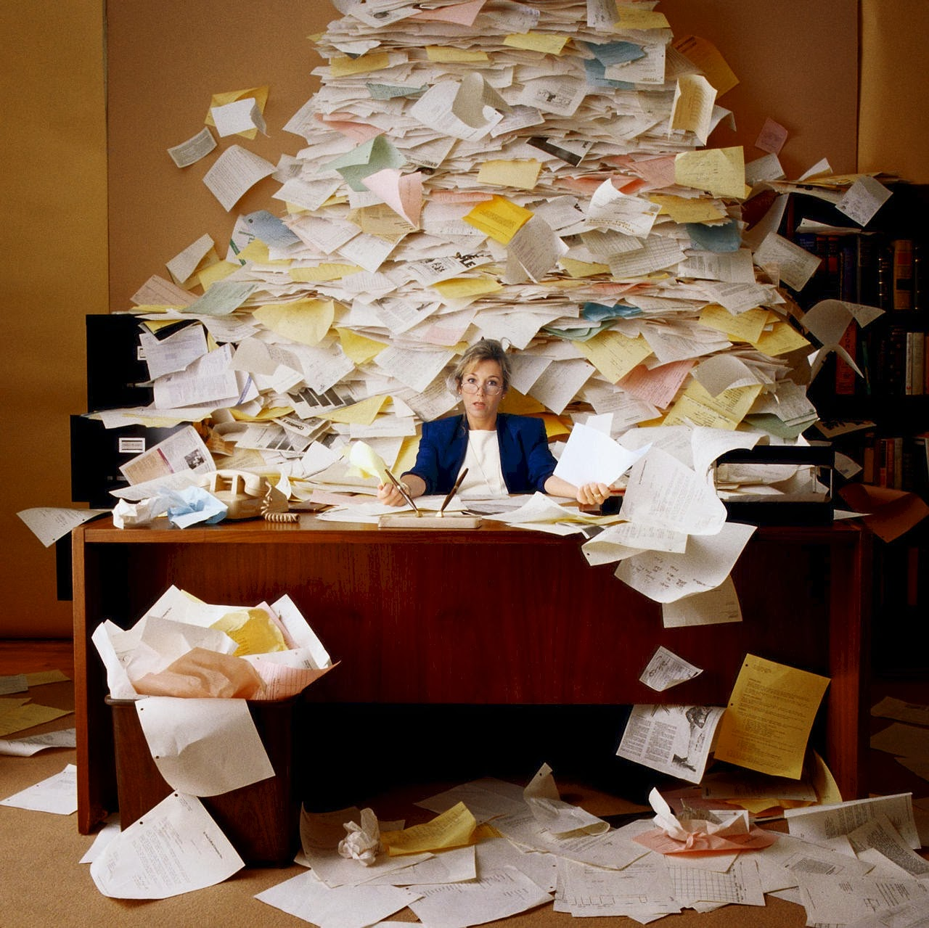
Novelization of criminal law regulation is a thankless task

Slide 8
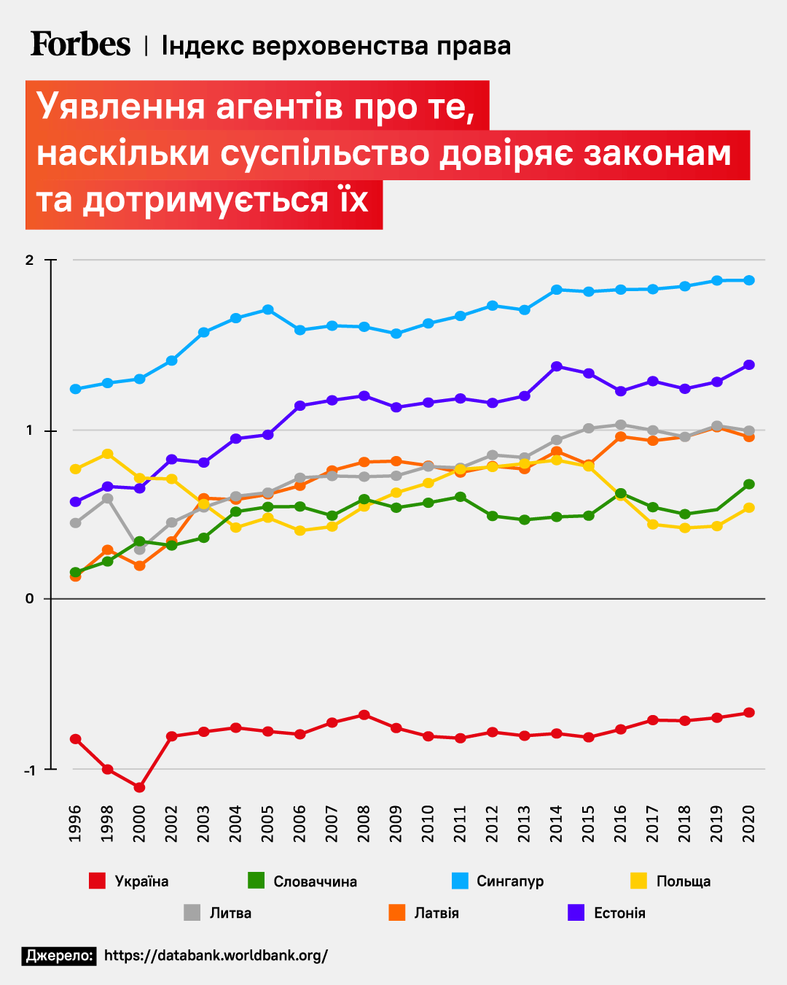
The force of law or the right of force
the principle of inevitability of responsibility ("The thief must go to jail") is compensated by the usefulness of criminal activity, the formation of two types of understanding of criminal law prohibitions –
positive (for everyone) a
valuable (for oneself).
Moreover, the second type of criminal law understanding is based on the ideology of usefulness, admissibility of criminal activity (criminal practices) among the family, a group of "friends" and "relatives", and is visualized through family and corporate contacts, in the network environment.

Slide 9
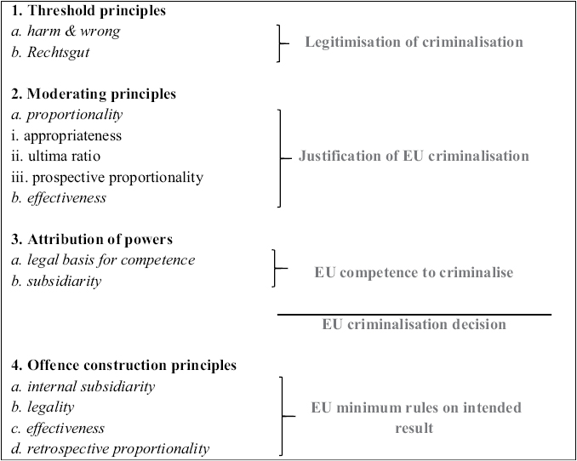
PRINCIPLES OF CRIMINALISASTION EU

Slide 10
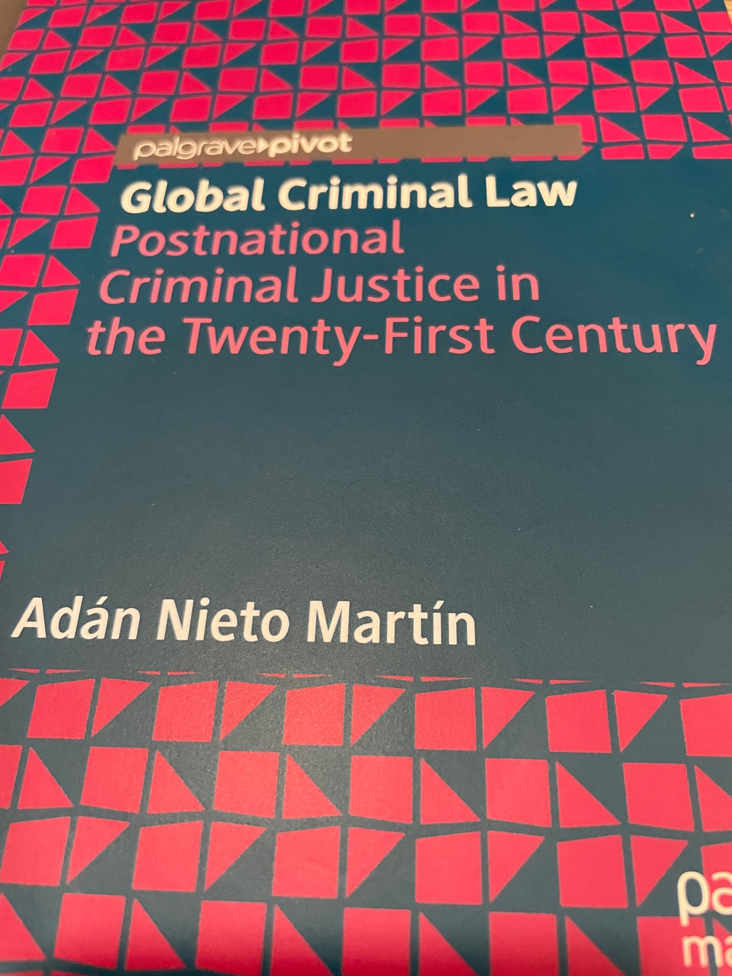
There are reasons to predict a decline in public trust in social institutions that enforce the law and, as a result, an increase in crime.
Karchevsky M., COMBATING CRIME IN UKRAINE IN DATA SCIENCE FORMAT https://karchevskiy.org/2022/10/28/art1/
Therefore, there is no single rule to regulate conflicts of Jurisdiction.
Adan Nieto (2022)

Slide 11
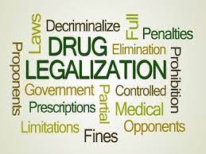
the theory of randomnes
the theory of randomness should be incorporated into the concept of decriminalization theory, since it is "random" norms that contribute to legal chaos, lead to uncertainty in criminal policy and ineffectiveness of criminal prohibitions.
- the presence of imbalances in the criminal-legal regulation (excessive criminalization),
- Internal, external, constitutional and international inconsistency of the criminal law norm with the provisions of other legal acts,
- Uniqueness of the regulation of an excessively narrow issue,
- instability of law enforcement practice (sporadic application),

Slide 12
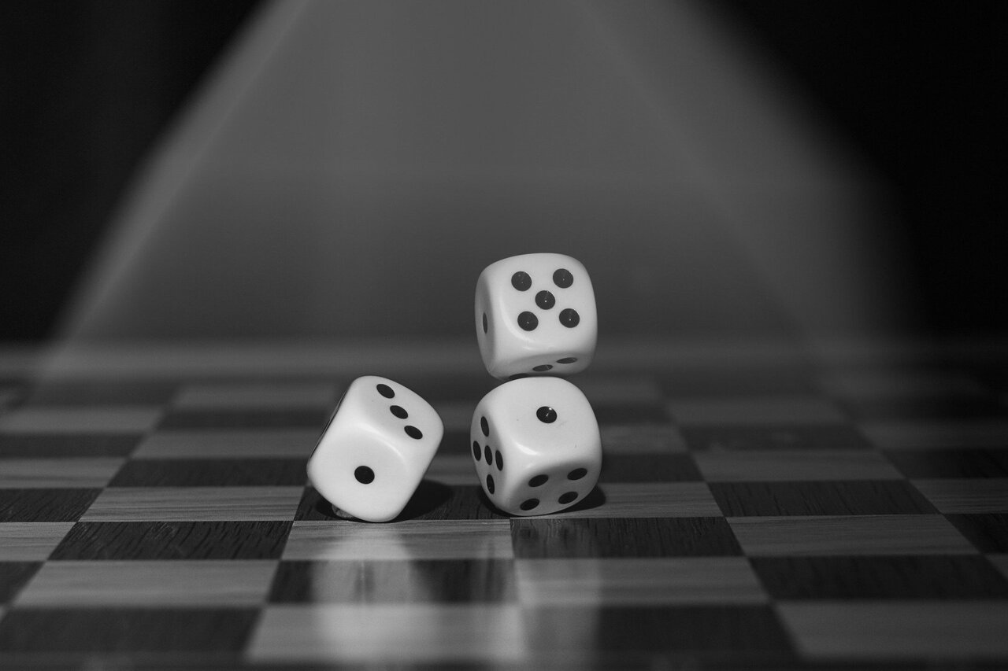
relativity of the prohibition
hidden decriminalization through the implementation of blanket and reference norms),
apparent randomness of existence of the norm, caused to life by the current changes in political processes.
economic and social inefficiency of stigmatization
impossibility of using preventive mechanisms

Slide 13

Feedback
We need new order but with our own paths…
I would criminalise to smoke in children
criminalise, specifically the squatters' law that defends the occupant against the owner of the occupied property
animal abuse
criminal policies of immigrants.
gender violence
Harsh penalties
Avoiding liberalism

Slide 14

Criminal law is therefore still considered to belong to political liberalism, and consequently we can find among one of its main tasks that of defending the citizen, criminal or not, from the possible abuses and arbitrariness of the punitive state. From this we can extract the protection of the delinquent, or of the potential or presumed delinquent citizen, on the same level as the protection of those essential presuppositions for coexistence just mentioned.
Finally, we will clearly support policies based on education, economic welfare, equality and all those social policies that improve society. We will not forget criminal law, but we will try to make it the exception and not the practice in criminal policy.

Slide 15
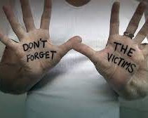
Recommendation CM/Rec(2023)2 of the Committee of Ministers to member States on rights, services and support for victims of crime
(Adopted by the Committee of Ministers on 15 March 2023 at the 1460th meeting of the Ministers' Deputies)
Crime is a wrong against society and a violation of the individual rights of victims. Member States should, therefore, ensure the effective recognition of, and respect for, the rights of victims with regard to their human rights; they should, in particular, respect the liberty, security, property, dignity, private and family life of victims and recognise the negative effects of crime on victims.
Right to understand and be understood
Right to reimbursement of expenses and return of property
Right to protection

Slide 16
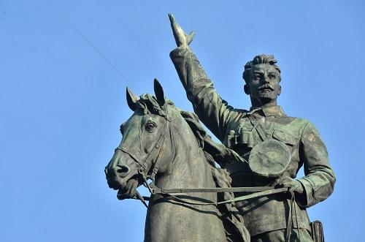
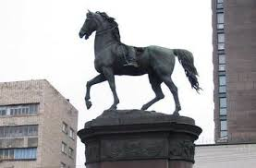
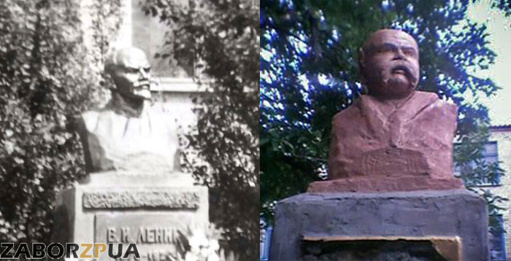
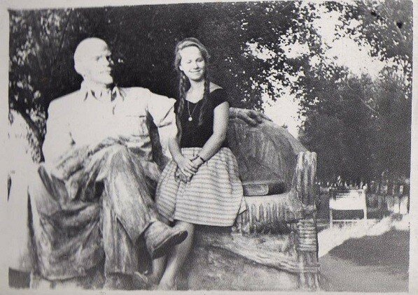
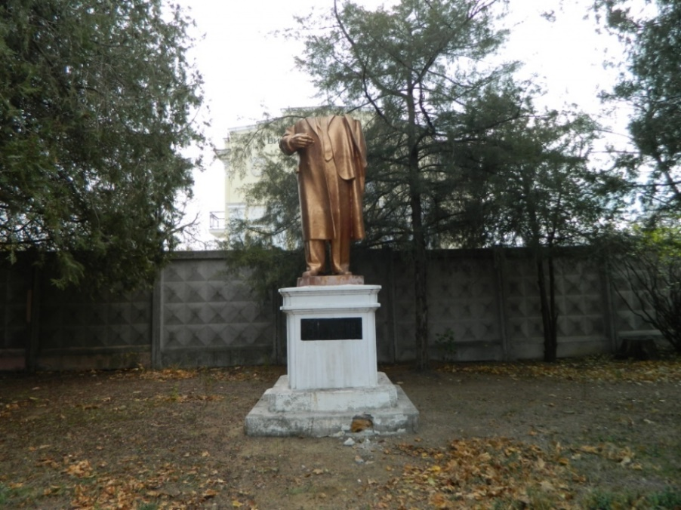
INNOVATION OR INTERPRETATION
"A wise legislator does not begin by making laws, but by examining their suitability to a given society».
J-J Rousseau

Slide 17
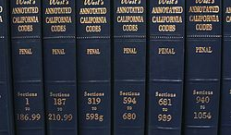
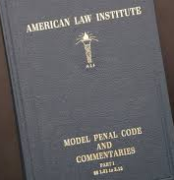

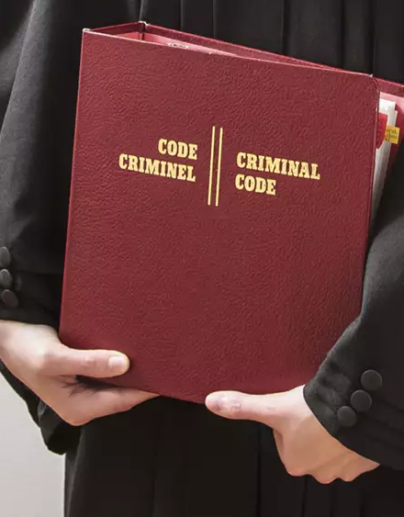

THANK YOU
Viacheslav Tuliakov
( C )2023

