Slide 1



The study of Human Rights and the promotion of the principles embedded in the human rights doctrine (Unit 1-1)
Prof. Viacheslav (SLAVA) TULIAKOV
Viacheslav.Tuliakov@esic.university

Slide 2
What are Human Rights
Human Rights are the basic rights and freedoms that belong to every person in the world, from birth until death.
Derechos Humanos son los derechos básicos y libertades que pertenecen a todas las personas en el mundo, desde el nacimiento hasta la muerte.
Why are they important?
They protect us from harm, ensure fairness, and allow us to live with dignity.
Nos protegen del daño, aseguran la justicia y nos permiten vivir con dignidad.

Slide 3


The study of human rights and the promotion of the values of human rights doctrine
Introduction
Human Rights are the basic rights and freedoms that belong to every person in the world. They are protected by law, and their purpose is to ensure dignity, freedom, and equality for all people.
"Human rights are rights inherent to all human beings, regardless of race, sex, nationality, ethnicity, language, religion, or any other status." (United Nations, https://www.un.org/en/global-issues/human-rights)

Slide 4
Definition and Characteristics
Human rights have specific characteristics that make them universal and essential for a just society:
Los Derechos Humanos son universales, inalienables, indivisibles e interdependientes.
Characteristics:
  Universal: They apply to everyone, everywhere.
  Inalienable: They cannot be taken away.
  No pueden ser quitados.
  Indivisible: All rights are equally important.
  Todos los derechos son igualmente importantes.
  Interdependent: The improvement of one right supports others.
  La mejora de un derecho apoya a los demás.
Protected by law – Governments must respect, protect, and fulfill human rights.

Slide 5

JUSTICE SHOULD BE EQUAL
The understanding of human rights also implies the idea of justice and fairness for the entire society.
Human rights must be respected on an equal basis by everyone, without any form of discrimination.

Slide 6
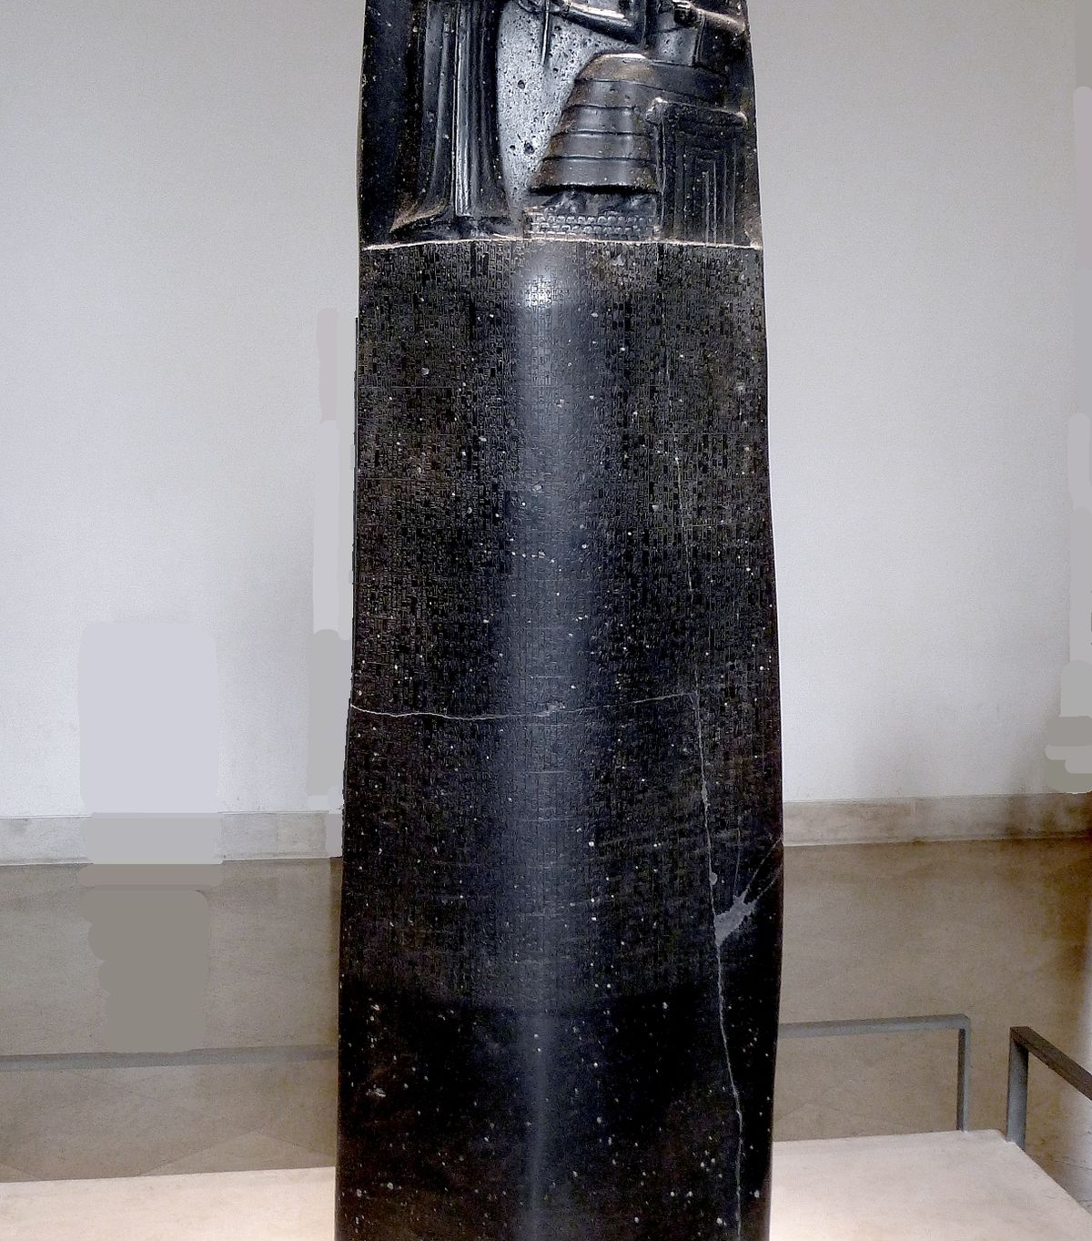
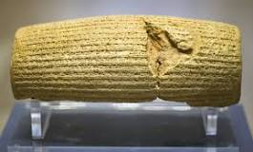
Ancient Roots:
  Code of Hammurabi (1754 BCE): One of the earliest written laws.
  https://avalon.law.yale.edu/ancient/hamframe.asp#:~:text=143.,144.
  Cyrus Cylinder (539 BCE): First charter of human rights by Cyrus the Great. If anyone oppresses others, should it happen, I will take his/her right back and penalize the oppressors. Today I declare Freedom of Religion. All are free to choose any religion, live in all regions and take up any job provided that they never violate other's rights.
  https://www.humanrights.com/what-are-human-rights/brief-history/

Slide 7

History: Origin and Evolution of Human Rights Protection
The idea of human rights has evolved over time. Some important milestones include:
Magna Carta (1215) – Limited the power of the king and gave some rights to the people.
Bill of Rights (1689, England) – Strengthened individual rights.
Declaration of Independence (1776, USA) – Stated that all men are created equal.
French Declaration of the Rights of Man and Citizen (1789) – Focused on liberty, property, and security.
Universal Declaration of Human Rights (1948, UN) – A global agreement on fundamental human rights.

Slide 8

Construction of Human Rights in the Modern State
Many philosophers helped to shape modern human rights. Their ideas influenced governments and laws

Slide 9
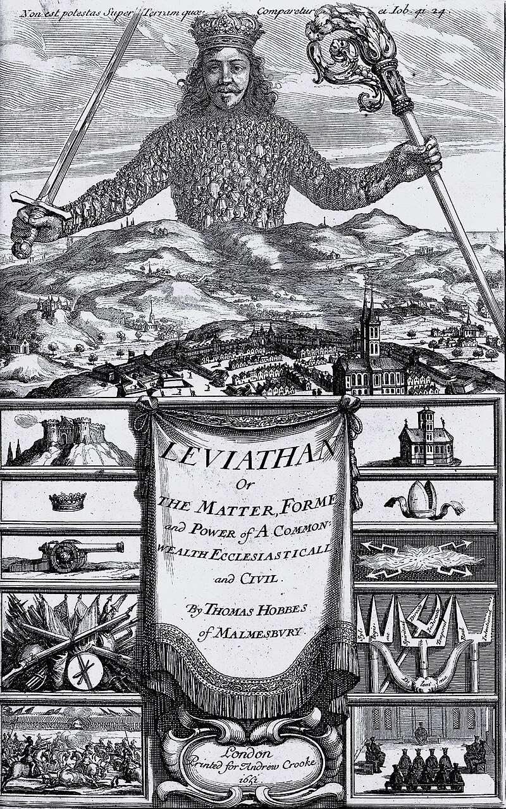
Thomas Hobbes and Absolutism
homas Hobbes (1588–1679):
Hobbes believed that without government, life would be "nasty, brutish, and short" (Leviathan, 1651). He argued that people need a strong ruler to maintain order.
  Believed in a strong central authority to prevent chaos.
  Wrote “Leviathan” (1651).
  Quote:
  “Without government, life would be solitary, poor, nasty, brutish, and short.”
  “Sin gobierno, la vida sería solitaria, pobre, desagradable, brutal y corta.”
Absolutism:
  The ruler has absolute power to maintain order.
  El gobernante tiene poder absoluto para mantener el orden.
"The only way to erect a common power... is to confer all their power and strength upon one man."(Hobbes, Leviathan, https://plato.stanford.edu/entries/hobbes-moral/)

Slide 10
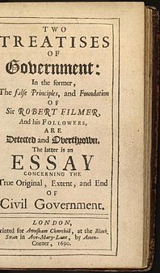
John Locke and Liberalism
John Locke (1632–1704):
believed in natural rights – life, liberty, and property.
He said the government must protect these rights, and if it fails, the people have the right to change it.
Wrote “Two Treatises of Government” (1689).
Quote:
“All mankind... being all equal and independent, no one ought to harm another in his life, health, liberty, or possessions.”
“Todos los seres humanos... siendo iguales e independientes, nadie debe dañar a otro en su vida, salud, libertad o posesiones.”
Liberalism:
Emphasizes individual freedom and limited government.
Enfatiza la libertad individual y el gobierno limitado.
(Locke, Two Treatises of Government, https://www.earlymoderntexts.com/authors/locke)

Slide 11

Immanuel Kant and the Enlightenment
Kant emphasized human dignity and moral duty.
He believed people should be treated as ends, not means.
"Act only according to that maxim whereby you can at the same time will that it should become a universal law." (Kant, Groundwork of the Metaphysics of Morals, https://plato.stanford.edu/entries/kant-moral/)
  Focused on reason, morality, and human dignity.
  Wrote “Groundwork of the Metaphysics of Morals” (1785).
  Quote:
  “Act in such a way that you treat humanity, whether in your own person or in the person of any other, never merely as a means to an end, but always at the same time as an end.”
  “Actúa de tal manera que trates a la humanidad, tanto en tu persona como en la de cualquier otro, siempre como un fin y nunca solo como un medio.”
Enlightenment:
  A movement that emphasized reason, science, and human rights.
  Un movimiento que enfatizó la razón, la ciencia y los derechos humanos.

Slide 12

Jean-Jacques Rousseau and the Social Contract
Rousseau argued that society should be based on a contract between people and their government. The people give up some freedom in exchange for protection and justice.
"Man is born free, and everywhere he is in chains." (Rousseau, The Social Contract, https://plato.stanford.edu/entries/rousseau/) “El hombre nace libre, pero en todas partes está encadenado.”
Social Contract:
  An agreement between the people and the government to protect rights.
  Un acuerdo entre el pueblo y el gobierno para proteger los derechos.

Slide 13
Human Rights are universal and protect everyone.
They have evolved over time, influenced by philosophers like Hobbes, Locke, Kant, and Rousseau.
Modern states are built on the ideas of freedom, equality, and justice.
Final Quote:
“Human rights are not a privilege granted by the few; they are a liberty entitled to all.”

Slide 14

Questions and Discussion
What do you think is the most important Human Right?
How can we protect Human Rights in our daily lives?
Activity Time
Let’s Practice TILL NEXT MEETING! Discuss in group: Which philosopher’s idea do you think is most important for protecting human rights today?
Why?
Bonus Question:
Can you name three human rights from the UDHR?

Slide 15
NEXT STEP
Unit 1-2. Regulation and legal justification
.
The relevance of Human Rights: legal justification.
Notions on Law and protection of Human Rights
Human Rights’ generations.
Relationship between international and national dimensions.
Spanish relationship between Human Rights and Fundamental Rights.
CASE STUDY (ECHR Judgements ANALYSIS)

Slide 16

References
Universal Declaration of Human Rights
Hobbes, T. (1651). Leviathan.
Locke, J. (1689). Two Treatises of Government.
Kant, I. (1785). Groundwork of the Metaphysics of Morals.
Rousseau, J.-J. (1762). The Social Contract.
https://www.humanrights.com/what-are-human-rights/brief-history/

Slide 17
Viacheslav TULIAKOV © 2025
mail: Viacheslav.Tuliakov@esic.university

