Slide 1
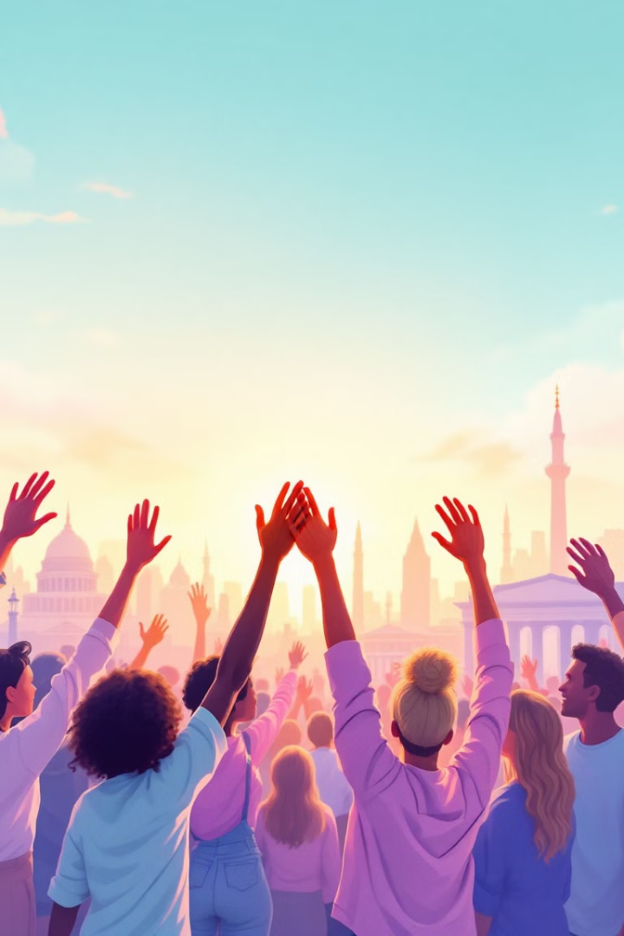

Human Rights: Foundations, Systems, and Protections
Welcome to the Human Rights course for the Bachelor's Degree in Law. This comprehensive exploration will guide you through the theoretical foundations, historical development, and practical applications of human rights across global systems.
Throughout this course, we'll examine the philosophical underpinnings of human rights, analyze international and regional protection mechanisms, and investigate how these rights impact vulnerable populations. You'll gain a thorough understanding of both theoretical frameworks and practical implementation of human rights principles.
by Dr.Tuliakov Viacheslav

Slide 2

Foundations and Evolution of Human Rights
1
Origins
Human rights emerged from philosophical debates about the relationship between individuals and the state. These rights are universal, inalienable, and interdependent, forming the foundation of human dignity and freedom.
2
Philosophical Development
The construction of human rights in the modern state was influenced by key thinkers: Hobbes and Absolutism, Locke and Liberalism, Kant and the Enlightenment, and Rousseau with his Social Contract Agreement.
3
Modern Evolution
The contemporary understanding of human rights has evolved through historical struggles, revolutionary movements, and international cooperation, establishing a framework that continues to develop today.

Slide 3



Legal Framework and Generations
Third Generation
1
Collective rights
Second Generation
2
Economic, social, cultural rights
First Generation
3
Civil and political rights
Human rights require legal justification to ensure their protection and enforcement. The relationship between international and national dimensions creates a complex legal framework where rights are recognized and protected at multiple levels.
In Spain, there exists a specific relationship between human rights and fundamental rights, with constitutional protections reinforcing international commitments. This multi-layered approach ensures comprehensive protection while respecting national sovereignty.

Slide 4
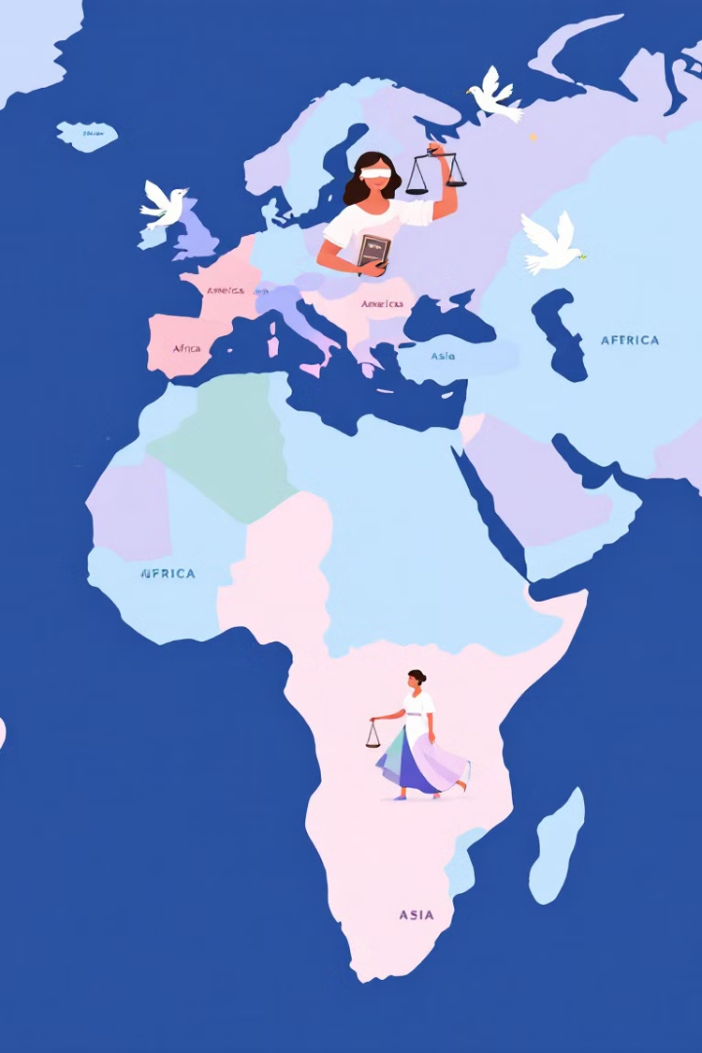
Regional Human Rights Systems
European System
The European system centers around the European Court of Human Rights, providing a robust judicial mechanism for citizens of member states to seek redress for human rights violations after exhausting domestic remedies.
Inter-American System
This system operates through the Inter-American Commission on Human Rights and the Inter-American Court of Human Rights, protecting rights across North, Central, and South America.
African System
The African Commission on Human and People's Rights and the African Court of Human and Peoples' Rights address violations while respecting cultural contexts unique to the continent.
Asian Protection
While lacking a comprehensive regional system, various sub-regional mechanisms and national institutions work to protect human rights throughout Asia.

Slide 5




Universal System of Human Rights Protection
Universal Framework
The universal system provides global standards and monitoring mechanisms that transcend regional boundaries, establishing minimum protections for all human beings regardless of nationality.
Key Institutions
Central to this system are the Human Rights Council and the United Nations High Commissioner for Human Rights, which monitor compliance and promote human rights globally.
International Justice
The International Criminal Court prosecutes genocide, crimes against humanity, and war crimes when national courts are unwilling or unable to do so, while Universal Jurisdiction allows certain crimes to be prosecuted regardless of where they occurred.
Legal Frameworks
International Human Rights Law operates alongside International Humanitarian Law, with the former applying at all times and the latter specifically during armed conflicts.

Slide 6




Core International Human Rights Instruments
Major Covenants
Universal Declaration
The International Covenant on Civil and Political Rights and International Covenant on Economic, Social and Cultural Rights translate declaration principles into binding obligations.
The 1948 Universal Declaration of Human Rights forms the cornerstone of international human rights law.
1
2
Specialized Treaties
Implementation Status
4
Additional instruments address specific rights or protect particular groups, including conventions on torture, racial discrimination, and rights of children.
The effectiveness of these instruments depends on ratification status and state compliance with treaty obligations.
3
These core documents establish the fundamental framework for human rights protection globally, creating both moral standards and legal obligations for signatory states.

Slide 7





United Nations Human Rights System
Protection Functions
Special Procedures
Sustainable Development
The UN system serves as the primary global guardian of human rights, establishing standards, monitoring compliance, and responding to violations through various mechanisms and bodies.
Special Rapporteurs, Working Groups, and Investigative Bodies examine specific human rights issues or country situations, providing expert analysis and recommendations to the international community.
The UN has established clear links between human rights and the Sustainable Development Goals, recognizing that development must be rights-based to be truly sustainable and equitable.
Business Guidelines
UN Guidelines on Business and Human Rights establish standards for corporate responsibility, requiring businesses to respect human rights throughout their operations and supply chains.

Slide 8

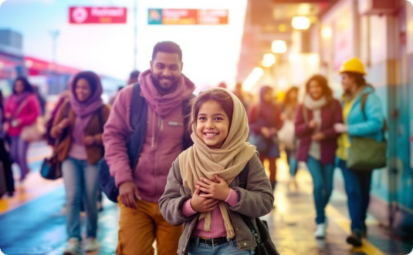
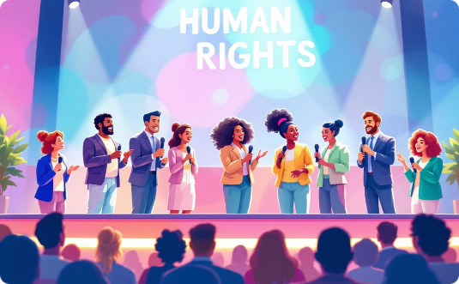
Vulnerable Groups and Access to Justice
Children's Rights
Refugees and Migrants
Other Vulnerable Groups
Children require special protection due to their vulnerability. International frameworks establish rights to education, protection from exploitation, and consideration of their best interests in all decisions affecting them.
Refugee law and migration frameworks protect those fleeing persecution or seeking better lives. These populations face unique challenges requiring specific human rights protections regardless of their legal status.
Women and girls, persons with disabilities, and LGBTI persons face distinct challenges requiring targeted protections. Civil society organizations and social media play crucial roles in advocating for these groups.

