Slide 1



TRENDS IN CRIMINAL POLICY: (DIS)
ORGANISING THE CHAOS
Lecture 3.
EUROPEAN CRIMINAL POLICY
(HOW TO LISBONIZE CRIMINALITY)
Dr.Hab. Prof. Viacheslav Tuliakov
NU ‘Odesa law academy’ (Ukraine), university of Castilla La Mancha (Spain)

Slide 2
International criminal policy
realized in ongoing conflict between globalization (unification of cl impact, universal rules) and fragmentation (ultima ratio, subsidiarity) processes based on HR prevalence.
Between globalization and fragmentation lies supranational regulation which unites non-united in synergy.

Slide 3


To learn
Supranational regulation in Criminal Law. Politics vs Policy
EU law and Manifesto on Criminal Policy. Holistic approach
EU approximation process (acquis, criminalization and penalization)
EU judicial practice in criminal matters
Infringement as regulative mechanism

Slide 4

To Know
Europeisation of criminal law. Processes and results
European Crimes. Concepts and dynamics
Principles of criminalization (EU criminal regulations)
Sanctions and/or confiscations
EU victims protection policy (New roadmap)

Slide 5

globalization and fragmentation of legislation
globalization and fragmentation of legislation in the context of defining sovereignties and ultima ratio are homeostatic processes that shape the balance of the criminal legal response of today.

Slide 6

Legality and subsidiarity in the context of
ultima ratio,
expediency
proportionality
are essential, if not the main elements of the procedure of elevation to aquis, taking into account the primacy of human rights and the rights of victims of crime.

Slide 7
VECTORS & PRINCIPLES
equality, legal certainty, proportionality, predictability, subsidiarity, legality as principles of criminal law and socio-legal foundations of criminal policy
1 vector of the primacy of human rights and safety of victims of criminal offenses,
2 complementarity of coercion and decent treatment,
3 compensation, restitution and rehabilitation, satisfaction, and guarantees of non-recurrence of harm to victims of criminal offenses,
4 public interests and requirements of crime prevention and control

Slide 8
The requirement of a legitimate purpose
The legislative powers of the EU in relation to criminal law issues should only be exercised in order to protect fundamental interests if:
(1)These interests can be derived from the primary legislation of the EU;
(2)The Constitutions of the Member States and the fundamental principles of the
EU Charter of Fundamentals Rights are not violated, and
(3)The activities in question could cause significant damage to society or indivi-
duals.
The requirement of a legitimate purpose can be derived from the European
principle of proportionality. European legislation can be regarded as legitimate and proportionate only if criminal law is used in order to safeguard the fundamental interests of its citizens.

Slide 9
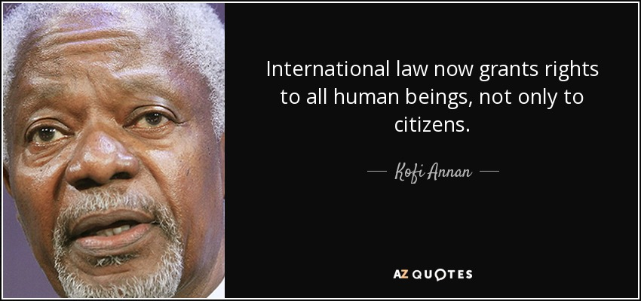

Slide 10
The ultima ratio principle
Since the European Union places the individual centre stage, the European legislator may only demand that an act be criminalised if it is necessary in order to protect a fundamental interest, and if all other measures have proved insufficient to safeguard that interest.
Only if this condition has been satisfied can criminal law be regarded as ‘necessary’ and in conformance with the European principle of proportionality.
This is also due to the fact that criminal sanctions entail social stigmatisation which significantly affects citizens’ rights, including the rights expressed in the EU Charter of Fundamental Rights.
Furthermore, excessive use of criminal sanctions and criminalisation leads to a decline in the efficiency of criminal law.

Slide 11
The principle of guilt (mens rea)
European legislation requiring the Member States to criminalise certain acts must be based, without exception, on the principle of individual guilt (the principle of nulla poena sine culpa).
This requirement captures not only the fact that criminalisation should be used solely against conduct which is seriously prejudicial to society, but that it should also be regarded as a guarantee that human dignity will be respected by criminal law. Furthermore, the requirement of individual guilt is in conformity with the generally accepted perception of guilt within the system of administrative sanctions in the EU and can also be inferred from the presumption of innocence in Art. 48 (1) of the EU Charter of Fundamental Rights.

Slide 12
The lex certa requirement
In European legal reasoning the principle of legal certainty requires that an individual shall be able to predict actions that will make him criminally liable.
This means that criminal law provisions must define offences in a strict and unambiguous way. This implies above all utmost clarity: the normative proscriptions should be understandable ‘on their own’.
Under any circumstances the norm must ensure that (1) the objective and (2) the subjective prerequisites for criminal liability as well as (3) sanctions which could be imposed if an offence is committed are foreseeable.
Although the subsidiary character of harmonisation work at EU-level necessarily requires that the Member states have a certain degree of latitude in drafting the details of implementation (which implies a certain degree of vagueness as regards European legislative acts), the lex certa requirement is nevertheless important for EU legal instruments as a general principle of law and a fundamental element of any criminal law system based on the rule of law.

Slide 13
The requirements of non-retroactivity and the principle of lex mitior
Punitive provisions must not apply retroactively to the detriment of the citizen involved. This principle, which also helps to reinforce foreseeability, implies that the European legislator cannot request that the Member States harmonise their criminal law by introducing criminal legislation to apply retroactively.
An exception to this basic rule is permissible only when retroactive criminal law benefits the offender. Criminal law provisions which come into effect after the commission of the offence, but which are favourable to the offender (i.e. according to which the act is not punishable or carries a lighter penalty than before), can be applied as a basis for conviction without violating the requirement of non-retro- activity (the lexmitior principle). The lex mitior principle is recognized by all Member States, but there are differences as regards its normative status, especially as regards the question of whether the principle is of constitutional character.

Slide 14
Nulla poena sine lege parlamentaria (no penalty without a law)
Since criminal law is the most intrusive of the institutions of state control, in a democratic society it must be justified by reference to as direct participation as possible by the people in the legislative process. To the extent that the EU does not have, or does not make use of a competence to make supranational criminal legislation, the competence to adopt criminal law provisions remains the preserve of the Member States (i.e. their national Parliaments).
Due to the fact that the European legislator can issue binding instruments which national Parliaments must comply with, constraints that impact on the freedom of national legislatures are placed on them.
This means that even instruments of harmonisation must be justifiable from the point of view of democracy. As far as European instruments limit the freedom of the national legislator, the harmonised criminal law provision cannot be justified on the grounds of democracy at the national level. This makes it necessary to strengthen democratic legitimacy at the European level by a more active role of the European Parliament in the Union’s legislative process.

Slide 15
The principle of subsidiarity
According to this principle the EU legislator may take action only on the condition that the goal pursued
(1) cannot be reached more effectively by measures taken at national level and
(2) due to its nature or scope can be better achieved at Community level. Accordingly, the national legislator will be given priority in relation to the
The principle of subsidiarity is of special importance in the area of criminal law, since criminal law is also a value system, and as such it is a component part of the ‘national identities’ of the Member states, which must be respected by the Union in accordance with Art. 4 (2) of the Treaty on European Union.

Slide 16
The principle of coherence
The invasive character of criminal law makes it especially important to ensure that every criminal law system is a coherent system. Such inherent coherence is a necessary condition if criminal law is to be able to reflect the values held to be important by society collectively and by individuals and their understanding of justice. Inner coherence is, furthermore, necessary in order to ensure acceptance of criminal law.
When enacting instruments which affect criminal law, the European legislator should pay special attention to the coherence of the national criminal law systems, which constitute part of the identities of the Member states, and which are protected under Article 4 (2) of the Treaty on European Union (vertical coherence).
This means, first and foremost, that the minimum-maximum penalties provided for in different EU instruments must not create a need for increasing the maximum penalties in a way which would conflict with the existing systems.
In addition, the European legislator must pay regard to the framework provided for in different EU- instruments (horizontal coherence, cf. Art. 11 (3) Treaty on European Union).

Slide 17

By its nature, the principle of subsidiarity is an express manifestation of the diversified character of the implementation of human rights guarantees at national level

Slide 18
The Manifesto on European Criminal Policy 2011
European legislation has only partly amounted to unacceptable or at least critical results. Although the line to unbearable consequences has not been crossed some alarming tendencies must be observed and not be ignored: criminal law must not be adopted without pursuing a legitimate
purpose; the principle of ultima ratio must not be neglected; the Member States must not be obliged to pass imprecise national criminal laws; the legislation must not answer every social problem with passing increasingly repressive acts and consider this as a value in itself.
These worrisome tendencies can also be perceived on a national level but are significantly amplified by European developments. If the entailed risks are not acknowledged in time, we fear to be confronted with criminal laws that contradict our fundamental principles.
https://www.europarl.europa.eu/document/activities/cont/201112/20111207ATT33475/20111207ATT33475EN.pdf

Slide 19
The algorithm for working out the approximation
analysis of the current EU criminal law at the supranational level,
the case law of the European Court of Justice,
European Commission directives,
procedures for bringing to justice for violation or non-compliance with EU law,
draft EГ Directives on criminal policy of criminalization and penalization of acts (substantive, procedural, procedural, penitentiary and preventive aspects),
European legislation of a non-criminal profile that requires additional protection of the

Slide 20
Euro-crimes (Art. 83(1) TFEU
Most of the framework decisions on substantive criminal law have now been repealed by directives based on Art. 83(1). They are as follows:
The 2011 Directive on preventing and combating trafficking in human beings and protecting its victims;
The 2011 Directive on combating the sexual abuse and sexual exploitation of children and child pornography;
The 2013 Cybercrime Directive;
The 2014 Directive on the protection of the euro against counterfeiting;
The 2017 Directive on terrorism;
The 2017 Drugs Directive;
The 2018 criminal anti-money laundering Directive
The 2019 non-cash counterfeiting Directive
This means that, of the ten Euro-crimes, seven have been addressed in specific directives.
While arms trafficking, corruption, and organised crime have not been the subject matter of dedicated directives (yet), they are referred to in the other directives (e.g., as predicate offences for money laundering)

Slide 21
Offences related to ensuring the effective implementation of EU policies (Art. 83(2) TFEU)
- determination of EU law with regard to specific provisions of EU treaties, regulations and directives in terms of the principle of subsidiarity (the level of mandatory implementation of a rule);
- Analyzing the relevant provisions of national criminal law and determining how they comply with EU law;
- assessing the level of approximation of the corpus delicti and the system of sanctions to EU law;
- determining the balance of interests in terms of consistency and coherence in the application of EU law with the need to respect the national sovereignty of EU Member States and their right to define and punish criminal offenses through interpretation or implementation of the legal provision
Opinion of Mr Advocate General Ruiz-Jarabo Colomer delivered on 12 September 2006.
Advocaten voor de Wereld VZW v Leden van de Ministerraad. Case C-303/05. URL: https://eur-lex.europa.eu/legal-content/EN/TXT/?uri=CELEX%3A62005CC0303

Slide 22
which EU policies require the use of criminal law
EU institutions need to make policy choices in terms of the use or non-use of criminal law (instead of other measures, such as administrative sanctions) as tools to enforce legislation
Already in 2011, the Commission issued specific guidance on this point in a Communication which outlined the principles that should guide EU criminal law legislation and the policy areas where it might be needed.
As is well known, the policies of the European Union are wide-ranging and cover such diverse areas as road transport, environmental protection, consumer protection, social policies, regulations for the financial sector, data protection, and the protection of the financial interests of the EU.
All of them require effective implementation but not necessarily through criminal sanctions. Certainly, criminal law can, as a last resort (ultima ratio), play an important role when other means of implementation have failed.
The development of an EU criminal policy on the basis of Art. 83(2) TFEU is therefore particularly sensitive and the need to introduce criminal measures must be demonstrated in a way that goes beyond the traditional scrutiny imposed by the principles of proportionality and subsidiarity. These considerations may explain why, to date, only two directives have been based on Art. 83(2): the 2014 Market Abuse Directive and the 2017 PIF Directive.

Slide 23
European Court of Justice
In November 2022, in the judgment of the in the case of Luxembourg's claim on the legality of public access to the registers of beneficial owners, which is provided for by the EU anti-money laundering directives, the Court ruled that the provision of public access to the identification and personal data of beneficial owners would violate the right to respect for private and family life, as well as the right to protection of personal data, which are enshrined in Articles 7 and 8 of the European Union Charter for the Protection of Human Rights and Fundamental Freedoms, respectively. Thus, Directive 2018/843 on the use of criminal law measures to combat money laundering was declared invalid insofar as it required that information on the beneficial owners of companies be publicly available. It is known that after this decision of the EU Court of Justice, EU states began to close state registers of beneficial owners of companies, which may undermine the effectiveness of the stated EU goals of preventing money laundering, but guarantees that interference with fundamental rights will be compensated.

Slide 24
Lisbonising the paths
Road transport, concerning, for instance, serious infringements of EU social, technical, safety, and market rules for professional transports;
Data protection, in cases of serious breaches of existing EU rules;
Customs rules on the approximation of customs offences and penalties;
Fisheries policy, in order to counter illegal, unreported, and unregulated fishing; and
Internal market policies to fight serious illegal practices, such as counterfeiting and corruption or undeclared conflicts of interest in the context of public procurement.
not all Euro-crimes have been defined in specific directives, either. Corruption and organised crime, in particular, would lend themselves to legislation at the Union level, because they are also already the subject of international conventions and have been referred to in Union legislation.

Slide 25

Commission President Ursula von der Leyen noted the EU should do all it can to prevent domestic violence, protect victims, and punish international offenders.

Slide 26
Strategy to protect victims
The main objective of the Strategy will be to ensure that all victims of crime can fully rely on their rights independently of where in the EU the crime took place. The Strategy will identify policy priorities These five key priorities which will constitute the backbone of the Strategy are: empowering victims of crime, strengthening cooperation and coordination, improving protection and support of the most vulnerable victims, facilitating victims’ access to compensation a nd working on the international dimension of victims’ rights. It is envisaged that each of the five key priorities will be addressed through a set of specific objectives

Slide 27
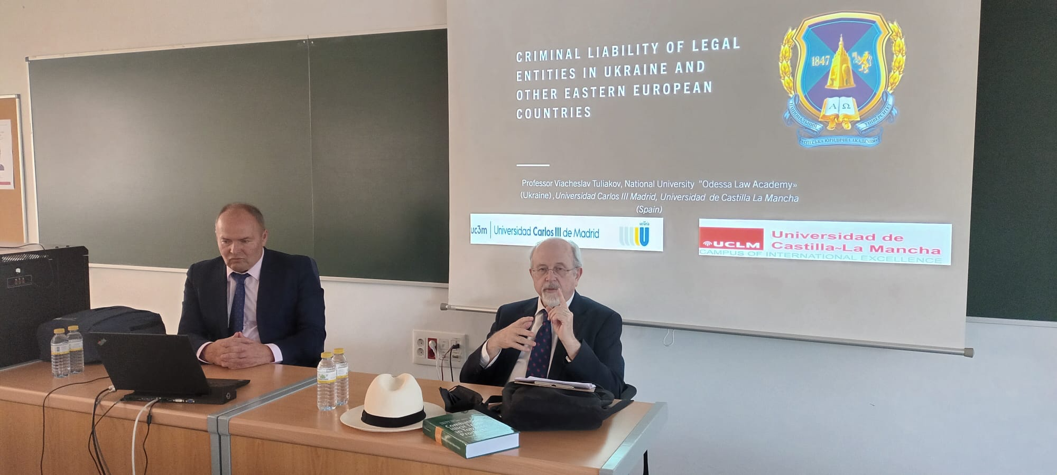
The European Commission drew attention to the need for further development of the justice system and protection of fundamental human rights in Ukrainian legislation in accordance with the EU's provisions on Justice, Freedom and Security when deciding to support Ukraine's candidacy for EU membership.
A significant role in that is played by the development of Ukraine's criminal legislation with its focus on the protection of fundamental rights and freedoms and security of citizens.
At the same time, there are a number of problems caused by a certain novelty of the subject matter, lack of experience and difference in legal cultures in the practice of approximation of national criminal legislation to EU law
Legal cultures… The next step

Slide 28




THANK YOU
Viacheslav Tuliakov
( C )2023

