Slide 1



TRENDS IN CRIMINAL POLICY: (DIS)
ORGANISING THE CHAOS
Lecture 5.
CRIMINALISATION VS DECRIMINALISATION
(CULTURAL APPROACH)
Dr.Hab. Prof. Viacheslav Tuliakov
NU ‘Odesa law academy’ (Ukraine), university of Castilla La Mancha (Spain)

Slide 2

CRIMINALISATION VS DECRIMINALISATION (CULTURAL APPROACH)
Monotheism and criminal policy (e.g., Judaism, Christianity, Islam, Buddhism, Gandhian)
New world order after Mordor Hybrid criminalization
(Narratives of criminalization) Media and parties. Dark IR and hidden circles
The rise of Organized transnational crime and Weak state.

Slide 3
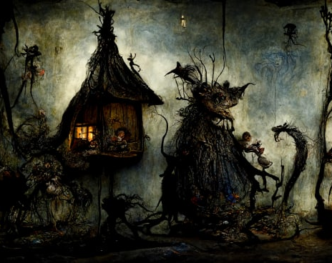
CULTURE OF CRIMINALIZATION shared set of (implicit and explicit) values, ideas, concepts, and rules of behaviour that allow a social group to function and perpetuate itself ... [it is] the dynamic and evolving socially constructed reality that exists in the minds of social group members.
Hudelson, Patricia M. 2004. “Culture and Quality: An Anthropological Perspective.”
International Journal for Quality Health Care 16, no. 5: 345–6

Slide 4

CRIME AND PUNISHMENT ARE SOCIAL CONSTRUCTS THAT DEPEND ON CULTURE

Slide 5
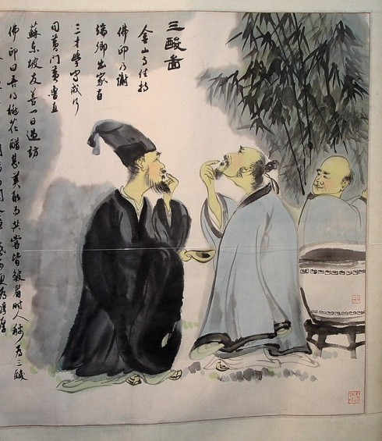
This painting shows Lao Tzu, Shakyamuni Buddha, and Confucius tasting vinegar. Each has a different reaction and facial expression that corresponds to the basics of understanding the teachings. Confucius has disgust on his face, Buddha has sorrow, and Lao Tzu has a smile on his face

Slide 6

"如果垫子铺得不平整，主人就不会坐在上面。"
If the mat lies unevenly, the Master will not sit on it."

Slide 7

the bitter winds of everyday existence
The Buddha,
human life is a prisoner of attachments and desires that lead only to suffering, and saw in it nothing but bitterness. T
he world, as the Buddha saw it, does nothing but trap man, giving him illusions and causing him, like all life on earth, nothing but endless torment.
Peace can only be found by "shaking off the ashes of this world"

Slide 8
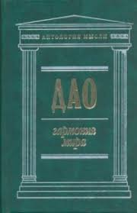
the vinegar that symbolizes the Life Essence does taste unpleasant
But the fact is that the harmonious worldview peculiar to Taoism turns everything that others find unsatisfactory into something positive.
From the Taoist point of view, bitterness and acidity are the products of a mind that is not sensitive to its surroundings and seeks to remake everything.
Life itself, if properly understood and used as intended, tastes sweet.

Slide 9
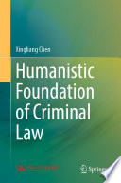
Monotheism and criminal policy (e.g., Judaism, Christianity, Islam, Buddhism, Gandhian)
HUMAN NATURE (INDIVIDUALISM VS HOLISM)
CULTURAL BACKGROUND
FREE WILL
ONTOLOGY OF CRIME (SOCIETAL VS INDIVIDUAL)
HUMAN NATURE OF PUNISHMENT
ADMINISTRATION OF JUSTICE

Slide 10
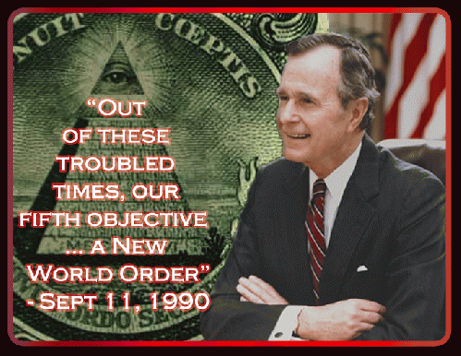
MONOPOLARITY
Crime and punishment are constructed under political interests
US invasion to Iraqi (2002-2011)
Misuse of Law (UN Charter – Self Defence)
Tribunal for Putin (parallels and outcomes)

Slide 11

NARRATIVES OF CRIMINALIZATION
Ms Bangura explained that during the war, a rebel soldier or commander could “seize a woman, often in the course of an attack, and claim her as his wife”
Brima et al. 2005, Decision on Prosecution Request for Leave to Call an Additional Witness Zainab Hawa Bangura, paras. 4 and 13)
The defence, in turn, argued that “in normal Sierra Leonean society many girls under the age of eighteen married without giving their consent, and were thus victims of forced marriage”, and that the crime committed was more akin to forcible abduction, as opposed to forcible marriage
In the end, the Chambers reasoned that the facts fulfilled all the elements of sexual slavery when considered in their totality. The court said: “the use of the term ‘wife’ by the perpetrator in reference to the victim is indicative of the intent of the perpetrator to exercise ownership over the victim

Slide 12
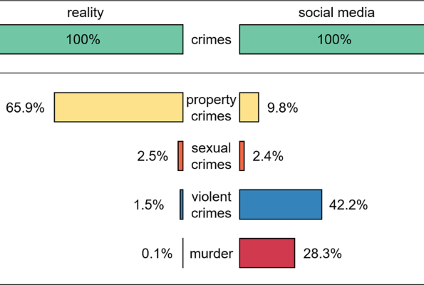
INFLUENCE OF STORYTELLING
the stories people tell reflect values, identities, cultures and communities

Slide 13
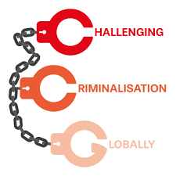
The social media revolution
The use of social media completely revolutionised the way in which information is now shared and consumed, and is now a relevant part of government agencies and companies
Social media has given its users the ability to share content and opinions without having to depend on traditional and centralised news media outlets, potentially obtaining a more democratic distribution of opinions, offering users the ability to reach a large proportion of the population
There are significant differences between what is published in traditional media, and what is posted on social media. For instance, traditional media typically covers major disasters in more depth than social media
In terms of crime, social media could provide a more accurate description of the crime suffered in a country or a city than traditional media does.
Victims, indirect victims, and witnesses might be inclined to share their thoughts after experiencing a crime, regardless of whether that crime was minor or not, so that social media might be able to provide a more accurate version of the criminal reality of a city.
Leaving aside the potential readability issues and fake news social media could potentially provide a powerful tool for detecting crime trends and patterns.

Slide 14

WEAKNESS OF STATE
SUBSTITUTION
SUBLIMATION
SELF AWARENESS

Slide 15

The constituent elements of the theory of criminalization are:
1) The fundamental directions and methods of implementing criminal-legal regulation;
The grounds for criminalization;
The legislative technique and principles of criminalization.

Slide 16
The grounds of criminalization should include
Public danger, which refers to the presence of significant material or moral harm inflicted on victims;
Typicality and sufficient prevalence of anti-social behavior, while taking into account the degree of their public danger and the fear of crime;
The dynamics of socially dangerous deeds, considering the causes and conditions that lead to them;
The necessity for specific criminal law measures;
The consideration of the capacity of the criminal justice system in countering vulnerable individuals and groups;
The requirement for the use of criminal law measures

Slide 17

The principles of criminalization
The clarity and non-redundancy of the law's prohibition;
Certainty and unity of terminology;
Expediency.

Slide 18
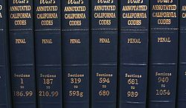
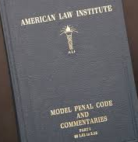

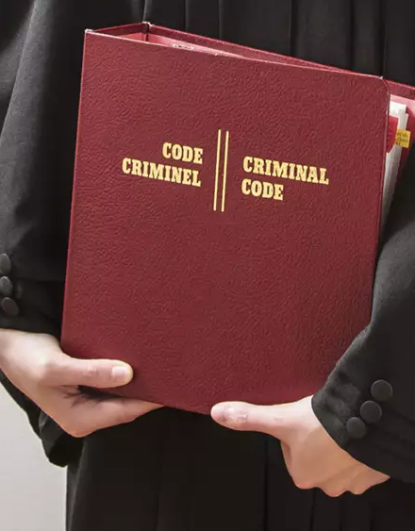

THANK YOU
Viacheslav Tuliakov
( C )2023

