Slide 1
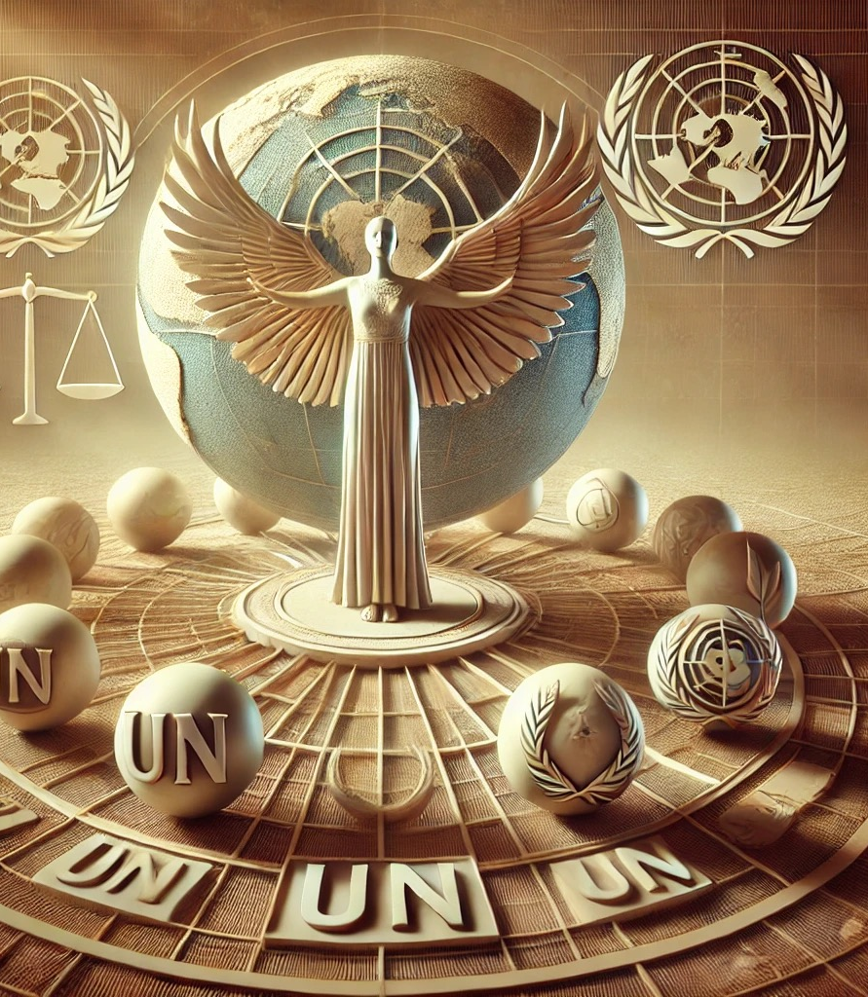
UNIT 6-2.
"Exploring the UN Protection Mechanism through Concrete Assessments”
Prof. Viacheslav (SLAVA) TULIAKOV
Viacheslav.Tuliakov@esic.university

Slide 2

Case Study: Corporate Accountability Gone Wrong
Scenario: A multinational company outsources production to a low-cost factory. Labor rights violations are exposed, sparking public outrage and investor panic.
Lesson: Failing to integrate human rights considerations can lead to financial loss and brand damage.
Punchline: Turns out, human rights violations are not just morally wrong—they’re also expensive.
Это изображение, автор: Неизвестный автор, лицензия: CC BY

Slide 3

The Intersection of Human Rights and Business: Global Standards and National Practices
  The modern corporate world is a dance between profit and principles.
  With global standards evolving, companies now face the challenge of not only earning money but also respecting human dignity.
  Quote: "It’s not that I'm against human rights... I'm just also really into profits." — Imaginary CEO, 2025
  Thought: Can a multinational really care about human rights without being dragged kicking and screaming into compliance?
  Resume: Corporate responsibility is like dieting—you know you should do it, but Netflix and pizza are so much easier.

Slide 4

Human Rights and Sustainable Development Goals (SDGs)
Human rights and the SDGs are fundamentally interconnected. Respecting human rights is crucial to achieving goals like reducing inequality (SDG 10), promoting decent work (SDG 8), and achieving gender equality (SDG 5).
Modern Tendencies: Businesses are increasingly pressured to align their strategies with the SDGs, not just as a matter of corporate social responsibility (CSR) but as a way to ensure long-term sustainability.
Analysis: Companies that ignore human rights risk damaging their reputation and profitability. Investors and consumers are increasingly demanding transparency and ethical practices.
Think: Aligning business with human rights and SDGs is like convincing a cat to take a bath—possible, but usually requires some serious motivation.

Slide 5
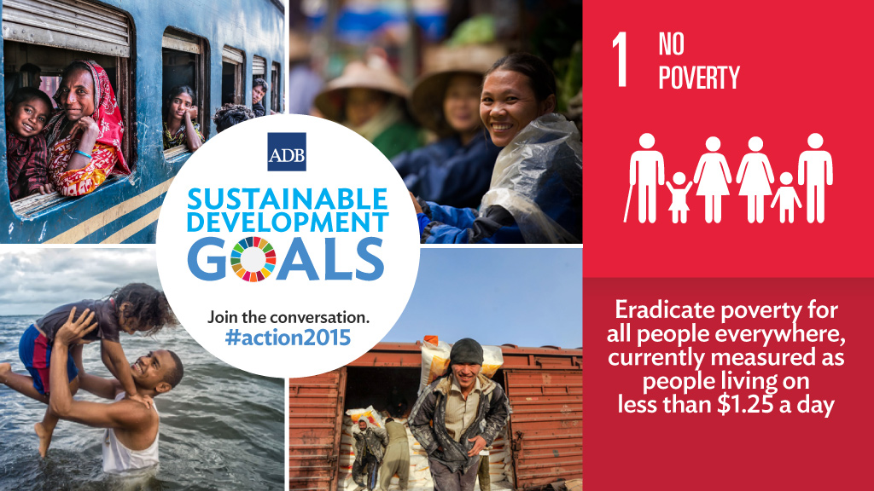
The Sustainable Development Goals (SDGs) are deeply intertwined with human rights.
  SDG 1 (No Poverty) aligns with the right to an adequate standard of living (ICESCR, Article 11).
  SDG 5 (Gender Equality) reinforces the principles of CEDAW.
Example of Interference : In 2020, the UN Special Rapporteur on Extreme Poverty highlighted how austerity measures in some countries violated the right to social security, undermining SDG 1.
https://upr-info.org/en/review/kenya?spm=a2ty_o01.29997173.0.0.46c5c921UAt9TN
Это изображение, автор: Неизвестный автор, лицензия: CC BY-NC-ND

Slide 6

Human rights and the SDGs are deeply interconnected
Reducing inequality (SDG 10) requires fair wages.
Promoting decent work (SDG 8) means no child labor or unsafe conditions.
Achieving gender equality (SDG 5) demands equal pay and opportunities.
Case Study:
Unilever launched its Sustainable Living Plan , integrating SDG-aligned practices like reducing waste and improving worker safety. While praised, critics argue it’s still driven by brand image rather than pure altruism.
Analysis:
Ignoring human rights risks damaging reputations—and profits. Investors now prioritize Environmental, Social, and Governance (ESG) metrics, proving ethics can be good business.
RESUME
Aligning business with human rights and SDGs is like convincing a cat to take a bath—possible, but usually requires bribery—or threats.

Slide 7
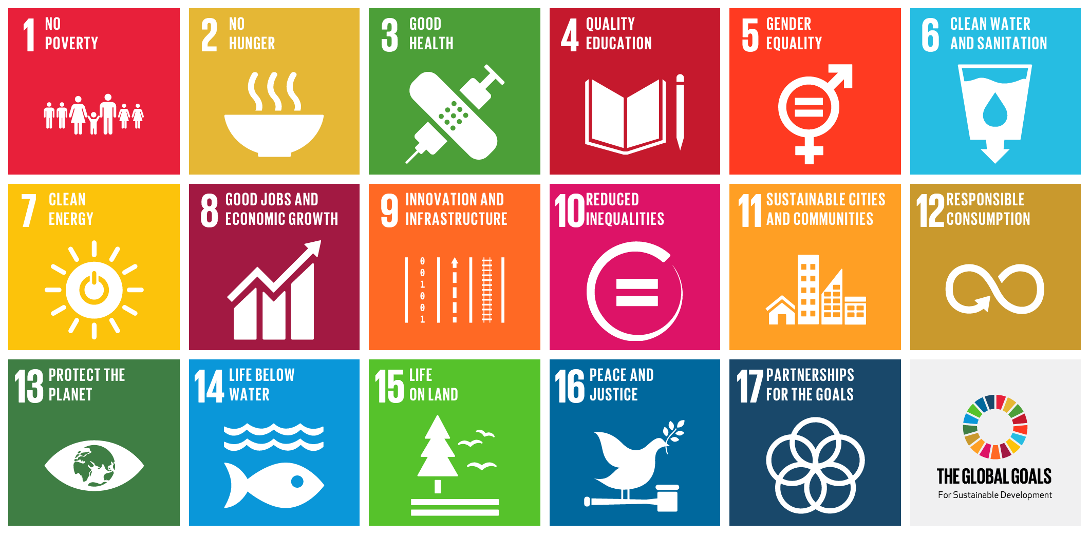
Economic, Social, and Cultural Rights (ESCR) and SDGs
Explanation : ESCR, enshrined in the ICESCR, include rights to education, work, health, and housing. These rights are directly reflected in several SDGs.
Interference Example :
  In Brazil, advocacy groups used the ICESCR to pressure the government to address housing shortages (SDG 11). This led to increased funding for affordable housing projects.
Key Point : The Optional Protocol to the ICESCR allows individuals to file complaints, creating a mechanism for holding states accountable for SDG-related commitments.
https://www.ohchr.org/en/instruments-mechanisms/instruments/optional-protocol-international-covenant-economic-social-and?spm=a2ty_o01.29997173.0.0.46c5c921UAt9TN
Это изображение, автор: Неизвестный автор, лицензия: CC BY-SA

Slide 8
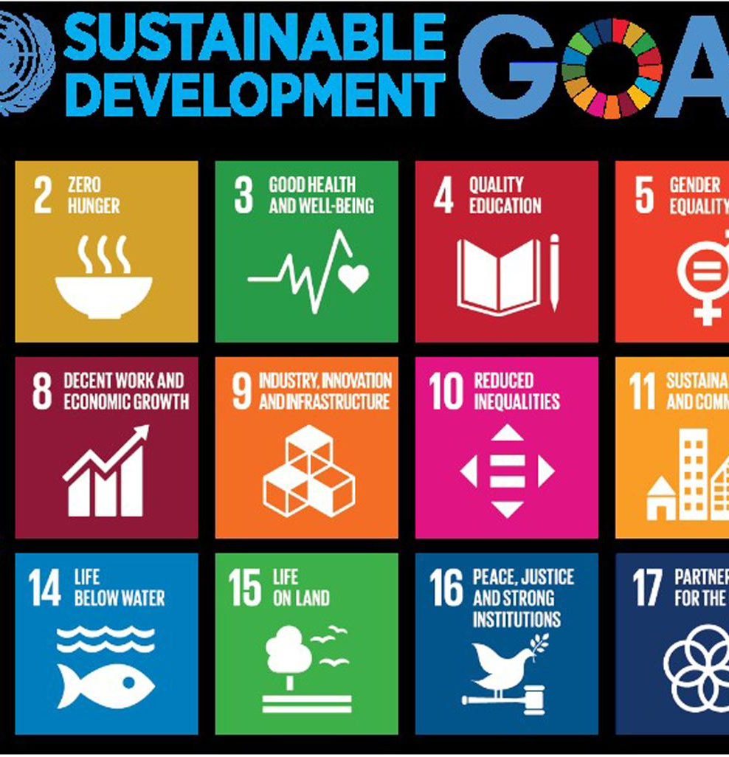
Civil and Political Rights and SDGs
Explanation : Civil and political rights (CPR), protected under treaties like the ICCPR, ensure freedoms such as expression, assembly, and participation in governance. These rights are essential for achieving SDG 16 (Peace, Justice, and Strong Institutions).
Interference Example :
  In Myanmar, restrictions on freedom of speech and assembly (violations of CPR) hindered progress on SDG 16, as civil society was unable to advocate effectively for peace and justice.
Key Mechanism : The Human Rights Committee monitors compliance with the ICCPR, issuing guidance that supports SDG implementation.
https://www.ohchr.org/sites/default/files/Reporting-ICCPR-Training-Guide.pdf
Это изображение, автор: Неизвестный автор, лицензия: CC BY

Slide 9

Intersectionality of Human Rights and SDGs
Explanation : Human rights and SDGs intersect across multiple dimensions, including gender, race, and disability. Addressing these intersections is critical for achieving both frameworks.
Example :
  Indigenous communities in Canada have invoked their rights under UNDRIP (United Nations Declaration on the Rights of Indigenous Peoples) to demand clean water access (SDG 6). This highlights how human rights advocacy drives SDG progress.
Key Takeaway : A holistic approach integrating human rights into SDG strategies ensures no one is left behind.
Это изображение, автор: Неизвестный автор, лицензия: CC BY

Slide 10
UN Guidelines on Business and Human Rights
The UN Guiding Principles (UNGPs) serve as a global framework for responsible business conduct, emphasizing three pillars:
  Protect: States must safeguard citizens from human rights abuses by third parties, including businesses.
  Respect: Businesses must avoid infringing on human rights and address adverse impacts.
  Remedy: Victims should have access to effective grievance mechanisms.
Modern Tendencies: Increasing adoption of due diligence requirements and non-financial reporting as part of business transparency.
Think: Implementing UNGPs is like keeping houseplants alive—it looks easy on paper, but in reality, it tends to be a bit more complicated.

Slide 11
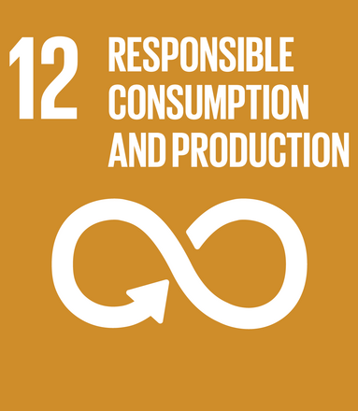
The UNGPs, adopted in 2011, establish a global standard for preventing and addressing business-related human rights abuses. They emphasize the "Protect, Respect, and Remedy" framework.
  States’ Duty to Protect : Governments must regulate businesses to prevent human rights violations.
  Companies’ Responsibility to Respect : Businesses must avoid infringing on human rights.
  Access to Remedy : Victims of abuse should have access to grievance mechanisms.
Example : Nestlé faced criticism for child labor in cocoa supply chains. Under the UNGPs, it committed to implementing due diligence processes to address this issue.
Это изображение, автор: Неизвестный автор, лицензия: CC BY-SA

Slide 12

"Protect, Respect, and Remedy" framework
The first pillar of the UN Framework is the state duty to protect against human rights abuses committed by third
parties, including business, through appropriate policies, regulation and adjudication. It highlights that states
have the primary role in preventing and addressing corporate-related human rights abuses.
Это изображение, автор: Неизвестный автор, лицензия: CC BY-NC-ND

Slide 13
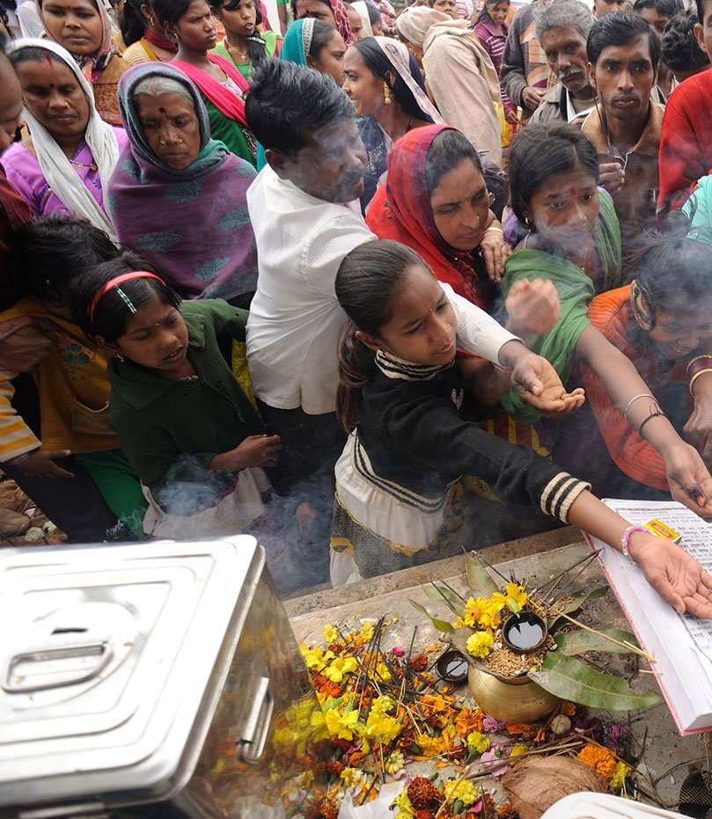
Respect
The corporate responsibility to respect human rights means acting with due diligence to avoid infringing on the rights of others, and addressing harms that do occur.
The term “responsibility” rather than “duty” is meant to indicate that respecting rights is not currently an obligation that international human rights law generallyimposes directly on companies, although elements of it may be reflected in domestic laws.
It is a global standard of expected conduct acknowledged in virtually every voluntary and soft-law instrument related to corporate responsibility
Это изображение, автор: Неизвестный автор, лицензия: CC BY-NC-ND

Slide 14

Remedy
As part of their duty to protect against business-related human rights abuse, states must take appropriate steps
within their territory and/or jurisdiction to ensure that when such abuses occur, those affected have access to
effective remedy through judicial, administrative, legislative or other appropriate means
https://media.business-humanrights.org/media/documents/files/reports-and-materials/Ruggie-protect-respect-remedy-framework.pdf

Slide 15
Explanation : The UNGPs stress the importance of grievance mechanisms, both judicial (courts) and non-judicial (ombudspersons, mediation).
Challenges : Many victims face barriers such as lack of awareness, fear of retaliation, or weak legal systems.
After the Rana Plaza collapse in Bangladesh, the Accord on Fire and Building Safety provided a non-judicial remedy for affected workers, funded by global brands.
https://bangladeshaccord.org/?spm=a2ty_o01.29997173.0.0.46c5c921UAt9TN

Slide 16

State Obligations Under the UNGPs
Explanation : States must create an enabling environment for businesses to respect human rights through legislation, incentives, and enforcement.
Example :
  France passed the Duty of Vigilance Law (2017), requiring large companies to publish plans to prevent human rights abuses in their operations and supply chains.
Global Trend : More countries are adopting mandatory human rights due diligence laws, reflecting the UNGPs' influence.
https://www.ohchr.org/sites/default/files/documents/publications/guidingprinciplesbusinesshr_en.pdf

Slide 17

Modern Trend
Due diligence laws and non-financial reporting are becoming mandatory in many regions, shifting responsibility from “nice-to-have” to “must-do.”
Case Study:
In 2021, Norway passed the Transparency Act requiring companies to disclose human rights impacts. Critics call it revolutionary; skeptics say it’s too early to tell.
Resume
Implementing UNGPs is like keeping houseplants alive—looks easy on paper, but reality tends to involve dead leaves and regret.

Slide 18

The State's Obligation to Protect Human Rights
Governments are increasingly focusing on embedding human rights considerations into national legislation and policies.
Example: The EU Directive on Corporate Sustainability Due Diligence requires companies to identify and address human rights risks throughout their supply chains.
Analysis: This directive represents a shift towards mandatory corporate accountability, rather than voluntary compliance.
Resume: Getting corporations to follow human rights standards is like asking them to give up coffee—good luck with that!

Slide 19
Case Study:
France’s Duty of Vigilance Law (2017) forced large companies to publish plans addressing human rights risks. While groundbreaking, enforcement remains inconsistent.
Resume
Getting corporations to follow human rights standards is like asking them to give up coffee—good luck with that!

Slide 20
Legal Framework Governing Transnational Corporations (TNCs)
Explanation : TNCs operate across borders, complicating regulatory oversight. Key instruments include:
  OECD Guidelines for Multinational Enterprises : Voluntary standards promoting responsible business conduct.
  UN Draft Treaty on Business and Human Rights : A binding instrument under negotiation to address gaps in accountability.
Challenge : Current frameworks rely heavily on voluntary compliance, limiting effectiveness.
Example : Shell’s oil spills in Nigeria sparked lawsuits in UK courts, highlighting jurisdictional complexities.

Slide 21
Extraterritorial Obligations of States
Explanation : States have obligations to regulate TNCs headquartered within their borders, even when abuses occur abroad.
Legal Basis :
  Maastricht Principles : Clarify states’ duties to protect against extraterritorial human rights violations.
Example : In 2021, a Dutch court ruled that Royal Dutch Shell must reduce emissions, setting a precedent for holding TNCs accountable globally.

Slide 22

Case Study:
Nike faced backlash in the 1990s over sweatshop labor. Their response? Investing in transparency and supplier audits. Today, they’re seen as an industry leader—but only after decades of effort.
Resume:
Corporate responsibility to respect human rights is like a unicorn—everyone talks about it, but seeing it in practice is a whole different story.

Slide 23
TO CONCLUDE
Companies are expected not just to avoid causing harm but to actively assess and mitigate human rights risks in their operations.
Analysis: Modern business practices increasingly integrate human rights policies into governance frameworks, linking compliance to long-term profitability and social license to operate.
Trend: Corporate responsibility to respect human rights is like a unicorn—everyone talks about it, but seeing it in practice is a whole different story.

Slide 24
EU Draft Directive on Due Diligence
This directive emphasizes that companies must conduct due diligence to prevent human rights violations, especially in global supply chains.
Key Elements:
  Risk identification and assessment
  Mitigation and prevention strategies
  Transparency and public reporting
Modern Trend: Due diligence is shifting from voluntary initiatives to binding legal requirements.
Joke: Imagine telling a CEO that transparency is non-negotiable—it’s like asking a magician to reveal their tricks.

Slide 25
National Protection of Human Rights: Spain
Spain’s human rights protection framework includes constitutional guarantees and international obligations. The country has been strengthening its due diligence laws to align with EU standards.
Modern Practices: Enhanced focus on protecting workers’ rights and combating labor exploitation.
Analysis: Although progress is evident, challenges remain, especially in monitoring compliance and enforcing regulations effectively.
Trend: In Spain, the phrase "due diligence" sometimes sounds like "mañana"—we’ll get to it... eventually.

Slide 26

Case Study:
Spanish tomato farms were exposed for exploiting migrant workers. In response, the government tightened labor inspections—but critics say enforcement lags behind rhetoric.
Resume:
In Spain, the phrase “due diligence” sometimes sounds like “mañana”—we’ll get to it... eventually.
Это изображение, автор: Неизвестный автор, лицензия: CC BY-NC-ND

Slide 27
Challenges and Criticisms
Balancing Profit and Ethics: Companies often argue that strict regulations hinder competitiveness.
Practical Challenges: Effective human rights monitoring in complex supply chains can be daunting.
Modern Reality: Social media scrutiny forces companies to act faster and more transparently than ever before.
Think: Corporate accountability is like a social media challenge—everyone’s doing it, but few get it right.

Slide 28
Conclusion
Balancing human rights and business interests requires more than just good intentions—it needs robust policies, diligent implementation, and public accountability.
01
Provocation: Can we ever make respecting human rights as instinctive as pursuing profit?
02
Trend: The real challenge of corporate ethics—getting CEOs to read more than the executive summary.
03

Slide 29
Discussion Questions
Can the private sector truly lead human rights protection without external enforcement?
How can humor effectively raise awareness about corporate responsibility?
Are modern business practices genuinely shifting towards human rights, or just rebranding old habits?
Is Spain’s approach to human rights protection sufficiently comprehensive?

Slide 30
A lie can travel halfway around the world while the truth is putting on its shoes." — Mark Twain
Closing Thought: Keep questioning and keep laughing—the combination might just change the world.

Slide 31

Thank U!
Viacheslav TULIAKOV © 2025
mail: Viacheslav.Tuliakov@esic.university

