Slide 1
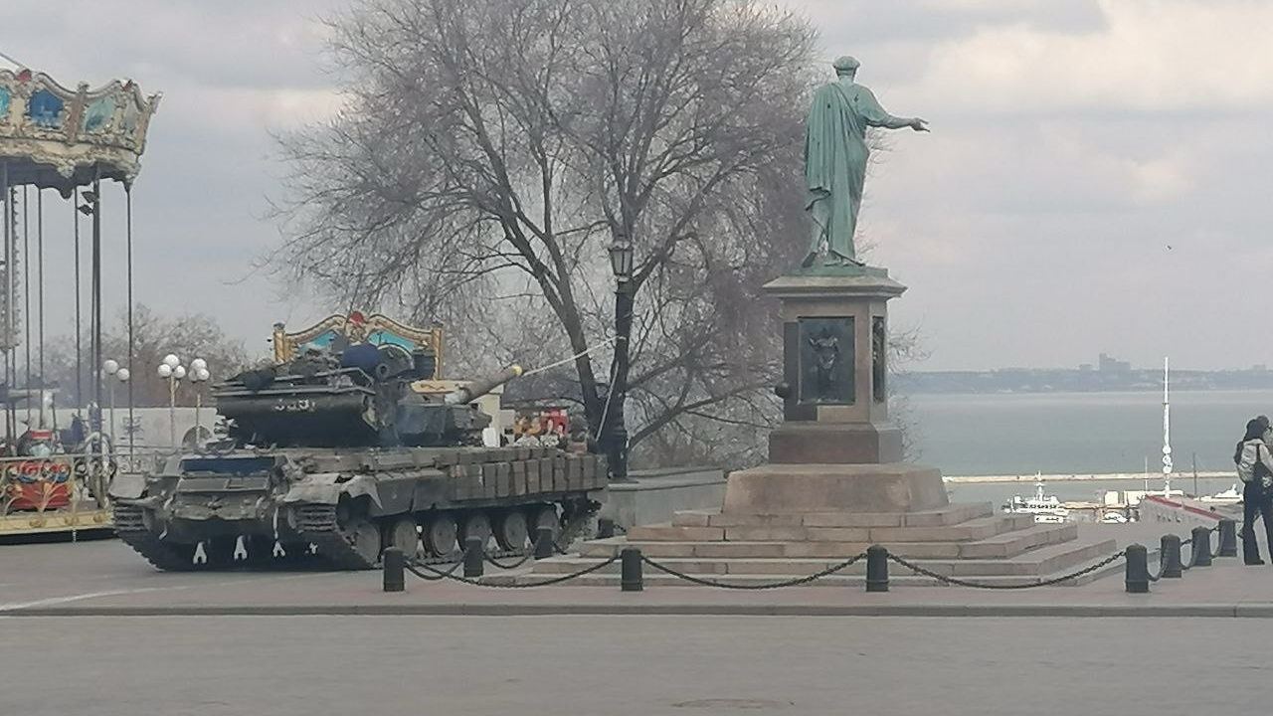
Unit 5 (2).
Human Rights Instruments
The COVENANTS.
.
Prof. Viacheslav (SLAVA) TULIAKOV
Viacheslav.Tuliakov@esic.university

Slide 2

Problems and Challenges in UDHR Direct Application
Non-Binding Nature: The UDHR lacks enforceability compared to treaties.
Conflicts with National Traditions: Resistance to integrating international norms.
Political and Social Challenges: Balancing national sovereignty with universal obligations.
Example: Tensions in Spain regarding Catalonia’s independence claims vs. constitutional order.

Slide 3

The Debate on the Legal Force of the UDHR
Comparison with Binding Treaties:
  International Covenant on Civil and Political Rights (ICCPR).
    ICCPR Text
  International Covenant on Economic, Social, and Cultural Rights (ICESCR).
    ICESCR Text
Scholarly Perspectives:
  Role of the UDHR in shaping modern international law.
Future Developments: Strengthening its legal impact.

Slide 4

International Covenant on Civil and Political Rights (ICCPR)
Overview: Adopted by the UN General Assembly in 1966 and entered into force in 1976.
Purpose: To protect civil and political rights such as the right to life, freedom of speech, and freedom of religion.
Link to Full Text: https://www.ohchr.org/en/instruments-mechanisms/instruments/international-covenant-civil-and-political-rights

Slide 5
Key Provisions of the ICCPR
Article 1: Right of self-determination.
Article 6: Right to life.
Article 19: Freedom of expression.
Article 25: Right to participate in public affairs.
https://www.ohchr.org/en/instruments-mechanisms/instruments/international-covenant-civil-and-political-rights

Slide 6
Optional Protocols to the ICCPR
First Optional Protocol: Allows individuals to submit complaints about violations.
Second Optional Protocol: Aims at the abolition of the death penalty.
Link to Optional Protocol: https://www.ohchr.org/en/instruments-mechanisms/instruments/optional-protocol-international-covenant-civil-and-political?

Slide 7
Case Study: Ahmadou Sadio Diallo (Republic of Guinea v. Democratic Republic of the Congo)
Background: Guinea filed a case on behalf of Diallo, alleging unlawful detention and expulsion by the DRC.
ICJ Findings: The DRC violated Diallo's rights under the ICCPR, including arbitrary detention and expulsion without due process.
https://www.corteidh.or.cr/tablas/r26998.pdf

Slide 8
International Covenant on Economic, Social and Cultural Rights (ICESCR)
Slide 1: Introduction to the ICESCR
Overview: Adopted by the UN General Assembly in 1966 and entered into force in 1976.
Purpose: To protect economic, social, and cultural rights, including rights to work, education, and health.
Link to Full Text https://www.ohchr.org/en/instruments-mechanisms/instruments/international-covenant-economic-social-and-cultural-rights?

Slide 9
Key Provisions of the ICESCR
Article 1: Right of self-determination.
Article 6: Right to work.
Article 12: Right to the highest attainable standard of health.
Article 13: Right to education.
Link https://www.ohchr.org/en/instruments-mechanisms/instruments/international-covenant-economic-social-and-cultural-rights

Slide 10
Optional Protocol to the ICESCR
Purpose: Allows individuals to submit complaints about violations of Optional Protocol to the ICESCR, Article 2. Also see Rules of Procedure of the Optional Protocol to the ICESCR, UN doc. E/C.12/49/3, 3 December 2012, Rule 4.
Significance: Strengthens enforcement mechanisms for economic, social, and cultural rights.
Link to Optional Protocol Overview: https://www.geneva-academy.ch/joomlatools-files/docman-files/The%20optional%20protocol%20In%20brief%202.pdf?

Slide 11
Case Study: Corporate Accountability for Abuses of Economic, Social, and Cultural Rights
Background: Analysis of corporate responsibilities and human rights obligations under the ICESCR.
Findings: Emphasizes the need for businesses to respect economic, social, and cultural rights in their operations.
Link to Analysis
https://www.icj.org/wp-content/uploads/2020/02/Universal-ESCR-accountability-guide-Publications-Reports-Thematic-report-2020-ENG.pdf

Slide 12
ECHR Case: Greece's Illegal Expulsion of Turkish Asylum Seeker
Background: Greece expelled a Turkish woman seeking asylum, violating non-refoulement principles.
ECHR Findings: Greece's actions breached international human rights obligations.
Link to Case Details:
https://www.ft.com/content/db24a774-8c97-4db2-8ac4-a31173d1236e?

Slide 13
Analysis and Impact of ICESCR Cases
ICJ's Role: Addresses state obligations concerning economic, social, and cultural rights.
ECHR's Role: Ensures individual rights are protected within the European context.
Significance: These cases highlight the enforcement of economic, social, and cultural rights globally.

Slide 14
Application in European Union Law
Charter of Fundamental Rights of the EU (2000):
  Legally binding since the Treaty of Lisbon (2009).
    https://eur-lex.europa.eu/legal-content/EN/TXT/?uri=CELEX%3A12012P%2FTXT
    European Convention on Human Rights (ECHR):
  Enforceable through the European Court of Human Rights (ECtHR).
  https://youtu.be/Bsm_vhEgKew?si=w3yCnJFMDN7QWKZB
  EU Treaties and Directives:
  Directive 2000/43/EC on racial equality.
    https://eur-lex.europa.eu/legal-content/EN/TXT/?uri=CELEX%3A32000L0043Video Resource:

Slide 15
Implementation in Spanish Legislation
Constitutional Basis:
The Spanish Constitution of 1978 incorporates many UDHR principles in Title I.
Judicial Interpretation:
The Constitutional Court ensures laws align with international human rights norms.
Specific Laws:
Organic Law 1/2004 on Integrated Protection Measures against Gender Violence.
https://www.youtube.com/watch?v=5Dwsq_0-By0

Slide 16

The Debate on the Legal Force of the UDHR
Comparison with binding human rights treaties (ICCPR, ICESCR).
Legal scholars’ perspectives on the UDHR’s role in international law.
Possible future developments in strengthening its legal impact.

Slide 17
Case Study: Spain and Human Rights Mechanisms
Tensions Between the UDHR and National Laws
Conflicts in areas such as asylum policy, freedom of speech, and anti-terrorism laws.
Responses from Spanish and European courts.
Example: Spain’s deportation policies and their compliance with human rights principles.
Case link: https://www.ohchr.org/sites/default/files/lib-docs/HRBodies/UPR/Documents/Session35/ES/Spain_Infographic_35.pdf

Slide 18
ECHR Case: Cyprus Authorities' Failure in Investigating Alleged Gang-Rape
Background: A British woman alleged she was gang-raped in Cyprus in 2019.
ECHR Findings: Cypriot authorities failed to properly investigate her complaint, highlighting gender biases and NON SENSITIVE VICTIM APPROACH.
https://www.theguardian.com/law/2025/feb/27/cyprus-authorities-failed-british-teenager-who-reported-alleged-gang-says-ehcr?utm_source=chatgpt.com

Slide 19

Rap as a CRIME?
https://eucrim.eu/news/cjeu-ruling-spanish-rapper-case/
https://globalfreedomofexpression.columbia.edu/cases/the-extradition-case-of-jose-miguel-arenas-valtonyc/#:~:text=Case%20Summary%20and%20Outcome,not%20be%20extradited%20by%20Belgium.

Slide 20
Chat GPT and…
https://www.perplexity.ai/
https://scite.ai
https://www.zotero.org
https://www.mendeley.com
https://evernote.com
https://uacademic.info
https://x.ai
https://claude.ai/
https://gemini.google.com/
https://chat.qwenlm.ai

Slide 21
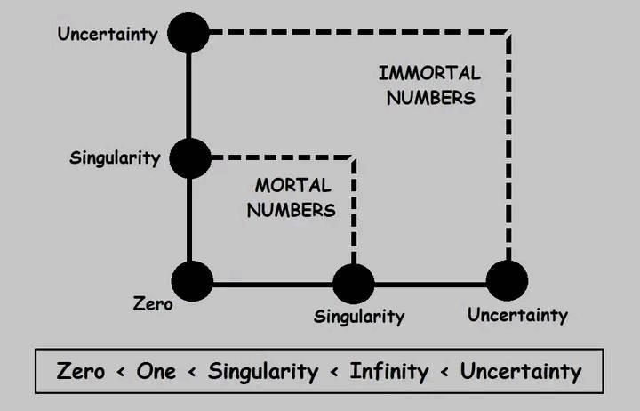
Thank U!
Viacheslav TULIAKOV © 2025
mail: Viacheslav.Tuliakov@esic.university

