Slide 1
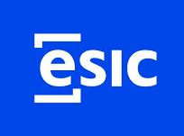

UNIT 7-8. CIVIL SOCIETY AND HUMAN RIGHTS: A LOVE-HATE RELATIONSHIP
HOW DEMOCRACY AND SOCIAL MEDIA SPICE UP THE LEGAL DRAMA
Prof. Viacheslav (SLAVA) TULIAKOV
Viacheslav.Tuliakov@esic.university

Slide 2
Introduction: “Law is reason, free from passion.” - Aristotle
Civil society and human rights are like roommates with conflicting lifestyles: essential to coexist but constantly stepping on each other’s toes.
Can civil society defend human rights while also threatening them through unchecked power and influence?
Thesis: This presentation explores how civil society, democracy, and social media intertwine with human rights, with in-depth analysis and critical perspectives on ECJ and ECHR case law.

Slide 3
Civil Society and Human Rights - A Symbiotic Mess
“Solidarity rights are the third generation of human rights, emphasizing collective aspirations.” (Alston, 1982)
Civil society: the watchdog, the voice, the challenger of power.
Human rights: the untouchable core of modern democracy.
Sometimes they harmonize; other times, civil society becomes the biggest violator.
Legal Criticism: Excessive activism can distort the balance between freedom and responsibility.
Reflection: Should civil society be held accountable when activism turns into disruption?

Slide 4
Regulation: Concept
The concept of civil society encompasses organizations, grassroots movements, and activists who collectively engage in advocacy for various rights and freedoms. In numerous contexts, civil society organizations (CSOs) have emerged as indispensable actors, especially in regions where state actors fail to uphold their human rights obligations.

Slide 5
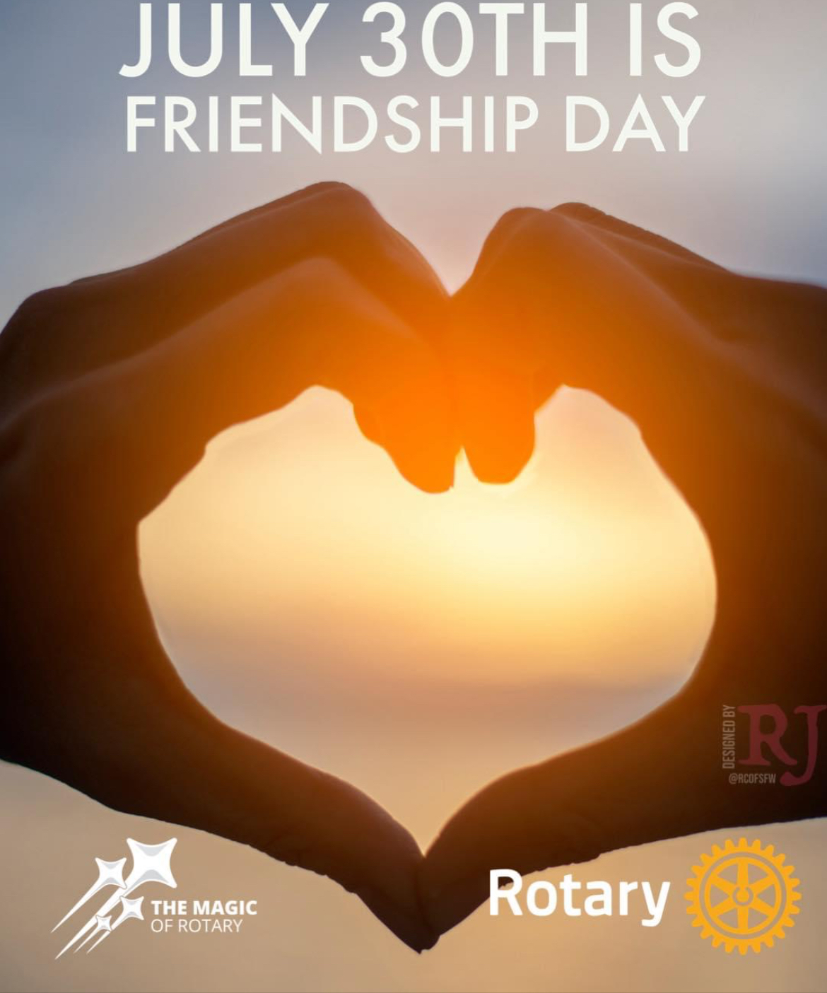
The relationship between human rights advocacy and civil society must be viewed through the lens of global governance, where these entities interact with international systems, including treaties, regulatory bodies, and transnational networks to enhance state obligations towards human rights

Slide 6
Normative Framework in International Humanitarian Law (IHL)
Key Points:
Geneva Conventions (1949) and Additional Protocols (1977):
  Role of NGOs: The Geneva Conventions and their Additional Protocols explicitly recognize the role of non-governmental organizations (NGOs) in providing humanitarian aid during armed conflicts. NGOs often operate in conflict zones to deliver essential services such as medical care, food, and shelter.
  Common Article 3: Article 3, common to all four Geneva Conventions, is a cornerstone of IHL. It mandates humane treatment for all persons taking no active part in hostilities, including wounded, sick, and detained individuals. NGOs play a crucial role in monitoring compliance with this provision, ensuring that the principles of humanity are upheld even in the midst of war.
International Committee of the Red Cross (ICRC):
  Central Role in IHL: The ICRC is a key actor in the implementation and promotion of IHL. As a neutral and independent organization, it works to protect and assist victims of armed conflict. The ICRC often collaborates with civil society organizations, including NGOs, to enhance the delivery of humanitarian aid and to advocate for the respect of IHL by all parties to a conflict.
  Civil Society Collaboration: The ICRC's partnership with civil society is vital in raising awareness about IHL and in ensuring that humanitarian principles are integrated into the actions of both state and non-state actors.
UN General Assembly Resolutions:
  Encouraging Partnerships: Various UN General Assembly resolutions have emphasized the importance of partnerships between states and civil society in humanitarian efforts. These resolutions recognize the complementary roles of governments and NGOs in addressing humanitarian crises and call for enhanced cooperation to ensure the effective delivery of aid and protection for vulnerable populations.
  Global Humanitarian Coordination: The UN resolutions also highlight the need for coordinated international responses to humanitarian emergencies, with civil society playing a significant role in these efforts.
Links:
Geneva Conventions
ICRC Role in IHL

Slide 7
Normative Framework in International Human Rights Law (IHRL)
Universal Declaration of Human Rights (1948):
  Foundation of IHRL: The Universal Declaration of Human Rights (UDHR) is the foundational document of international human rights law. It sets out a broad range of civil, political, economic, social, and cultural rights that are inherent to all human beings.
  Role of NGOs: NGOs are instrumental in promoting and protecting the rights enshrined in the UDHR. They often engage in advocacy, monitoring, and reporting on human rights violations, as well as providing direct assistance to victims.
International Covenants (1966):
  International Covenant on Civil and Political Rights (ICCPR): This covenant guarantees rights such as the right to life, freedom of speech, and freedom from torture. NGOs play a critical role in holding states accountable for violations of these rights through advocacy, litigation, and public awareness campaigns.
  International Covenant on Economic, Social and Cultural Rights (ICESCR): This covenant recognizes rights such as the right to work, the right to education, and the right to health. NGOs often work to ensure that these rights are realized, particularly for marginalized and vulnerable groups.
UN Human Rights Council and Treaty Bodies:
  Monitoring and Reporting: The UN Human Rights Council and various treaty bodies (e.g., the Human Rights Committee, the Committee on Economic, Social and Cultural Rights) are responsible for monitoring states' compliance with their human rights obligations. NGOs contribute significantly to this process by submitting shadow reports, providing testimony, and advocating for the implementation of recommendations.
  Special Procedures: The UN Special Rapporteurs and Working Groups, which are part of the Special Procedures mechanism, often rely on information provided by NGOs to investigate human rights violations and to make recommendations to states.
UN General Assembly Resolutions:
  Civil Society Engagement: Similar to IHL, UN General Assembly resolutions in the realm of human rights frequently emphasize the importance of engaging civil society in the promotion and protection of human rights. These resolutions encourage states to collaborate with NGOs and other civil society actors in the development and implementation of human rights policies and programs.
  Human Rights Defenders: Specific resolutions have been adopted to protect human rights defenders, recognizing the vital role they play in advancing human rights and calling on states to create an enabling environment for their work.

Slide 8
Concrete Agreements and Treaties Involving Civil Society
International and European Level
International Level:
Geneva Conventions (1949) and Additional Protocols (1977):
  Role of Civil Society: Explicitly recognize the role of NGOs in providing humanitarian assistance during armed conflicts.
  Link: ICRC - Geneva Conventions
UN General Assembly Resolution 46/182 (1991):
  Strengthening Humanitarian Assistance: Establishes the framework for international humanitarian response and emphasizes the importance of partnerships with civil society.
  Link: UN Resolution 46/182
UN Sustainable Development Goals (SDGs) (2015):
  Goal 17: Highlights the importance of multi-stakeholder partnerships, including civil society, in achieving sustainable development.
  Link: UN SDGs
International Covenant on Civil and Political Rights (ICCPR) (1966):
  Article 22: Protects the right to freedom of association, a cornerstone for civil society organizations.
  Link: OHCHR - ICCPR
European Level:
European Convention on Human Rights (ECHR) (1950):
  Article 11: Guarantees the right to freedom of assembly and association, essential for civil society activities.
  Link: ECHR - Article 11
Treaty on European Union (TEU) (Lisbon Treaty, 2009):
  Article 11: Emphasizes the importance of civil society participation in EU decision-making processes.
  Link: EUR-Lex - TEU
European Economic and Social Committee (EESC):
  Civil Society Dialogue: The EESC facilitates dialogue between EU institutions and civil society organizations.
  Link: EESC - Civil Society
EU Charter of Fundamental Rights (2000):
  Article 12: Protects the freedom of assembly and association, reinforcing the role of civil society in the EU.
  Link: EU Charter of Fundamental Rights
Key Links for Further Information:
ICRC - International Humanitarian Law: ICRC IHL Database
UN Office for the Coordination of Humanitarian Affairs (OCHA): OCHA - Civil Society
Council of Europe - Civil Society: CoE Civil Society
European Commission - Civil Society: EC Civil Society

Slide 9
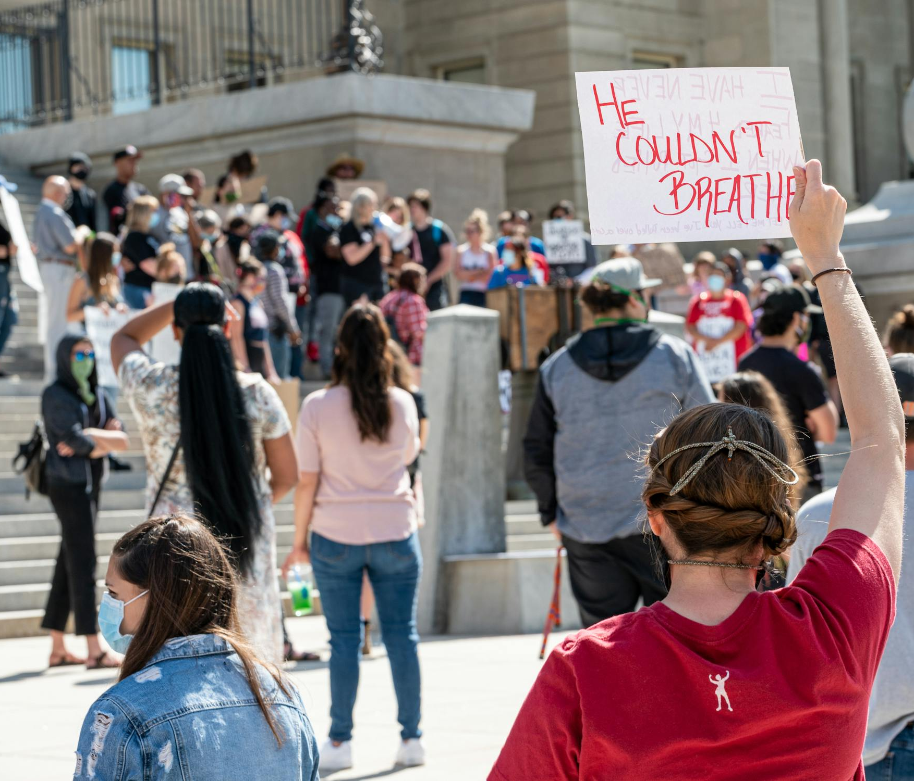

The Role of the United Nations in Protecting Activists
UN Mechanisms Supporting Civil Society:
  Special Rapporteurs : Independent experts monitor issues like freedom of expression and the safety of HRDs.
    Example: The Special Rapporteur on Freedom of Peaceful Assembly has criticized laws like Spain’s “Ley Mordaza.”
  Universal Periodic Review (UPR) : Countries are reviewed every few years on their human rights records.
    Case Study: Spain received recommendations to repeal restrictive protest laws but has yet to fully act.

Slide 10
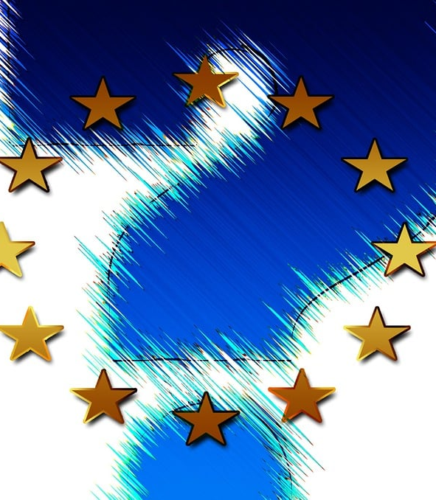
European Union Directives and Civil Society
Key EU Initiatives:
  Charter of Fundamental Rights of the European Union : Protects rights such as free speech, privacy, and non-discrimination.
  Framework Decision on Combating Racism and Xenophobia : Criminalizes hate speech while balancing freedom of expression.
  EU Guidelines on Human Rights Defenders : Encourages member states to support activists and condemn reprisals.
Real-Life Impact:
  Example: The EU condemned Hungary’s crackdown on NGOs and media outlets, tying funding to compliance with democratic values.

Slide 11
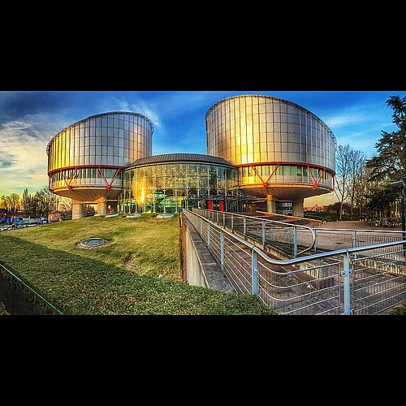
Council of Europe Conventions and Civil Society
Key Instruments:
  European Convention on Human Rights (ECHR) : Enforced by the European Court of Human Rights (ECtHR).
    Article 10: Protects freedom of expression.
    Article 11: Safeguards freedom of assembly and association.
  Convention Against Corruption (CETS No. 173) : Addresses systemic corruption that undermines civil society.
Landmark Cases:
  ECtHR Ruling: Struck down parts of Turkey’s internet censorship laws, affirming digital freedom.
  Spain’s “Ley Mordaza”: Challenged at the ECtHR for violating Articles 10 and 11.
Это изображение, автор: Неизвестный автор, лицензия: CC BY-NC-ND

Slide 12
Normative Framework in Spanish Law
Key Points:
Spanish Constitution (1978):
  Article 22 guarantees the right to association, foundational for civil society.
  Article 10.2 integrates international human rights treaties into Spanish law.
Ley de Asociaciones (Law on Associations, 2002):
  Regulates the formation and operation of NGOs in Spain.
Spanish Cooperation Law (1998):
  Promotes collaboration between the state and civil society in international development and humanitarian aid.
Links:
Spanish Constitution (English)
Ley de Asociaciones (Spanish)

Slide 13
What is Civil Society? Breaking It Down
Key Idea: Civil society includes groups like NGOs, activists, community organizations, and even YOU—people working together to improve lives and protect rights.
Why Should You Care?
  Example: In Spain, civil society has been at the forefront of movements like climate justice, gender equality, and protecting endangered languages like Basque and Catalan.
  Reality Check: But these efforts often come at a cost. Human Rights Defenders (HRDs) face threats, violence, and even murder for standing up against injustice.
Reflection Prompt: If you saw someone being silenced for speaking out, would you step in? What would stop you?

Slide 14
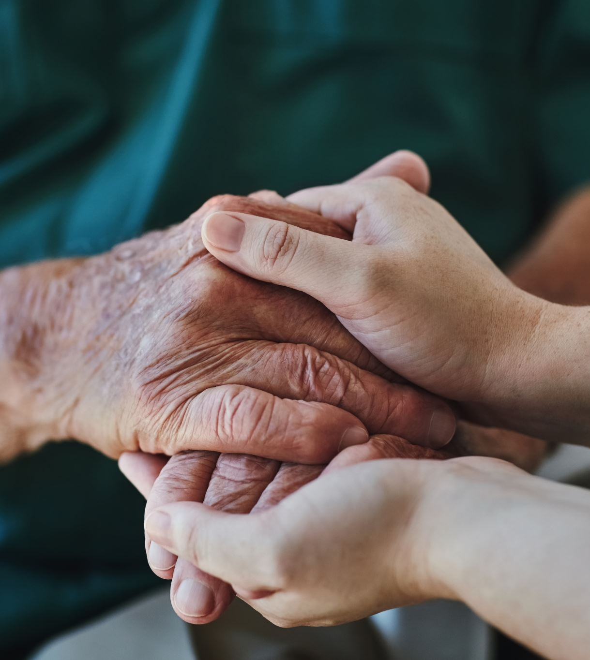
Research suggests that civil society mobilization together with the ratification of human rights treaties put pressure on governments to improve their human rights practices.
An unexplored theoretical implication is that pressure provokes counterpressure. Instead of improving treaty compliance, some governments will have an interest in demobilizing civil society to silence their critics.…”

Slide 15

Coexistence Conventions and Minority Rights
Focus on Diversity:
  Framework Convention for the Protection of National Minorities (FCNM) : Protects linguistic, cultural, and educational rights.
    Example: Catalonia sought protection under this convention during disputes over language policies.
  European Charter for Regional or Minority Languages : Preserves endangered languages like Basque and Galician.
Challenges:
  Governments sometimes resist implementing these conventions, citing sovereignty concerns.
Thought Experiment: If you were an activist defending minority rights, which convention would you invoke?

Slide 16

STATES CAN SUCCESSFULLY SUPPRESS HUMAN RIGHTS ACTIVISM
banning specific civil society organizations;
curtailing travel;
restricting visits to government sites;
limiting domestic and international funding sources;
creating difficulties in obtaining visas or denying visas;
creating difficulties in registering as civil society organizations;
censoring publications;
harassing civil society activists; and surveilling civil society activists.

Slide 17

Individual Activists - From Heroes to Targets
Role: Individuals using social media to mobilize support, expose violations, and challenge power.
Problem: When activism turns into misinformation or incitement.
Example: Digital activists in Myanmar, caught between state repression and misinformation on Meta platforms.
Legal Insight: Balancing freedom of expression with the responsibility to prevent harm.

Slide 18
The Dark Side of Activism: Threats and Violence Against HRDs
Harsh Truth: Being an activist isn’t just about protests or hashtags—it can mean risking your life.
Global Context:
  According to international reports, hundreds of HRDs are killed every year globally, often with impunity.
  In Spain, HRDs face increasing hostility, including harassment, defamation campaigns, and physical attacks.
Case Study: Indigenous language rights activists in regions like Galicia have reported intimidation when advocating for their cultural heritage.
Thought Experiment: Imagine if every time you spoke up for something important, you risked losing your job—or worse. Would you still do it?

Slide 19
Amnesty International and Human Rights Watch - Watchdogs or Activists?
“Justice is the constant and perpetual will to render to each his due.” - Justinian I
Role: Monitoring, reporting, and advocating for human rights protection.
Impact: Mobilizing global support and putting pressure on states to uphold human rights standards.
Criticism: Accusations of bias and selective reporting, particularly in politically sensitive cases.
Reflection: Can global NGOs remain neutral while actively pushing for justice?

Slide 20
ECJ and Civil Society - Friends or Foes?
Case: C-78/18 Commission v. Hungary (Transparency of Associations)
  Legal Context: Hungary’s law on foreign-funded NGOs aimed to increase transparency but sparked concerns over freedom of association.
  Judgment: Violates EU principles of freedom of association and fundamental rights.
  Legal Analysis: Striking a balance between transparency and civil liberties remains challenging.
  Criticism: Is the EU overstepping national sovereignty in civil regulation?
  Provocative Question: Does too much transparency kill activism?

Slide 21
Pilot Judgments of the ECJ
Key Points:
Case C-402/05 P and C-415/05 P, Kadi v. Council (2008):
  ECJ emphasized the importance of fundamental rights, including those protected by civil society, in EU law.
  Reinforced the role of NGOs in advocating for human rights within the EU framework.
Case C-363/12, Z. v. A Government Department (2014):
  Highlighted the intersection of EU law and international humanitarian principles, particularly in asylum cases.
Links:
Kadi v. Council (ECJ)
Z. v. A Government Department (ECJ)

Slide 22

ECHR vs. Civil Society - The Ultimate Showdown
Case: Magyar Helsinki Bizottság v. Hungary (2016)
  Issue: Access to information as a human right.
  Judgment: Right to freedom of expression includes access to public interest information.
  Legal Perspective: Access to information empowers civil society but risks creating legal loopholes for misinformation.
  Thought: Is information overload a threat to human rights?
  https://hudoc.echr.coe.int/eng?i=001-167828

Slide 23
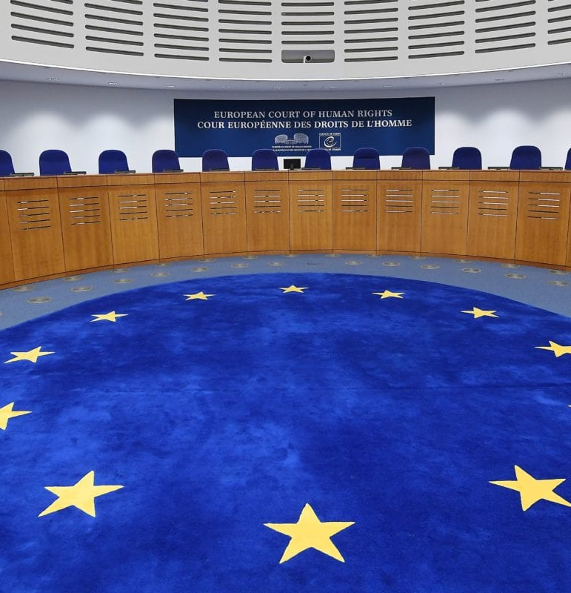
Pilot Judgments of the ECHR
Key Points:
Case of Al-Skeini and Others v. the United Kingdom (2011):
  ECHR ruled on the extraterritorial application of the European Convention on Human Rights (ECHR) in conflict zones.
  Reinforced the role of civil society in documenting human rights violations.
Case of M.S.S. v. Belgium and Greece (2011):
  Addressed the treatment of asylum seekers and the role of NGOs in providing humanitarian assistance.
Case of Hassan v. the United Kingdom (2014):
  ECHR recognized the interplay between IHL and the ECHR, emphasizing the importance of civil society in monitoring compliance.
Links:
https://hudoc.echr.coe.int
Это изображение, автор: Неизвестный автор, лицензия: CC BY-SA-NC

Slide 24
Censorship in Media Networks - A Legal Dilemma
Social media platforms like Meta (formerly Facebook) and X (formerly Twitter) are both advocates of free expression and perpetrators of censorship.
Legal Controversy: Are private companies accountable for human rights violations related to censorship?
Case Study: Facebook and the Myanmar Conflict
  Context: Facebook’s role in spreading hate speech that fueled violence against the Rohingya.
  Legal Criticism: Facebook failed to prevent hate speech, resulting in international condemnation.
  Question: Should social media companies be held accountable under international human rights law?

Slide 25
Social Media - The Double-Edged Sword
Social media as a tool for civil society: Mobilization, awareness, chaos.
Case: Delfi AS v. Estonia (2015) - Liability for online comments.
  Legal Dilemma: Balancing freedom of expression with accountability for harmful content.
  Case: Sanches v France (2023 ) - the right to freedom of expression includes forms of expression that are offensive, disturbing and shocking.
Thought: Are we sacrificing freedom of speech on the altar of accountability?
https://hudoc.echr.coe.int/fre?i=002-14074

Slide 26

Social Media: A Tool for Change or Another Risk?
Good News: Social media amplifies marginalized voices and connects activists worldwide.
Risks:
  Online harassment and trolling campaigns target HRDs, especially women and youth.
  Surveillance: Governments monitor social media to track and silence critics.
Example: Hashtags like #SaveCatalanLanguage gained traction but also drew attention from authorities, leading to arrests.
Debate Prompt: Can social media truly empower civil society without putting activists in greater danger?
Это изображение, автор: Неизвестный автор, лицензия: CC BY-SA-NC

Slide 27
Rand Corporation - Data, Security, and Human Rights
“Where law ends, tyranny begins.” - John Locke
Role: Analyzing global security policies and their human rights implications.
Controversy: Accused of promoting military-centric approaches that might undermine human rights.
Critical Insight: The challenge of balancing security priorities with civil liberties.

Slide 28
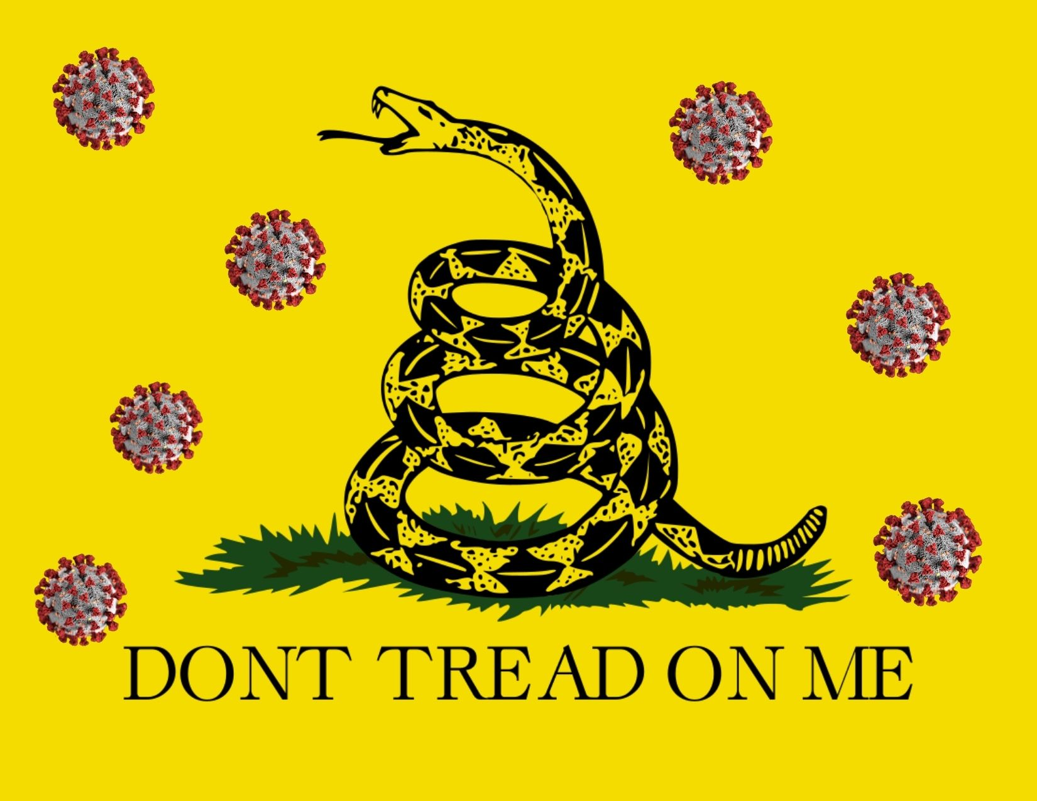
State Restrictions: Silencing Voices Through Laws
Beyond Violence: Governments use laws to suppress dissent by targeting freedom of association and expression.
Examples from Spain:
  The "Ley Mordaza" restricts protests and penalizes public criticism of authorities.
  Funding cuts and bureaucratic hurdles make it harder for NGOs to operate.
Compounding Factors:
  Impunity: Offenders who attack HRDs often go unpunished.
  Corruption: State actors may collude with those opposing activism.
  Government Inaction: Earlier Universal Periodic Review (UPR) recommendations to protect HRDs remain unfulfilled.
Reflection Question: How can we hold governments accountable when they fail to protect human rights defenders?
Это изображение, автор: Неизвестный автор, лицензия: CC BY-NC-ND

Slide 29
Spain and Civil Society - A Legal Battleground
Case: López Ostra v. Spain (1994) - Environmental rights vs. industrial activities.
  Legal Context: Right to private and family life (Article 8 ECHR) vs. environmental pollution.
  Judgment: Violation of Article 8 due to failure to protect citizens from industrial emissions.
  Legal Analysis: Spanish legislation struggles to balance economic development and human rights protection.

Slide 30
Case study
Angry Tweets vs. Restrictive Laws – Which is More Dangerous?
Humorous Prompt: Which scares you more—an angry tweet or a restrictive law?
Comparison:
  Angry Tweet: Cyberbullying hurts emotionally but doesn’t legally stop you from speaking out.
  Restrictive Law: Laws banning protests or censoring speech physically prevent activism—and carry severe consequences.
Case Study: A young activist in Catalonia was fined under the Ley Mordaza for participating in a peaceful protest near a government building.
Reflection Activity: How could laws or online harassment affect your ability to advocate for justice?

Slide 31
Civil Society as a Human Rights Villain
Example: NGO misuse of funds, false narratives.
Case: Amnesty International and Others v. United Kingdom (2000) - Privacy vs. State Surveillance.
Legal Insight: The line between protecting privacy and ensuring security remains legally contentious.
“Equity and social justice are prerequisites for sustainability.” (Boyce, 1995)

Slide 32
The Way Forward - Legal and Social Strategies
Embrace nuanced approaches balancing transparency, accountability, and rights.
Integrate civil society into legal reform to ensure alignment with human rights norms.
Foster critical thinking to challenge dogmas and question narratives.
Question: Should human rights advocacy be treated differently when civil society crosses legal boundaries?

Slide 33
References
Abbot, Ch. (2006), Action Aid (2006), Adams, W.M. (2006), Alston, P. (1982), Berraondo, M. (2006), Boyce, J.K. (1995), Clay, J. (2005), Comisión Interamericana de los Derechos Humanos (2007), Esteve Pardo, J. (2017), Alfian & Pinem (2021), Bakke et al. (2019), Buse et al. (2017), Chaney (2023), Eze (2016), Patterson et al. (2019), Poppe & Wolff (2017), Roche et al. (2023), Thiel & Uçarer (2014)

Slide 34
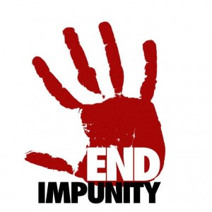
Impunity, Corruption, and Broken Promises
The Bigger Problem:
  Impunity: When perpetrators of violence against HRDs go unpunished, it emboldens others to commit similar acts.
  Corruption: Corrupt systems allow powerful interests to silence activists without consequence.
  Broken Promises: Despite earlier UPR recommendations urging Spain to safeguard HRDs, little progress has been made.
Example: In rural areas, land rights activists fighting corporate exploitation face not only violence but also legal barriers imposed by corrupt officials.
Discussion Point: How can young people push for accountability in systems that seem too big to challenge?
Это изображение, автор: Неизвестный автор, лицензия: CC BY-ND

Slide 35

Success Stories – Young People Making a Difference
Inspiring Examples:
  Basque Youth Revival: Young activists created digital platforms to teach Euskara, defying decades of suppression.
  Fridays for Future Spain: Students organized strikes and used social media to demand climate action, inspiring global movements.
Resilience in Action: Despite facing backlash, these young activists found creative ways to keep moving forward.
Takeaway Message: Even small actions—like sharing information or joining a campaign—can create ripples of change.
Это изображение, автор: Неизвестный автор, лицензия: CC BY

Slide 36
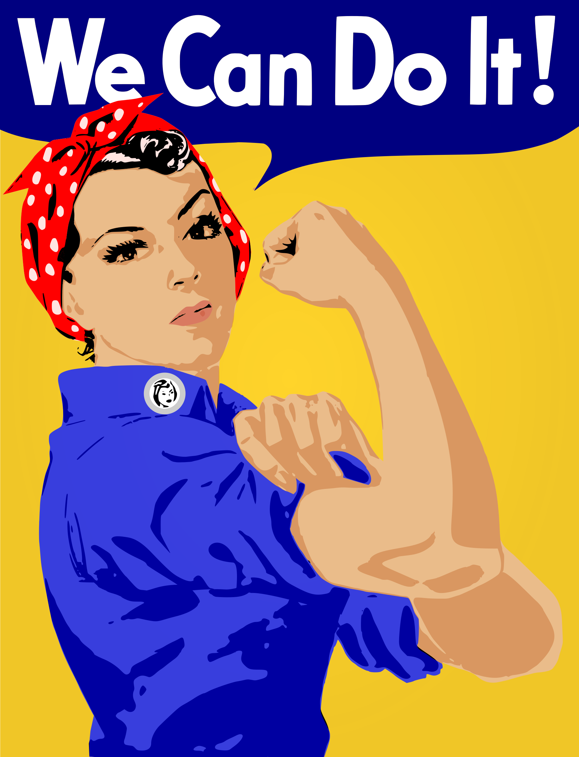
What Would YOU Do?
  Imagine your local government bans protests. How would you still raise awareness about an issue you care about?
  Brainstorm safe and effective ways to use social media to support human rights causes.
Guiding Questions:
  What skills do you already have that could help civil society?
  Who else could you partner with to amplify your message?
Do you have an idea for supporting HRDs in your community?

Slide 37
capability to challenge
address human rights violations.
mobilized civil society can pressurize governments to adhere to international human rights treaties
contributes to humanitarian narratives and the broader discourse on human rights through digital and traditional channels,utilizing digital platforms to advocate for rights, raise awareness, and influence policy
mobilize resources, facilitate discussions, and put pressure on both state actors and corporations to be more accountable for human rights practices.
corporate accountability has come under scrutiny, with calls for a human rights framework to hold multinational corporations accountable for violations, particularly in contexts related to public health and environmental harm

Slide 38
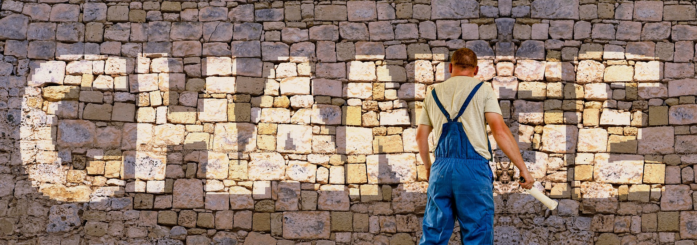
"Change begins when we refuse to stay silent."
Viacheslav TULIAKOV © 2025
mail: Viacheslav.Tuliakov@esic.university

